Slide 1
Bell Work
What was the most immediate cause of American entry into World War I?
Why is the Zimmermann telegram significant?

Slide 2
American Involvement in and End to World War I

Slide 3
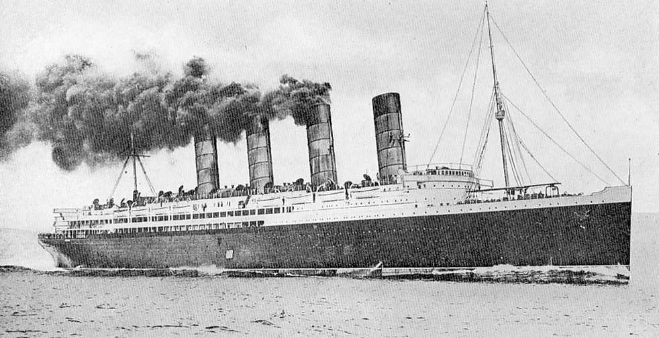
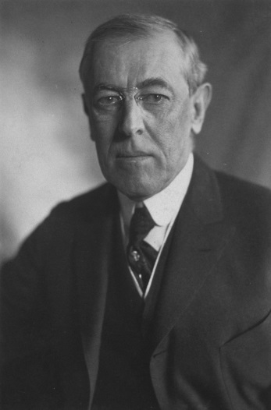
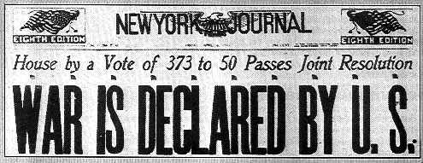
Review
Neutrality/Isolationism
America entry in WWI
Sinking of the Lusitania
Sussex Pledge
Zimmermann Telegram
Unrestricted submarine warfare resumes
War declared on April 2, 1917

Slide 4
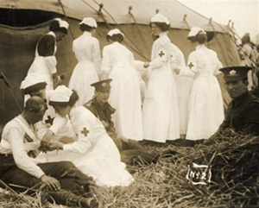
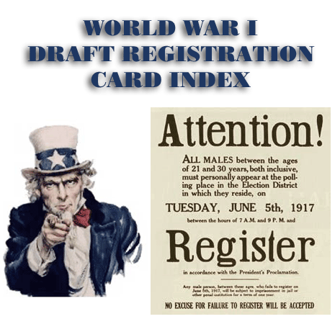
Building up the Military
Selective Service Act 1917
2 million looking to defend democracy and find adventure
Segregation of African Americans
Women in noncombat positions

Slide 5
Organizing Industry
Cooperation between business and government to mobilize for war
War Industries Board under Bernard Baruch
Food Administration under Herbert Hoover
Fuel Administration under Harry Garfield
Daylight savings time to conserve energy
Tax increase and selling bonds to raise money

Slide 6
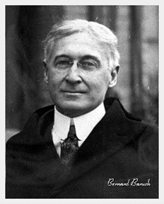
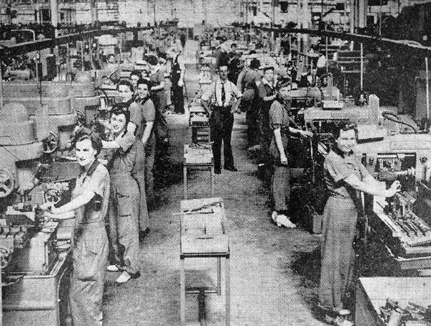
War Industries Board

Slide 7
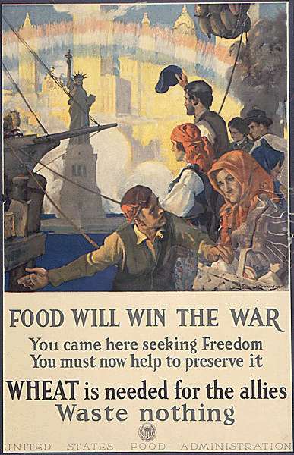
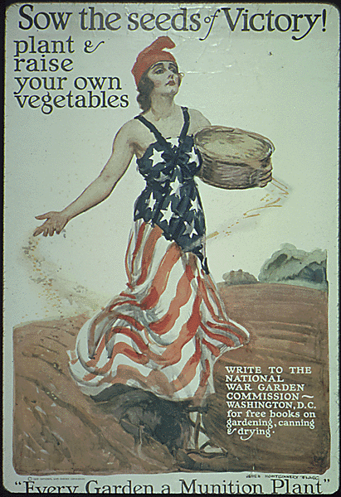
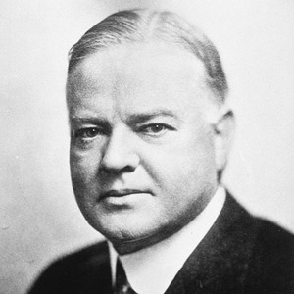
Food Administration

Slide 8
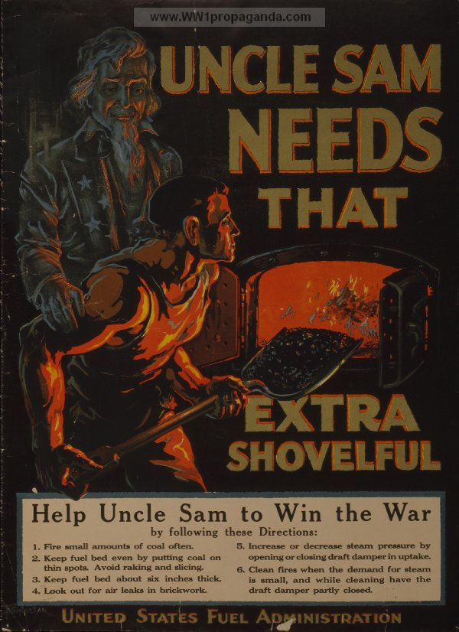
Fuel Administration

Slide 9
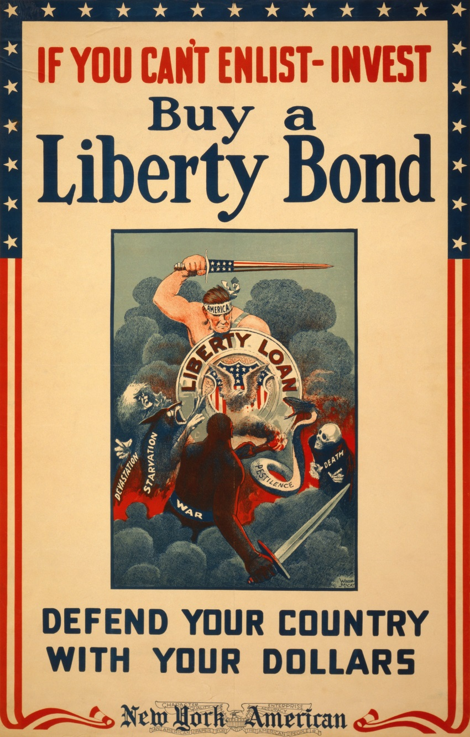
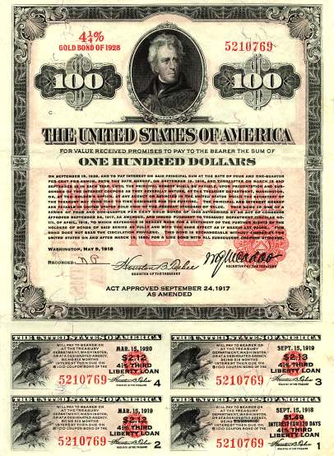
Victory and Liberty Bonds

Slide 10
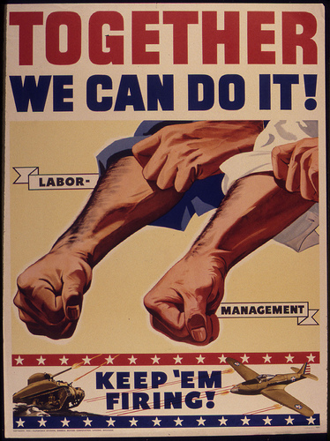
Mobilizing the Workforce
National War Labor Board under Taft and Frank Walsh (mediate labor disputes)
New jobs for women
Great Migration-jobs for African Americans
Mexican American immigration

Slide 11
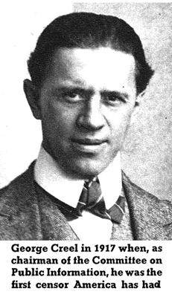
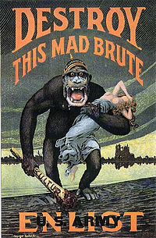
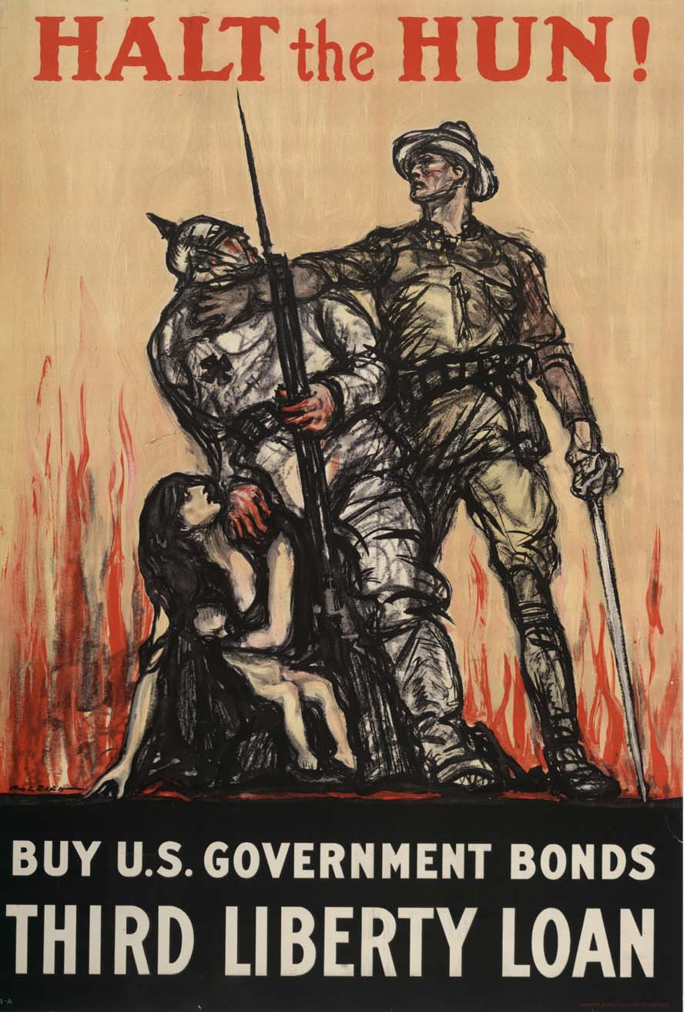
George Creel
Head of Committee on Public Safety

Slide 12
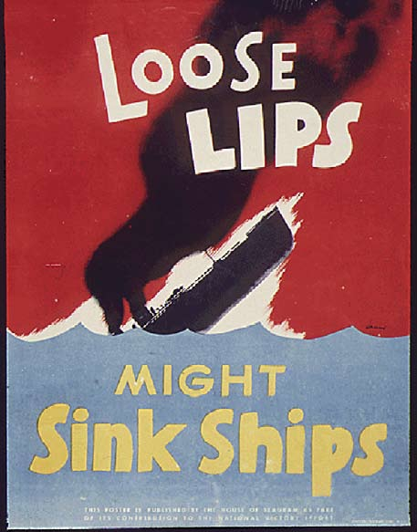
Violation of Liberties
Espionage Act 1917
Sedition Act 1918
Discrimination and persecution of Germans, socialists, labor activists, and socialists
Schenck v. United States 1919

Slide 13
Bell Work
What is the purpose of the War Industries Board?
Name some behaviors that would be considered illegal under the Espionage and Sedition Acts.

Slide 14
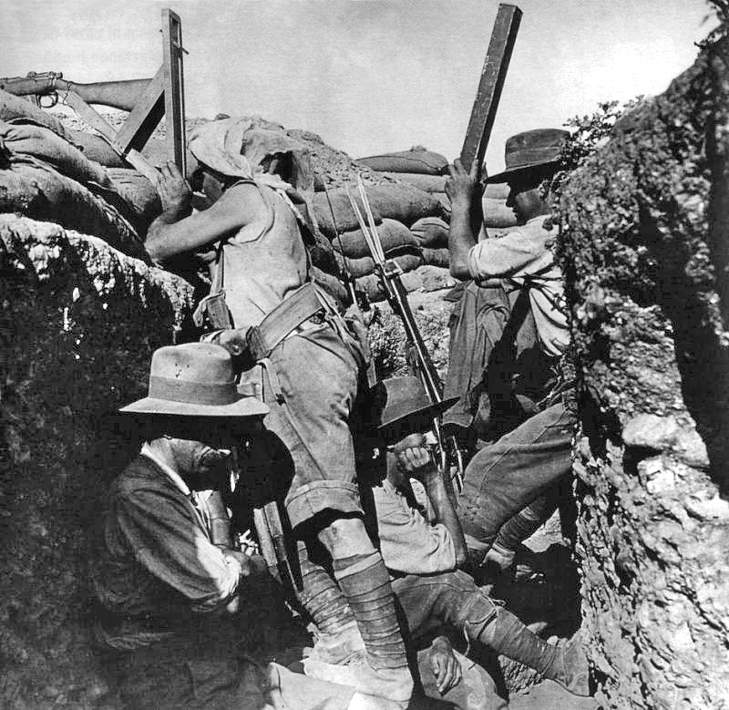
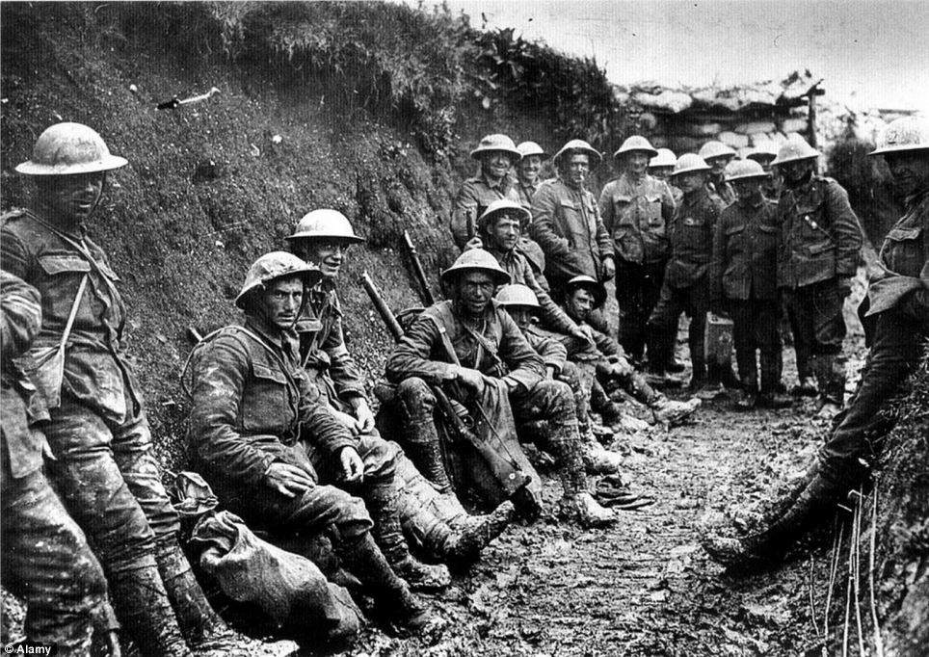
Combat
Trench warfare resulting in a stalemate after three years

Slide 15
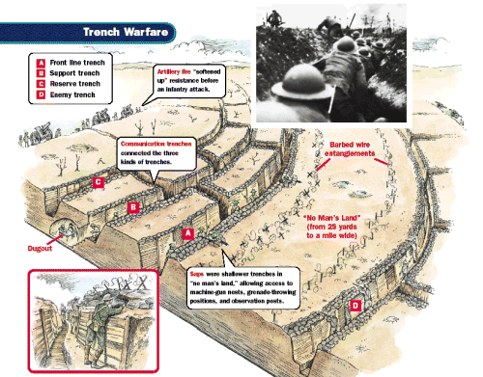

Slide 16
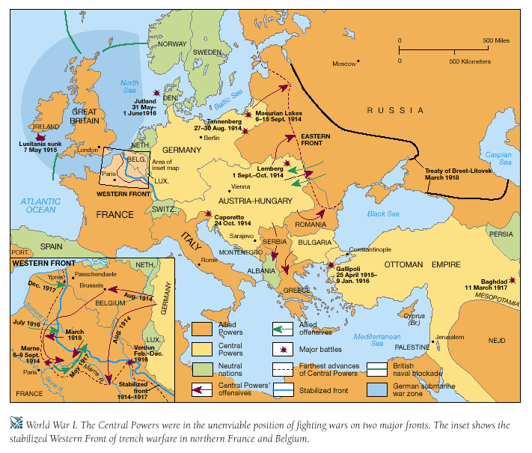

Slide 17
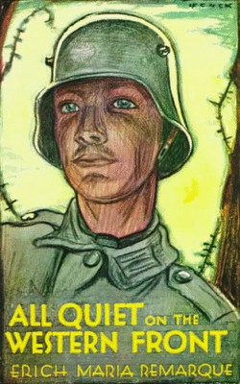
All Quiet on the Western Front
Erich Maria Remarque
“The sun goes down, night comes, the shells whine, life is at an end. Still the little piece of convulsed earth in which we lie is held. We have yielded no more than a few hundred yards of it as a prize to the enemy. But on every yard there lies a dead man.”

Slide 18
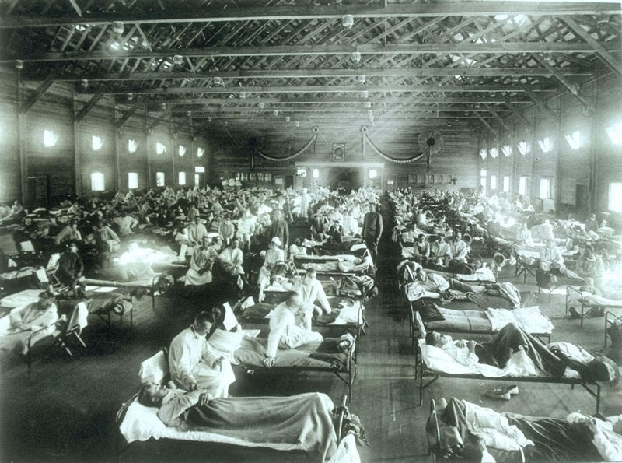
Spanish Influenza Outbreak
1918
Trench conditions
Weakens the Central Powers

Slide 19
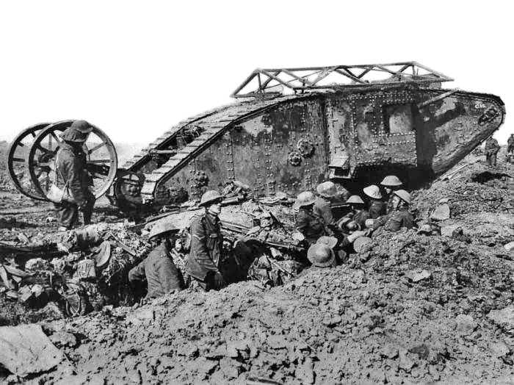
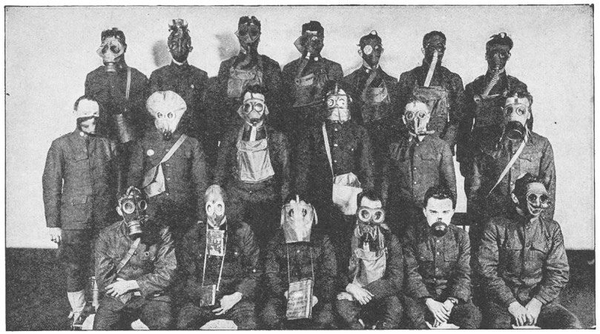
Technology
Rapid fire machine gun
Bayonets in no man’s land
Tanks
Grenades
Mustard gas
Airplanes

Slide 20
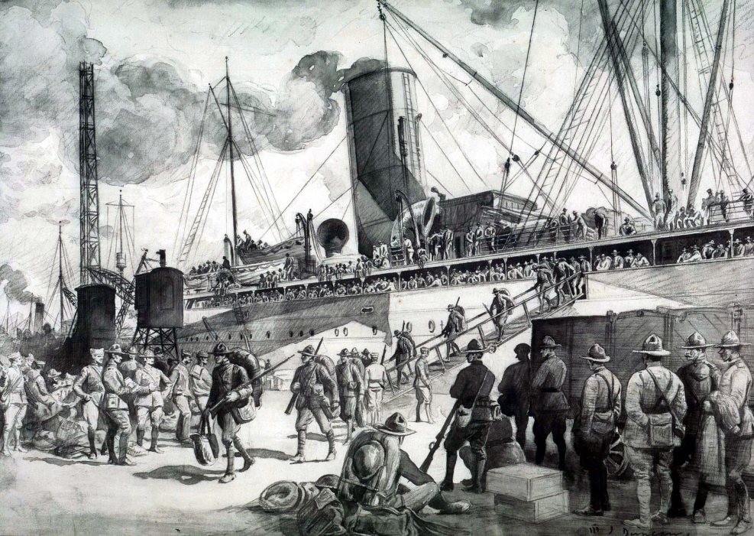
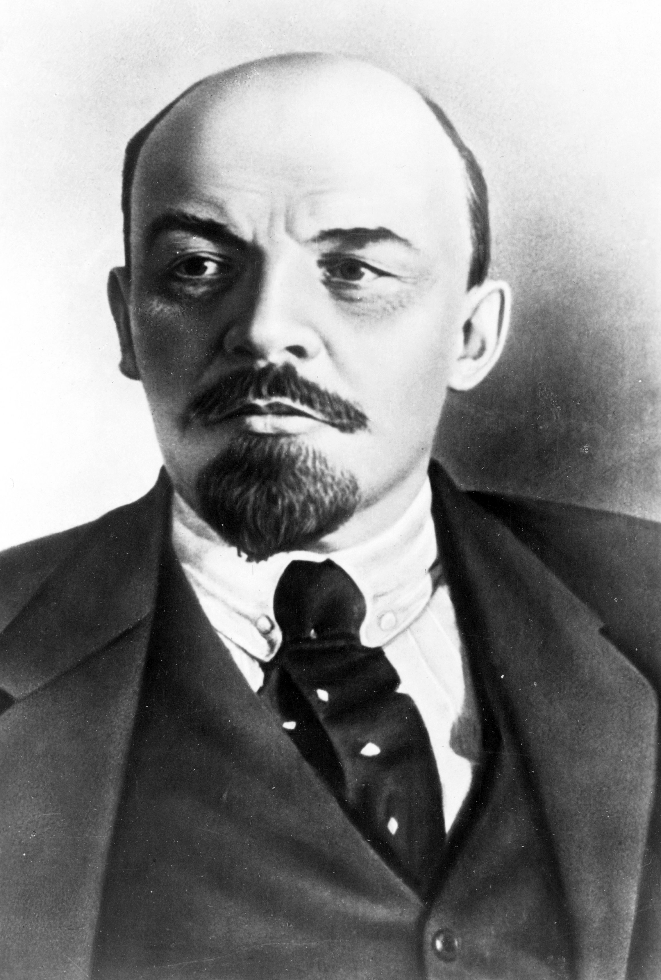
Shakeup in 1917
Doughboys first arrive in convoys
Russian Revolution
Treaty of Brest-Litovsk

Slide 21
Major Battles
First and Second Battles of the Marne 1914, 1918
Battle of Ypres 1915
American involvement
Capture of Cantigny
Chateau-Thierry

Slide 22
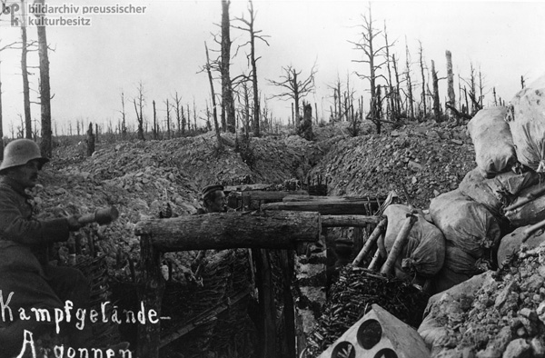
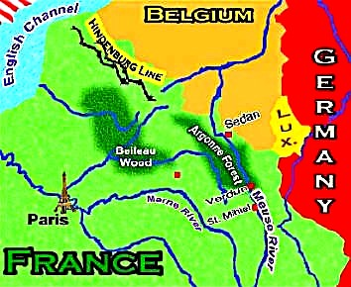
Battle of Argonne Forest
September 26, 1918
Last German attempt at Paris
Pershing and the American Expeditionary Forces
Americans open a hole in the German defenses

Slide 23
Bell Work
What new pieces of technology were used in World War I?
Why was the Battle of Argonne Forest significant in World War I?
Take out your Interview Transcript to turn in

Slide 24
Armistice Signed
November 11, 1918 at 11 am
Reasons
American involvement reinvigorates the Allies
Revolution in Austria-Hungary
Surrender of Ottoman Turks
Forcing of the German kaiser to step down
Failure of the trench warfare

Slide 25
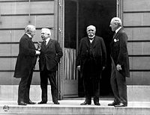
Paris Conference
January 1919
“Big Four”
David Lloyd George (British PM)
Woodrow Wilson (American)
Georges Clemenceau (French)
Vittorio Orlando (Italian PM)

Slide 26
Fourteen Points
Woodrow Wilson
First 5-free trade, disarmament, freedom of the seas, impartial adjustment of colonial claims, open diplomacy
Next 8-self-determination, require Central Powers to evacuate invaded countries
14th-League of Nations

Slide 27
Treaty of Versailles
Other three believe Wilson is being too lenient with Germany
Germany forced to sign:
June 28, 1919
Stripped of armed forces
Pay reparations to the Allies
Acknowledge guilt for the war
Territory loss
Austria-Hungary split
9 new countries established

Slide 28
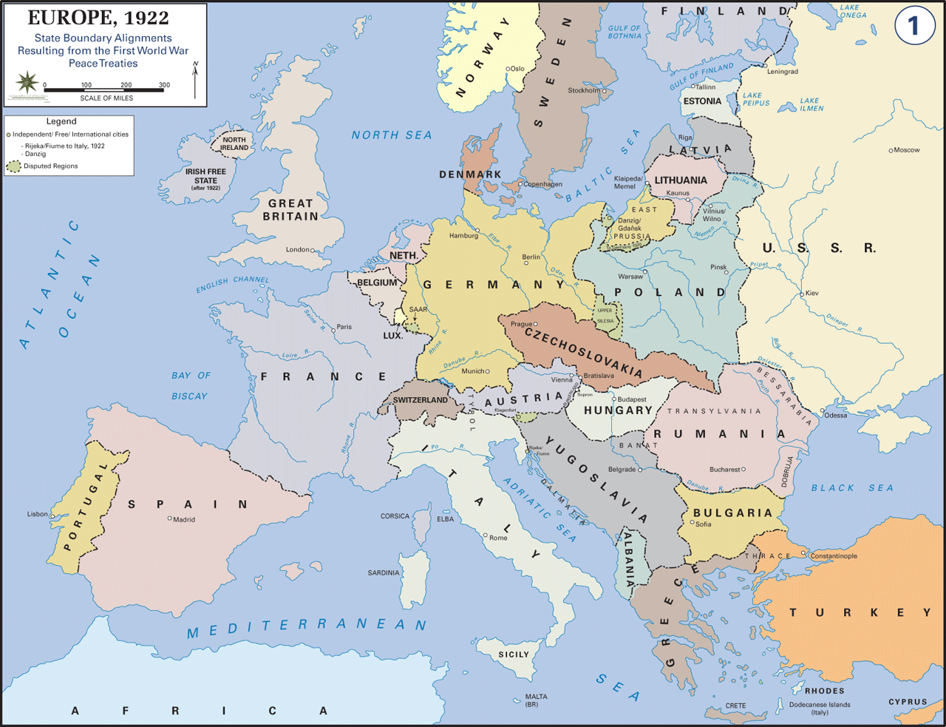

Slide 29
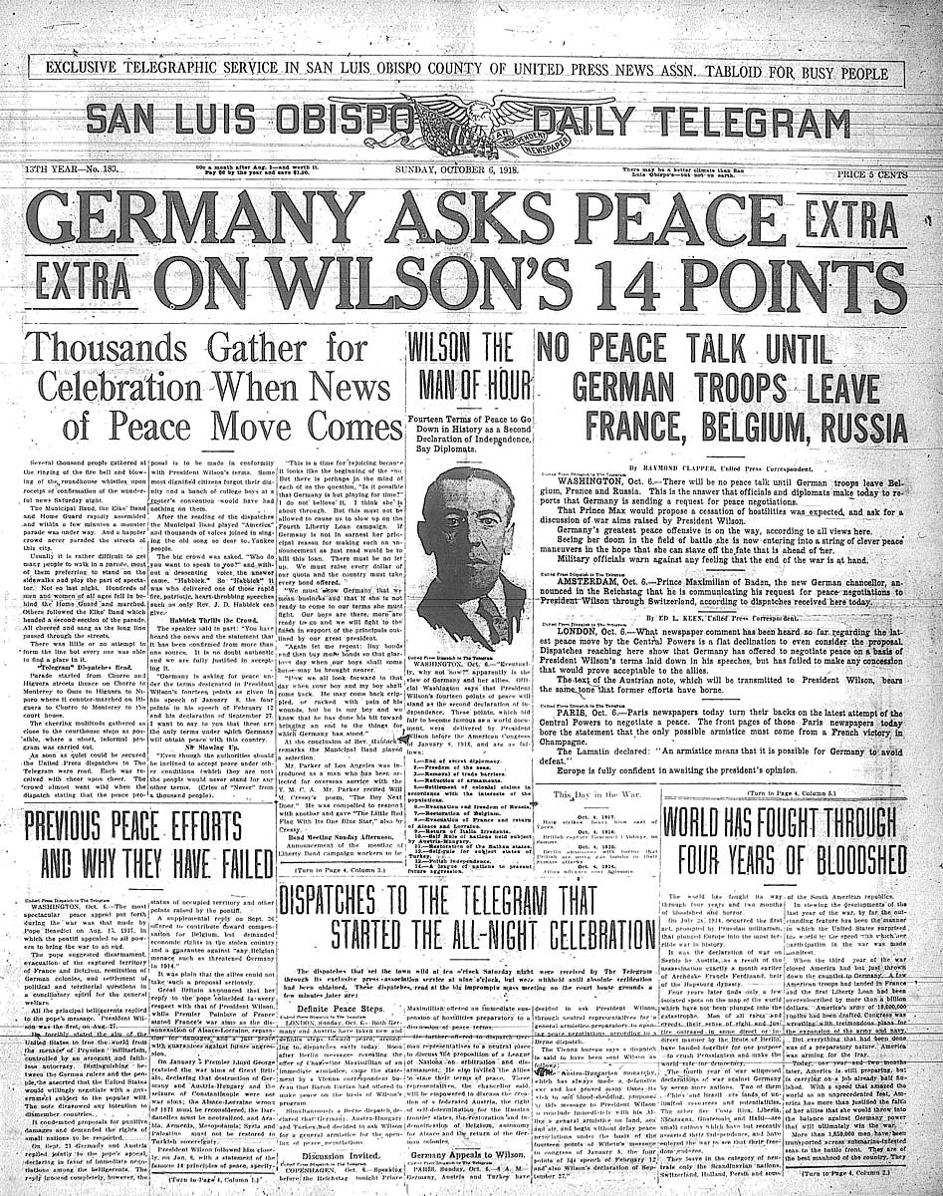

Slide 30
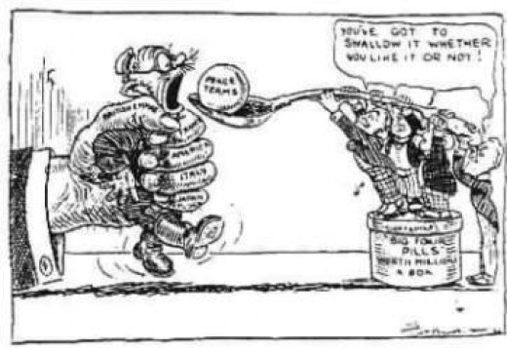

Slide 31
American Ratification
Wilson disappointed with treaty, but excited as prospect of League of Nations
Opposition from the Senate
Warn against “entangling alliances”
Fear that the League might supersede Congress to declare war
Henry Cabot Lodge: supports League but will only ratify treaty with amendments to preserve USA’s freedom to act independently
Treaty of Versailles never ratified

