Slide 1
Bell Work
What was a goal of Progressive Era reforms such as the initiative, referendum, and recall?
A. increase the power of citizens in state and local government
B. reestablish the system of checks and balances
C. provide low-interest loans to farmers
D. expand voting rights to Native Americans
2. Theodore Roosevelt’s Square Deal involved
A. dismantling monopolies, such as US Steel and Standard Oil.
B. giving women the right to vote and eliminating alcohol from society.
C. conservation, trust regulating, and protecting workers and consumers.
D. laissez faire economics.

Slide 2
Wilson’s Presidency

Slide 3
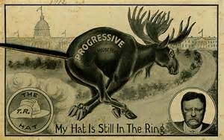
Background
Theodore Roosevelt served his two terms energetically and prided himself in being a progressive.
His handpicked successor, William Howard Taft ended up alienating many of his Republican party members, including Roosevelt
Payne Aldrich Tariff
Ballinger-Pinchot Controversy
Roosevelt: “Taft sold the Square Deal down the river”
Roosevelt declares “my hat is in the ring” in 1912

Slide 4
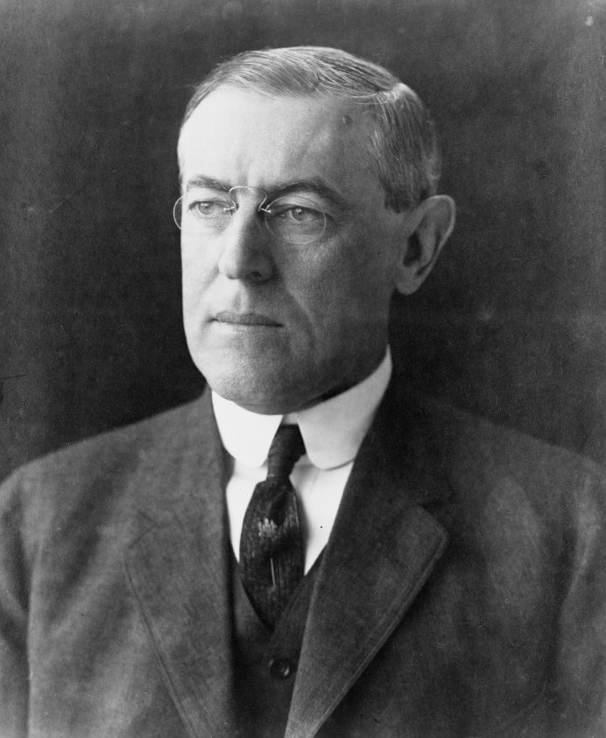
Election of 1912
Conservative Republican William Howard Taft
Progressive/Bull Moose Party Theodore Roosevelt
Democrat Woodrow Wilson
Efficiency/Democratic Progressive
Governor of New Jersey
Academic, President of Princeton

Slide 5
Election of 1912
Theodore Roosevelt
Woodrow Wilson
New Nationalism
Accepted the power of trusts as a fact of life; wanted to regulate them
Protect women and children in labor
Worker’s compensation
Program to regulate industry, like the ICC (railroads)
New Freedom
Monopolies were evils to be destroyed
Freedom more important them efficiency
Demand free enterprise and competition

Slide 6
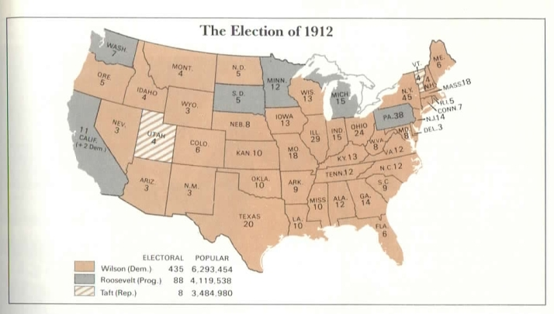
Splitting the Ticket

Slide 7
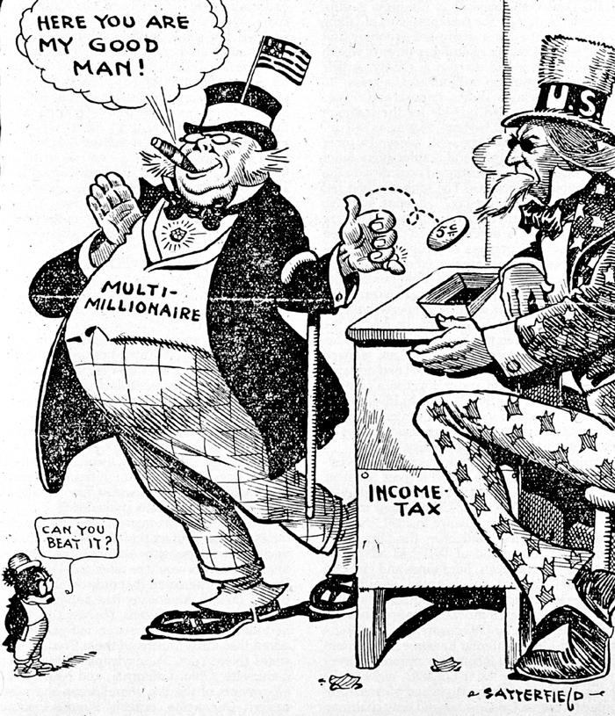
Wilson’s Reforms
Underwood Tariff 1913
Reduced the tariff rate (believes this will help business increase competition)
Income tax (16th amendment)

Slide 8
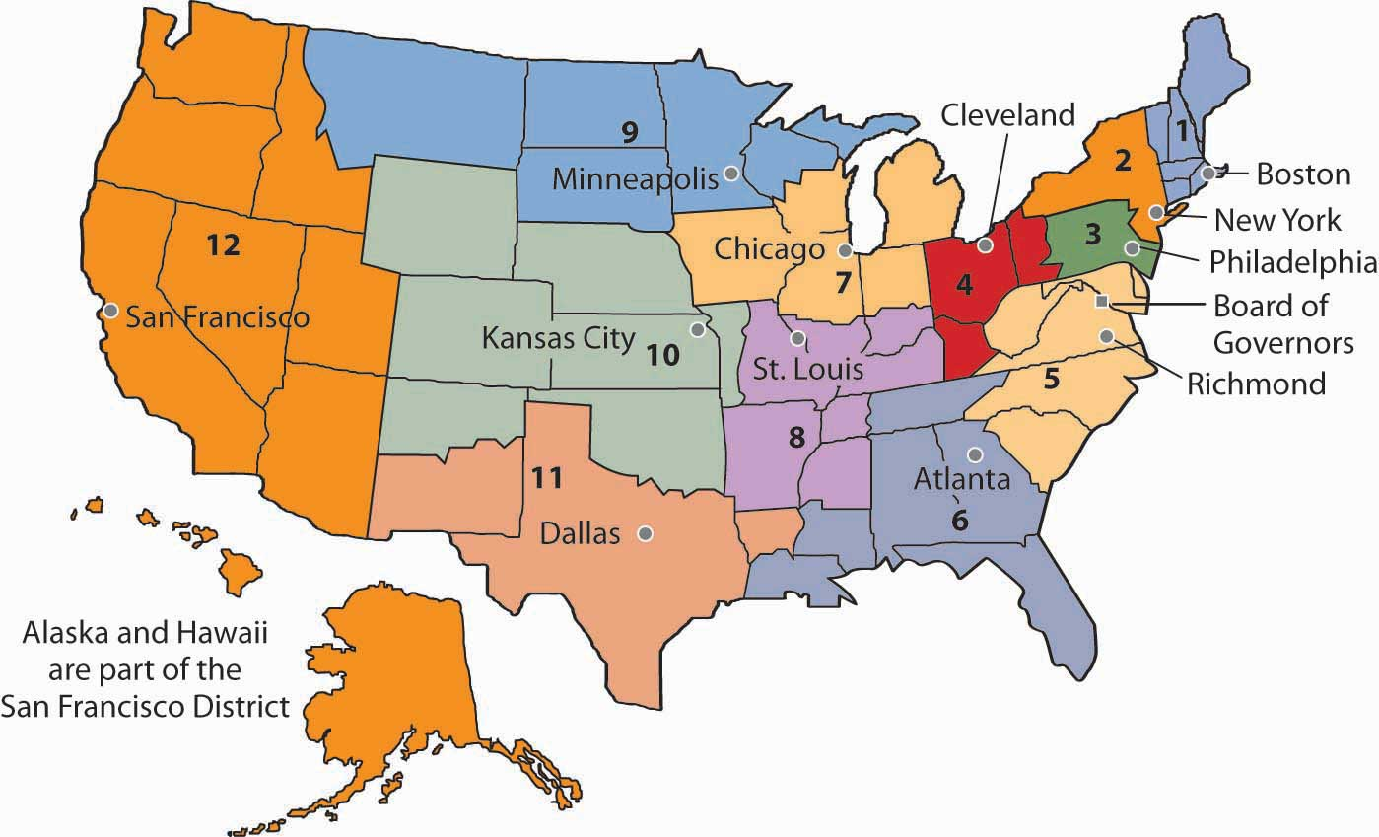
Wilson’s Reforms
Federal Reserve Act
Designed to restore confidence in the banking system
Regional federal reserve banks in which banks keep a portion of their money as a cushion in case losses occur
Board of Governors who set the interest rate
Can fight inflation (decline in the value of money, which causes prices to increase) by raising interest rates
Can stimulate the economy by lowering interest rates

Slide 9
Wilson’s Reforms
Wilson begins to agree with Roosevelt that trusts should be regulated
Federal Trade Commission in 1914
Has power to investigate companies that engage in unfair business practices and order them to stop
Wilson wants FTC to work with trusts and monopolies
Clayton AntiTrust Act
Progressives in Congress are upset, so they pass Clayton
Allows labor unions, banns tying agreements, and banns price discrimination

Slide 10
Wilson’s Reforms
Keating-Owen Child Labor Act 1916
First federal child labor law
Prohibits employment of children under age of 14 who work in businesses that engage in interstate commerce
Adamson Act
Established 8 hour workday for railroad workers
Federal Farm Loan Act
Created 12 federal land banks to provide farmers with long term loans at low interest rates

Slide 11
Legacy of Progressivism
Wilson expanded the role of the federal government and president
Now there are laws protecting workers
Americans expect government to address social issues and regulate the economy

Slide 12
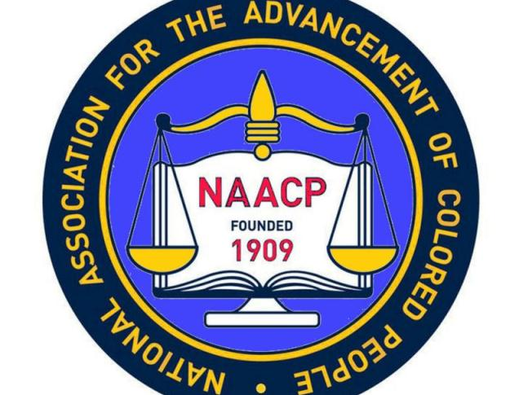
Who is Left Out of Progressivism?
African Americans
W.E.B. DuBois founds National Association for the Advancement of Colored People in 1909
Voting will bring an end to lynching and racial discrimination

Slide 13
Checks
What did the Underwood Tariff do?
How did Congress respond to Wilson’s views regarding monopolies and the creation of the Federal Trade Commission?
Why is the Federal Reserve Act important?

