Slide 1
Theodore Roosevelt’s Foreign Policy

Slide 2
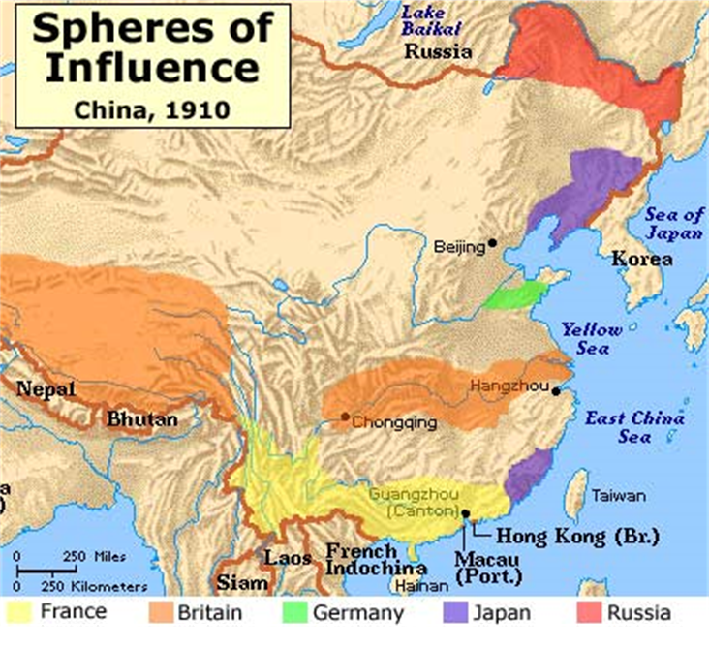
Topic #1-
Open Door Policy

Slide 3
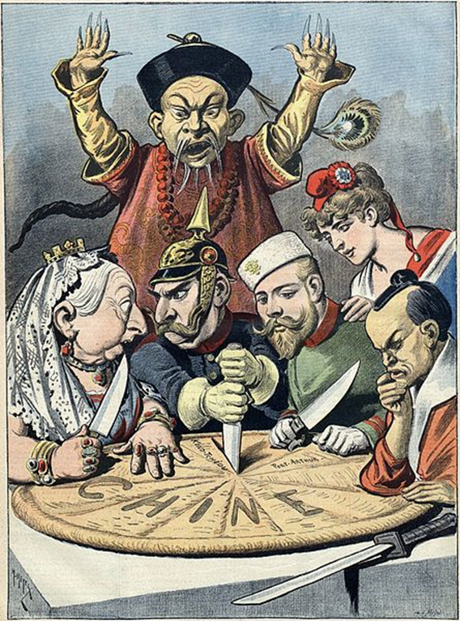
Topic #1-
Open Door Policy
Cartoon A

Slide 4
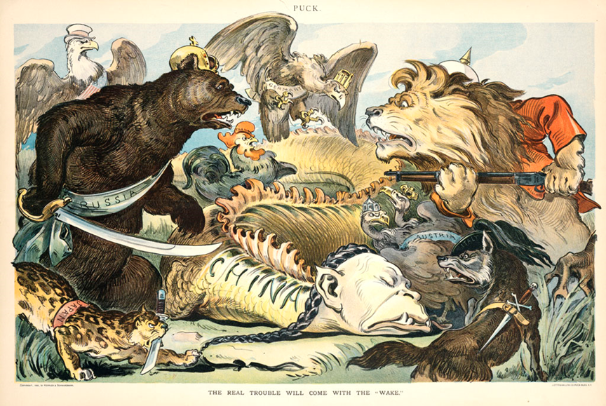
Topic #1-Open Door Policy / Cartoon B

Slide 5
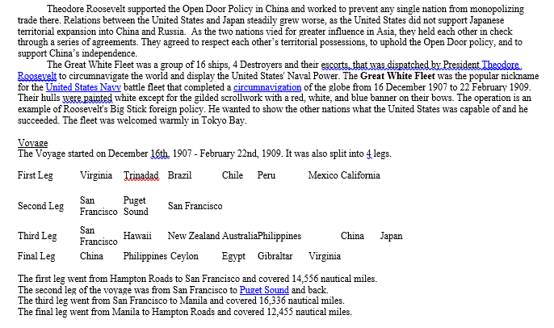
Topic #2-Great White Fleet

Slide 6
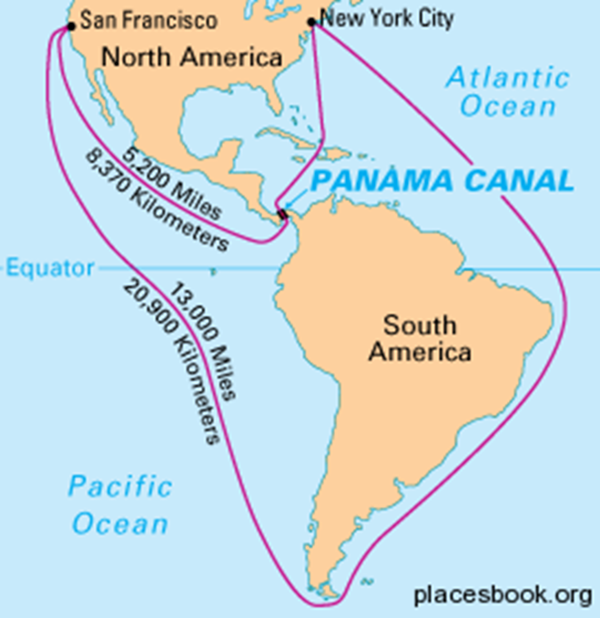
Topic #3-
Building the Panama Canal

Slide 7
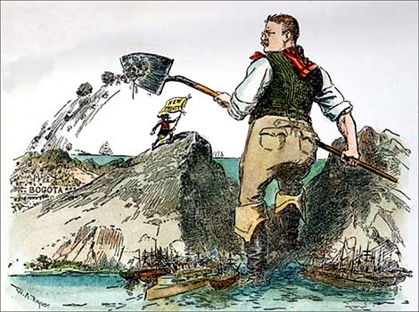
Topic #3-Building the Panama Canal / CartoonC

Slide 8
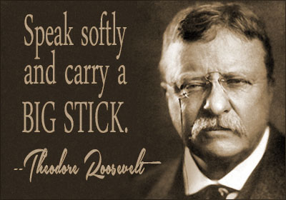
Topic #4-Big Stick Policy

Slide 9
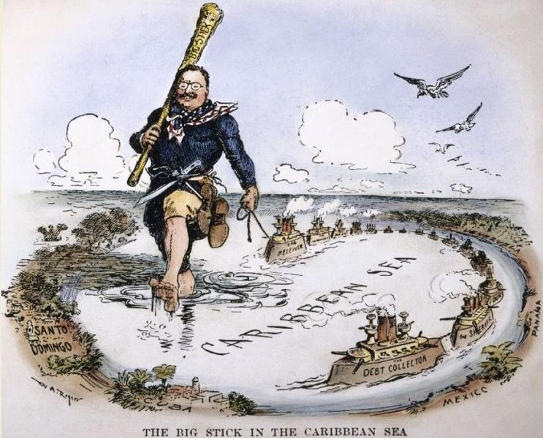
Topic #5-Roosevelt Corollary

