Slide 1
Bell Work
John F. Kennedy became president in the 1960s, during the height of Cold War tension. His new foreign policy called _1._ was designed to decrease tension over nuclear war. His _2._ policies were aimed at helping Americans, including minorities, women, and the poor. JFK also wanted to help other countries by creating the _3._ to send aid to Latin America. He even put money into science education and NASA in order to shrink the perceived _4._. It was unfortunate that he passed away so soon, but many of his domestic ideas were realized, thanks to President Lyndon Johnson’s _5._ programs.

Slide 2
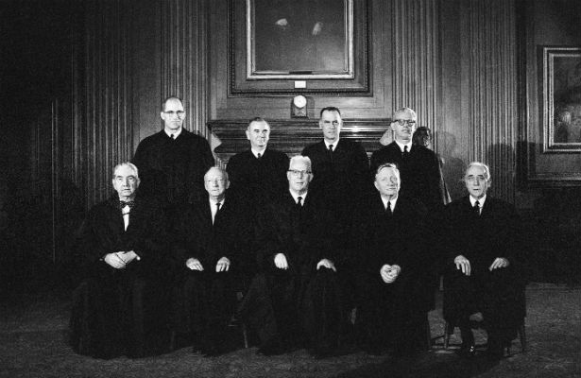
The Warren Court
The Supreme Court under Chief Justice Earl Warren
1953-1969

Slide 3
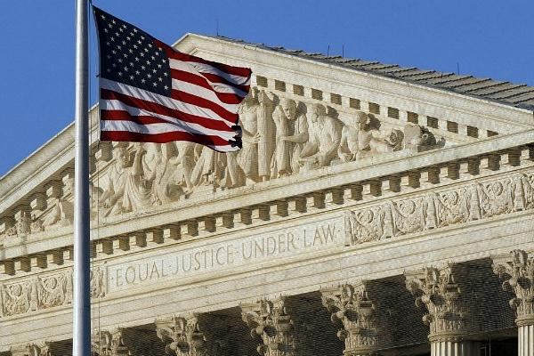
Characteristics of the Warren Court
Expand civil rights and civil liberties
Increase the power of the federal government over the states
Address social issues of the 1950s and 1960s
Very liberal in nature (willing to adopt change)

Slide 4
What is Due Process?
Means that the law may not treat individuals unfairly, and courts must follow proper procedures when trying cases
The Warren Court ruled in several cases that upholding due process meant that the federal bill of rights should be applied to states, as well as individuals.

Slide 5
Due Process
Term comes from the Fourteenth Amendment to the Constitution:
Section 1.
“All persons born or naturalized in the United States, and subject to the jurisdiction thereof, are citizens of the United States and of the state wherein they reside. No state shall make or enforce any law which shall abridge the privileges or immunities of citizens of the United States; nor shall any state deprive any person of life, liberty, or property, without due process of law; nor deny to any person within its jurisdiction the equal protection of the laws.”

Slide 6
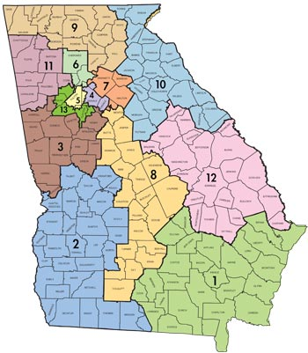
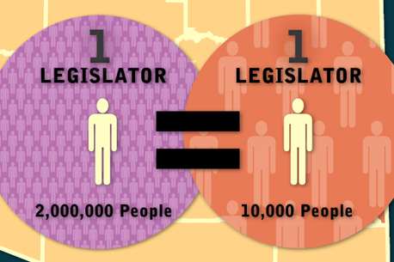
Warren Court Themes
Apportionment
restructuring electoral districts to make them more representative
re-drawing districts to accurately reflect a region’s population, so that everyone’s vote is equal

Slide 7
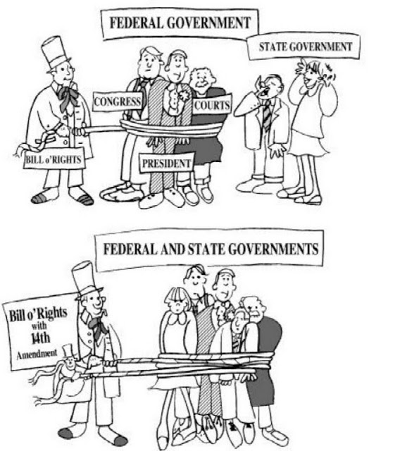
Warren Court Themes
2. Due Process
everyone, including states, must be treated fairly and equally under the law and courts have to follow proper procedures when trying cases

Slide 8
Warren Court Themes
3. Civil Rights
4. Freedom of Religion/Speech
5. Right to Privacy

Slide 9
Warren Court Cases

Slide 10
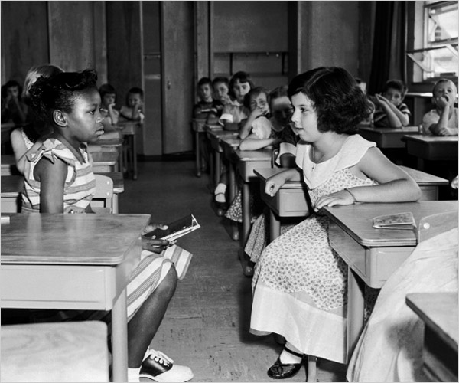
Brown v. Board of Education of Topeka, Kansas, 1954
Issue: Little Linda Brown wants to attend a school close to her house, but that school will not accept her, because it is a white school, and she is black.
Her dad sues the school district, and the case winds up in the Supreme Court as a class action lawsuit.
Ruling?

Slide 11
Baker v. Carr, 1962
Charles Baker lives in Shelby County, Tennessee and sues the Tennessee Secretary of State Joe Carr, stating that Tennessee hasn’t re-drawn any district lines since 1900.
It’s supposed to be done every 10 years based on the census, and the population of his country has increased.
Baker claims that he is not equally protected under the Fourteenth Amendment, because his vote is not worth as much as someone who lives in a rural county with a smaller population.
Ruling?

Slide 12
Reynolds v. Sims, 1964
The people of Jefferson County in Alabama are concerned about the unequal representation of state legislative districts.
Some districts represent large amounts of people, and some districts represent small amounts of people.
Ruling?

Slide 13
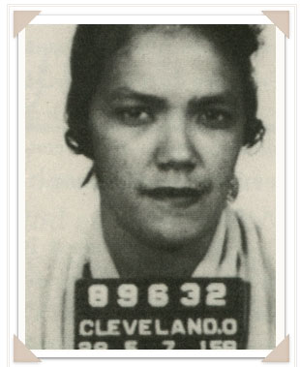
Mapp v. Ohio, 1961
Dollree Mapp part of an illegal gambling ring in Ohio, and the police came to her apartment one day to look for her friend who was wanted in questioning for a bombing three days earlier.
Mapp told them to leave, as they did not have a warrant.
The police came back three hours later with a piece of paper that they would not show to Mapp or her lawyer and stormed her house, where they found evidence of Mapp’s illegal gambling operation and pornographic materials.
Mapp was arrested and sued the state of Ohio for failure to obtain a warrant.
Ruling?

Slide 14
Gideon v. Wainwright, 1963
A pool room in Florida was burglarized in the middle of the night. A witness claimed that he saw Mr. Clarence Gideon at the pool room around 5:30 am.
Based on that witness report alone, Gideon was arrested and charged with the crime.
Gideon could not afford a lawyer, and the courts would not provide him one, so he had to defend himself in court.
He was sent to prison and filed an appeal, stating that the refusal to provide him a lawyer was a violation of the Sixth Amendment.
Ruling?

Slide 15
Miranda v. Arizona, 1966
Ernesto Miranda was stopped in Arizona and charged with the kidnapping and rape of an 18 year old girl.
After two hours of police questioning, Miranda confessed to the crime (although he was not informed of his rights to remain silent) and was convicted.
Miranda’s court-appointed lawyer filed appeal that Miranda should have been told of his rights, and the case went to the Supreme Court
Ruling?

Slide 16
Tinker v. Des Moines, 1969
The Vietnam War has started, and some students in Iowa decide to wear black armbands in protest of the war.
The school administrators informed the students that they would be suspended if they wore the armband, and the students wore the armband anyway.
After being suspended, the students filed a lawsuit against the school, and the case wound up in the Supreme Court.
Ruling?

Slide 17
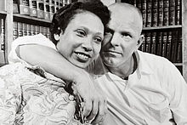
Loving v. Virginia, 1967
Mildred (black woman) and Richard Loving (white man) were married in Washington, D.C. but lived in Virginia, where it was illegal to marry someone outside of your race.
The police invaded their home one night after receiving an anonymous tip that the interracial couple were together and arrested them both.
After moving out of Virginia, the Lovings filed a class action lawsuit that went to the Supreme Court.
Ruling?

Slide 18
Hernandez v. Texas, 1954
Pete Hernandez was a Mexican American agricultural worker who was tried for murder.
In court, the jury was all white (by law), and Hernandez claimed that he could not be given a fair trial with an all-white jury.
He sued Texas, and his case went to the Supreme Court.
Ruling?

