Slide 1
Bell Work
Do the First New Deal programs effectively end the Great Depression?
No, although some Americans are able to get jobs or relief, some of the New Deal programs are closed, and some do not do enough to be effective.
What is the significance of the Emergency Banking Relief Act?
Americans now feel confident in putting their money in a bank.
How do Americans feel about the First New Deal programs?
They feel happy that Roosevelt is trying to do something to help them, and their confidence in their president increases.

Slide 2
The Second New Deal

Slide 3
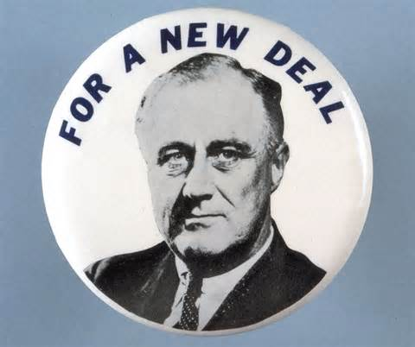
Background
Franklin D. Roosevelt gets elected in 1932 and begins passing First New Deal legislation from 1933-1934.
The First New Deal programs did little to significantly improve the economy.
10 million Americans still unemployed
Nonetheless, Americans had their faith in the nation restored.
By 1935, Roosevelt is facing some opposition.

Slide 4
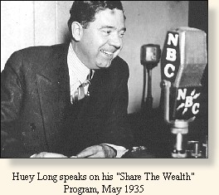

Slide 5
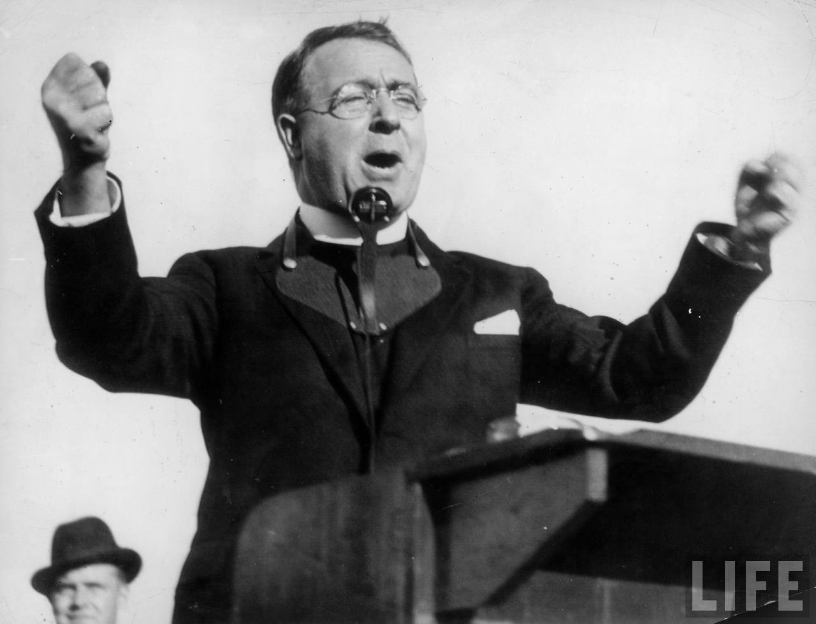
Father Coughlin

Slide 6
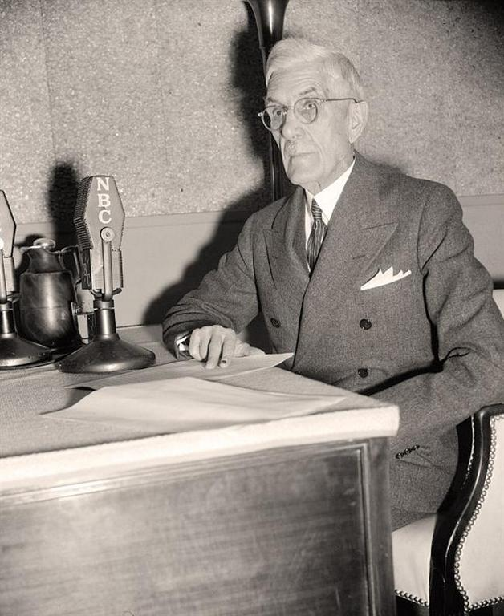
Dr. Francis Townsend

Slide 7
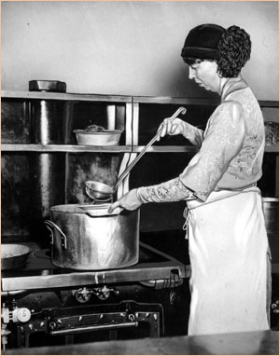
Roosevelt Makes a Decision
Knows his political support may get undermined, despite the fact that Americans love the Roosevelts
Disturbed by the First New Deal’s inability to generate a rapid economic recovery
Launches Second New Deal in 1935
Speed up nation’s recovery
Provide economic security to Americans
Ensure re-election in 1936

Slide 8
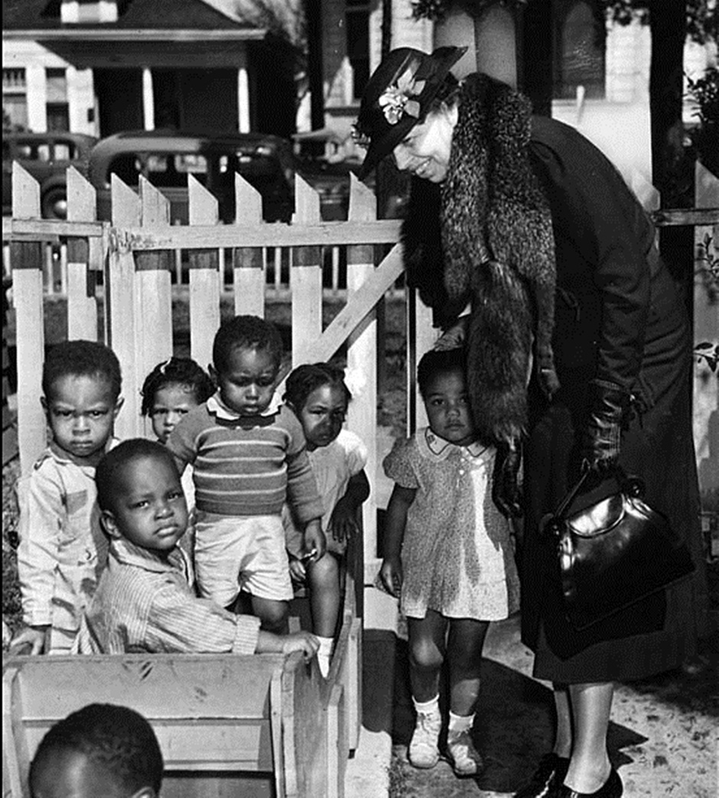

Slide 9
Judicial Opposition to NIRA
Roosevelt gets disheartening news
May 1935: Supreme Court declares the National Industrial Recovery Act to be unconstitutional (Schechter v. United States)
FDR is scared that other New Deal programs will be declared unconstitutional
He needs voter support to win re-election, so he begins a “second hundred days” in June 1935

Slide 10
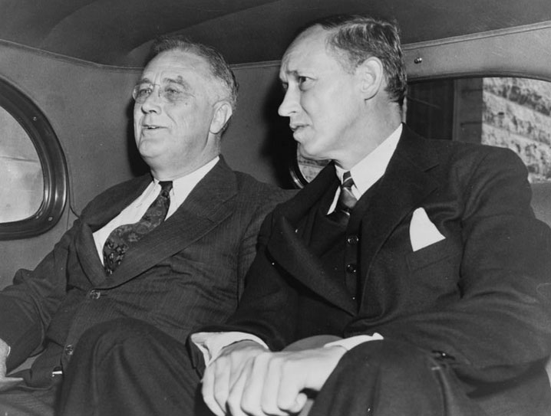
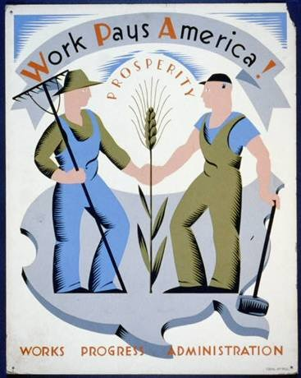
Second New Deal
Works Progress Administration (WPA)
Under Harry Hopkins in April 1935
Provided jobs to construct highways, roads, streets, public buildings, bridges, and airports
Provide work to artists, musicians, theatre people, and writers to beautify the walls of buildings, create symphonies, finance historical programs, etc.

Slide 11
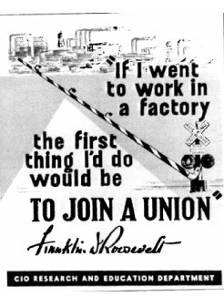
More Second New Deal Programs
FDR wants to keep union workers happy (with NIRA unconstitutional, workers could not organize)
National Labor Relations Act/Wagner Act
June 1935
Guarantees workers the right to organize unions without interference from their bosses
Creates National Labor Relations Board to organize secret ballots to see if workers want a union and then certify that union
Sets up binding arbitration practices and will investigate bosses who are using unfair practices
Results in increased union activity, including the formation of the Committee for Industrial Organization for the automobile and steel industries

Slide 12
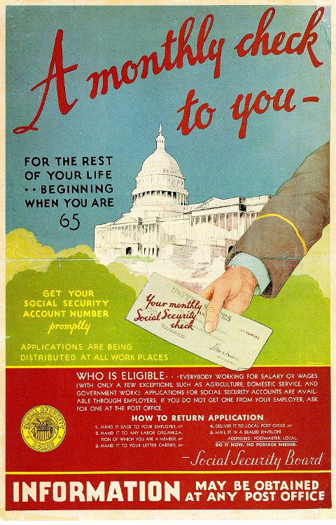
More Second New Deal Programs
Social Security Act
August 1935
Provide some security for the elderly and unemployed workers
Workers pay Social Security taxes, and the tax money is used to give payments to the elderly , the needy, and the disabled
Established the principle that the federal government should be responsible for those who were unable to work through no fault of their own
Do you think FDR was scared of the Social Security Act being declared unconstitutional?

Slide 13
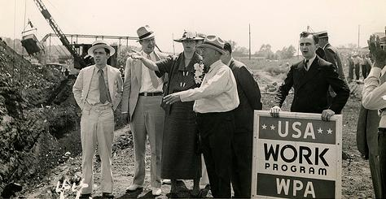
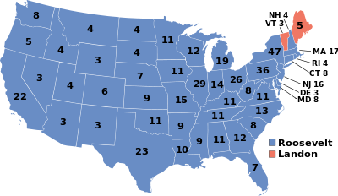
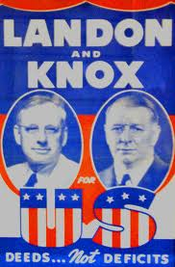
Election of 1936
New Deal “violates the basic ideals of the American system”

Slide 14
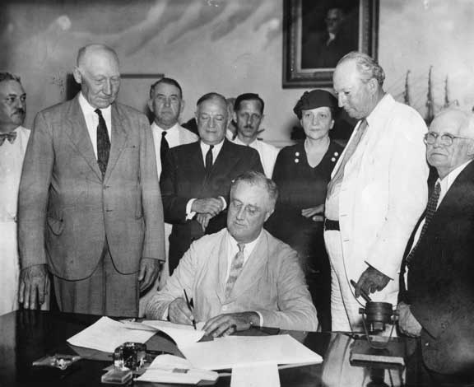
Secretary of Labor Frances Perkins-the first female cabinet member

Slide 15
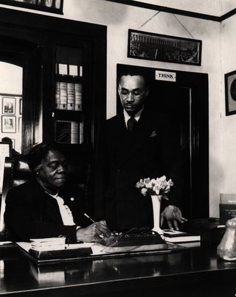
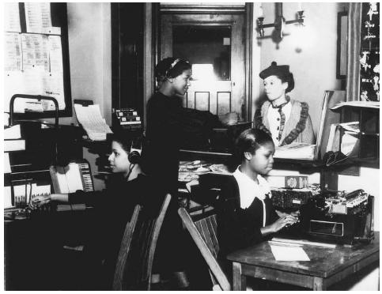
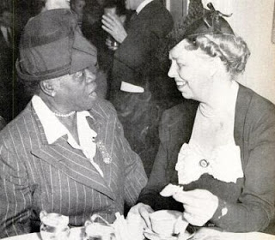
Mary McLeod Bethune

Slide 16
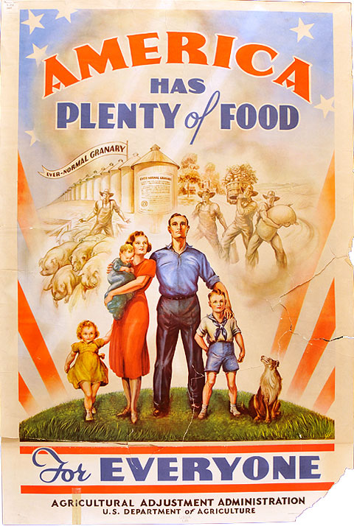
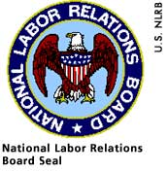
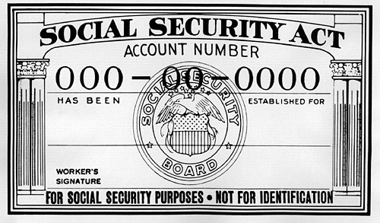
Court Packing Scheme

Slide 17
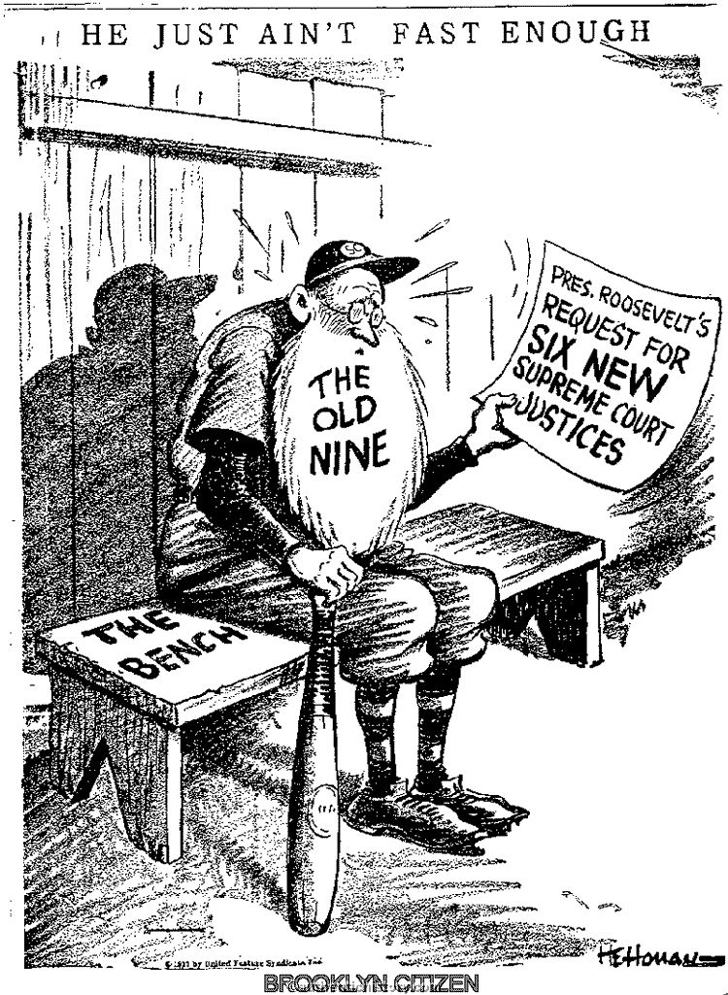
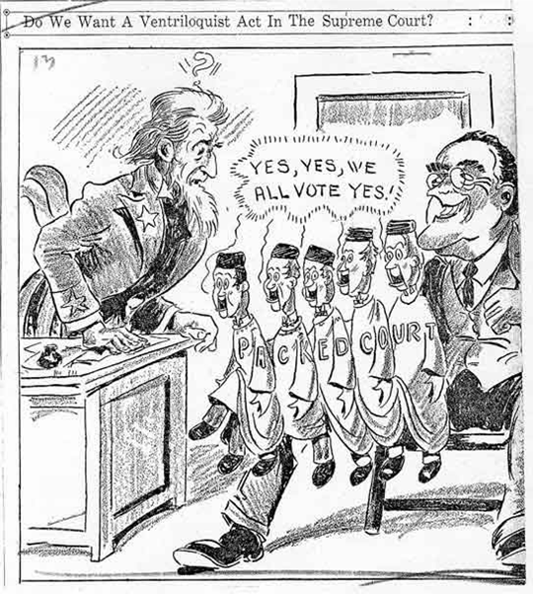
Court Packing Scheme

Slide 18
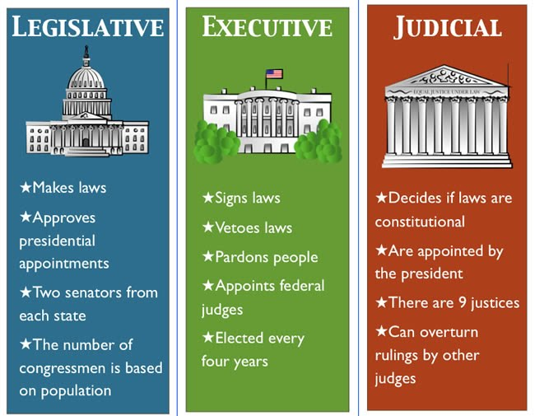

Slide 19
Check
1. Schechter v. United States was a Supreme Court case that declared which New Deal program to be unconstitutional?
A. National Industrial Recovery Act
B. Agricultural Adjustment Act
C. Civil Works Administration
D. Wagner Act
2. The New Deal program that provided monthly retirement checks to the elderly using payroll taxes is called
Works Progress Administration
National Labor Relations Act
Social Security Act
National Industrial Recovery Act

Slide 20
Check
3. From President Roosevelt’s perspective, what was the purpose of establishing the National Labor Relations Board?
To ensure support from union workers who would favor their right to organize
To create jobs by financing construction projects
To provide a safety net for Americans who were suffering economically
To avoid issues with the Supreme Court regarding the constitutionality of the law
4. The Works Progress Administration could be considered controversial because
It did not provide assistance to farmers.
There were safety concerns among the workers.
There was opposition from the left over deficit spending.
Government funds were going to artists and musicians.

Slide 21
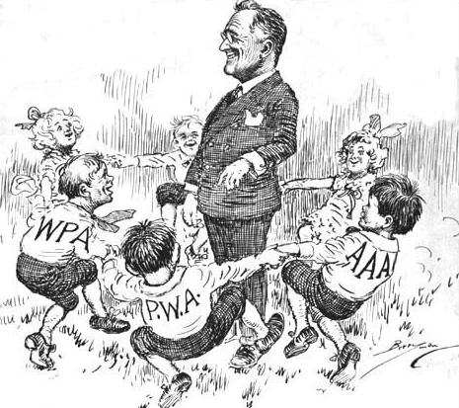
Check

