Slide 1
Bell Work
1. What was your experience in the Stock Market game like?
2. Did you lose or earn money?
AT&T, GM, US Steel increased from Day 1 to 6
American Can and RCA decreased
GE stayed the same
3. Why do you think people get involved with the stock market?
4. What are some limits to you buying stock right now?

Slide 2
Review of the 1920s
What was the standard of living like?
Very high—there were more jobs available, and people had more money to spend.
What new products were available?
Automobiles, appliances, radios, toiletries, make-up, sliced bread
How did consumers purchase these products?
On credit/installment plan, which put them into debt
What could be some repercussions (consequences) of high debt?
Not enough money to pay bills, a decrease in spending once one owes too much money, buy stock on margin
How might companies be affected by this?
Less demand for products means less money the company makes, which leads to lower wages and loss of jobs

Slide 4
Stock Market Crash and Causes of the Great Depression
Represents the top 30 companies whose stock is traded on the New York Stock Exchange

Slide 5
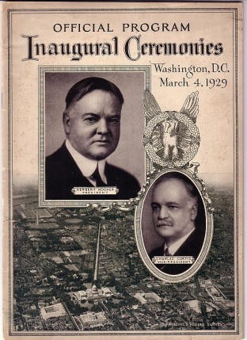
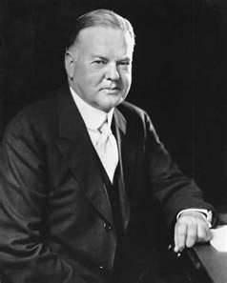
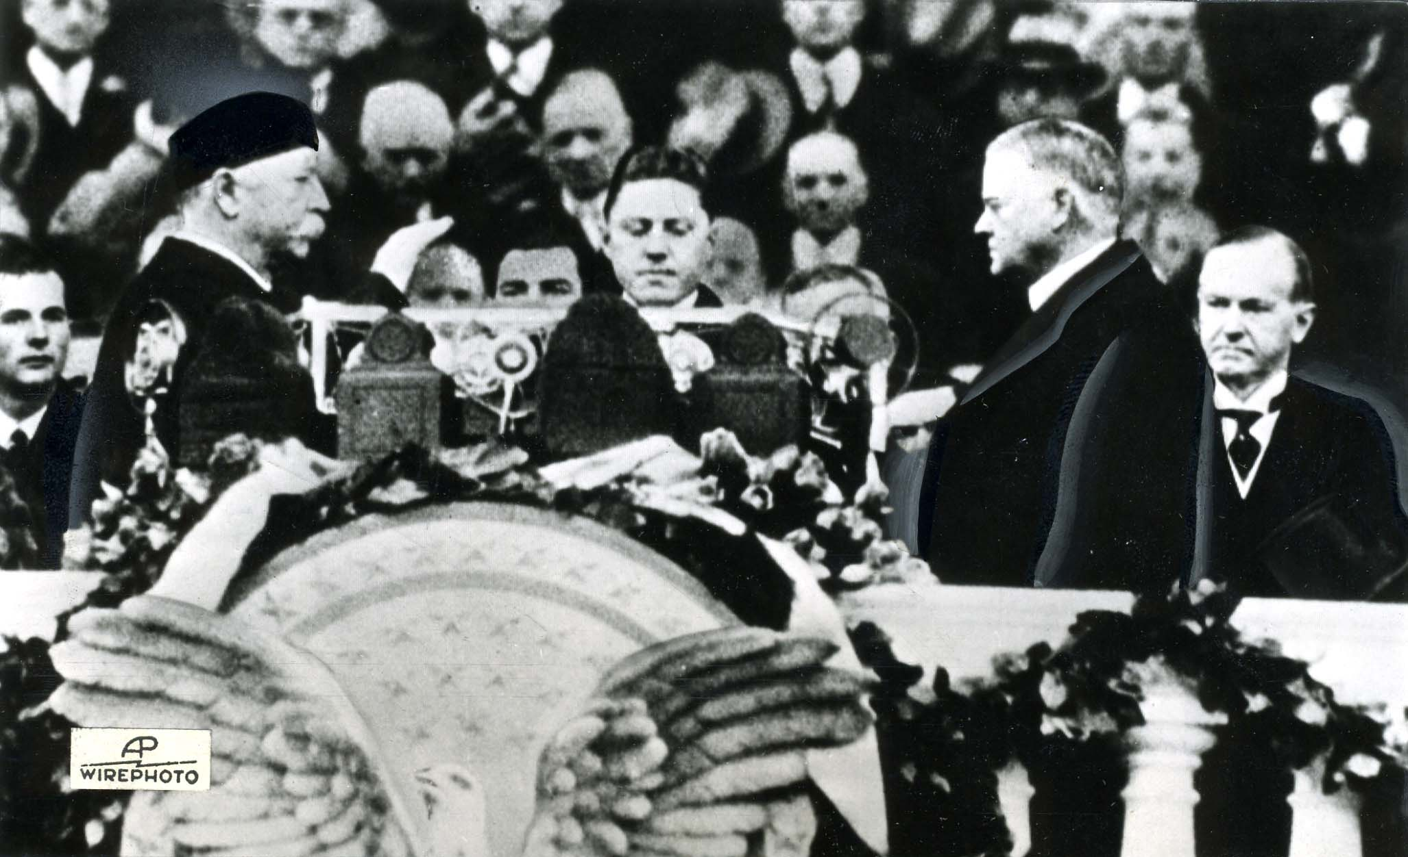
Election of 1928
Republican Herbert Hoover becomes president
March 1929: First inauguration to be covered by sound movie cameras and be radio-broadcast worldwide
“I have no fears for the future of our country. It is bright with hope.”

Slide 6
What the Stock Market in the 1920s was Like
Americans invested heavily in the stocks during the prolonged bull market period of the late 1920s
3 million Americans (10% of households) owned stock
With soaring prices, how could Americans afford the high stock price?
Buying on margin-Investor puts down 10% of the stock’s value and borrows the rest from a stockbroker. Pay back the loan when the price of the stock increases
What happens when the price of the stock bought on margin goes down?
Stockbroker issues a margin call, where the investor has to pay back the loan all at once
Fearing a margin call, investors are sensitive to any changes in the price of a stock.

Slide 7
What the Stock Market in the 1920s was Like
Even though stock prices were going up, companies were not necessarily doing well.
This is because investors were trying to make a fortune overnight and were being risky. Stock prices were going up, because investors kept buying lots of stock. What is this called?
Overspeculation
Go for the Gold Game!

Slide 8
The Stock Market Crash
By end of 1929, market is running out of customers
September 1929: professional investors sense danger and start selling their shares
Prices begin to start falling
Early October 1929: prices continue to fall and more people start to sell their shares
Monday, October 21, 1929: Prices plunge, chaos on the trading floor, margin calls issued
“Black Thursday,” October 24, 1929: prices plummeted further
“Black Tuesday,” October 29, 1929: prices took the steepest dive
$30 billion dollars lost

Slide 10
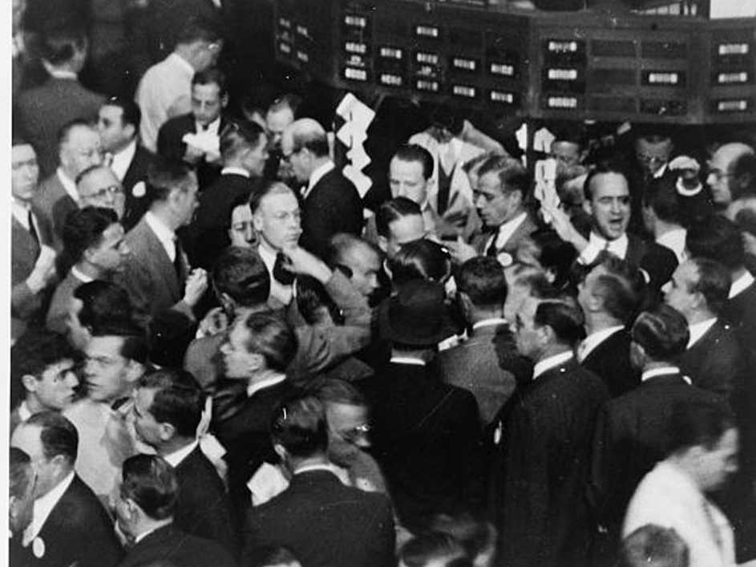

Slide 11
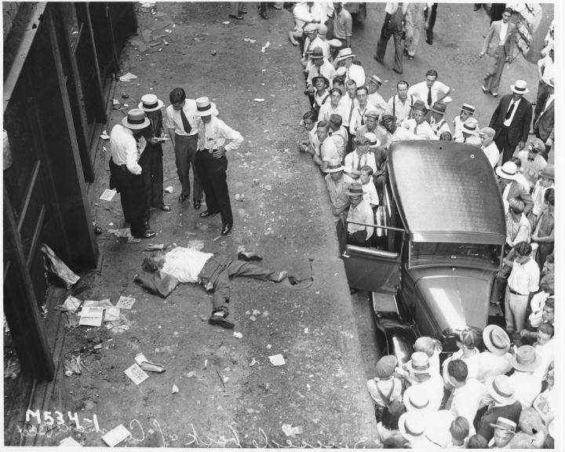

Slide 12
What Do You Do?
Run to the bank to get some money!
Problem!
The banks invested money into the stock market, which has crashed, so the banks have lost money.
People who have loans through the bank cannot pay their loans, so the bank is not making any money.
People make bank runs, trying to get their life savings out of the bank, but the bank runs out of money. 10% of nation’s banks close by 1930.
Starts a recession (period of economic decline before a depression) and triggers a crisis of confidence in the banking system

Slide 13
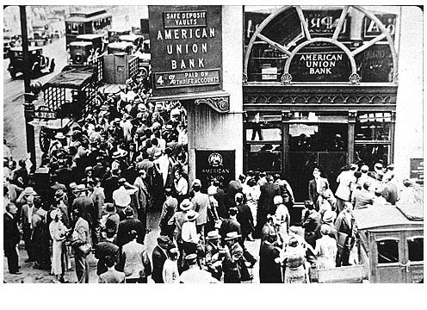

Slide 14
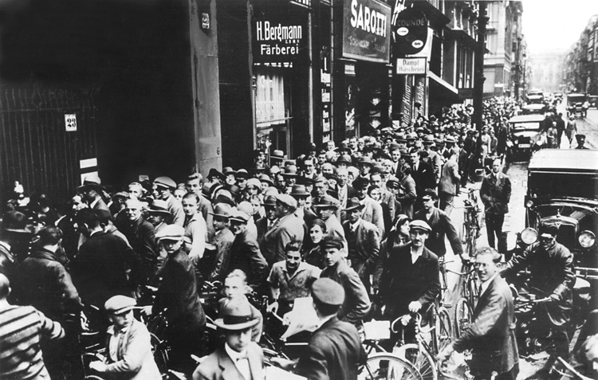

Slide 15
Sends the United States into the Great Depression, a period of time lasting from 1929-1939 characterized by high unemployment, economic troubles, low production, and misery

Slide 16
Check!
What was the stock market like in the 1920s?
A bull market-stock prices kept going up, even though companies were not doing super well
How were people engaging in speculation in the 1920s?
To make a quick buck in a short amount of time
Why did the stock market crash?
There were not enough people buying stock (due to the debt they had), so people slowly started selling their stock, causing prices to fall and brokers to make margin calls

Slide 17
Causes of the Great Depression
Contributing factor: Stock Market Crash of October 1929
Uneven Distribution of Wealth
Overproduction (people don’t make enough money to buy all of the stuff available)
After buying high-end items on credit, buyers reach a point where they have to pay off their debt and stop buying extra stuff
Companies cut back on production and start to cut expenses (including jobs)---chain reaction

Slide 18
Causes of Great Depression
2. Loss of Export Sales
Loans were made to American speculators, not foreign companies , so foreign companies don’t have money to buy American products
June 1930: Hawley Smoot Tariff (protection) raises tariff rate, so other countries cannot afford to buy our stuff. Plus other countries put their own protective tariffs on American products.

Slide 19
Causes of Great Depression
3. Mistakes by the Federal Reserve
Never raised interest rates to stop over speculation (indicated that economy was growing, when in reality, it was not)
After the crash, Feds raised interest rates, which limited the money that people could borrow (bad!)

Slide 20
Review
Which factors are most characteristic of an economic depression?
High unemployment and increased real estate investments
Too much money in circulation and high stock prices
High unemployment and overproduction
Large business investments and low taxes
Which situation helped cause the stock market crash of 1929?
Excessive speculation and buying on margin
Unwillingness of people to invest in new industries
Increased government spending
Too much government regulation of business

Slide 21
How did foreign influence affect factors leading to the Great Depression?
Loans to European countries facilitated an increase in American exports.
Foreign nations bought fewer American goods as a reaction to American protection tariffs.
Europe refused to buy American goods in an effort to stimulate their own economies.
Latin American nations began to buy more American products.
Which best describes the status of banks after the crash?
Banks were able to offer credit to consumers through loans.
Consumers successfully made bank runs to obtain funds from their accounts.
Banks were unaffected by the crash.
Many banks closed, due to loss of funds, which caused many to be wary of banks.

