Slide 1
Bell Work-Choose the vocab word that best completes the below sentences.
__(1)__ of the 1920s were anxious to invest money in the __(2)__. The problem with this __(3)__ was the fact that companies were not doing well, even though the __(4)__ prices were rising. In October 1929, a __(5)__ occurred when prices fell dramatically. This resulted in a nation-wide __(6)__, and many people who lost their jobs had no choice but to live in __(7)__. At the same time, farmers had tons of crops to sell, but they were not selling them for enough money because of __(8)__. Therefore, many farmers could not make their __(9)__ payments, and banks eventually __(10)__ on their property.

Slide 2
Stock Market Basics

Slide 3
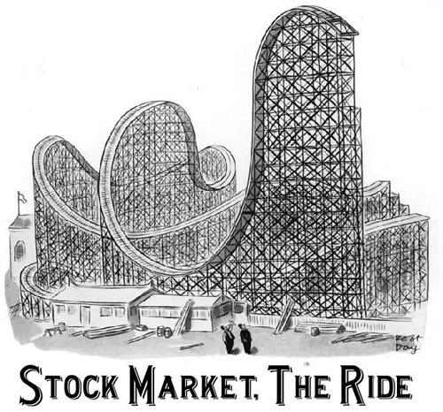
The Stock Market
Trading institution where people buy shares of stock in companies and make or lose money based upon that company’s performance

Slide 4
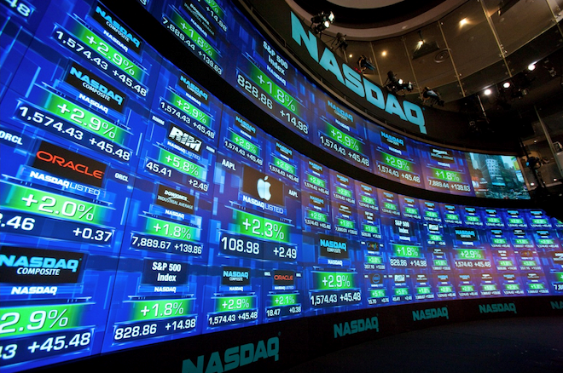
Means that the price of the share went up $2.49 from yesterday
Means that one share of Apple stock costs $108.98

Slide 5
Closing Bell video

Slide 6
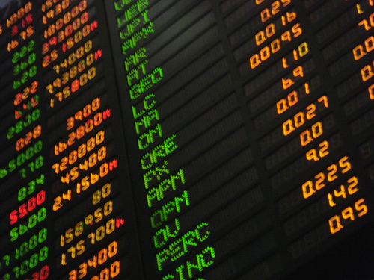

Slide 8
You can look up stock information online at places like Yahoo Finance

Slide 9
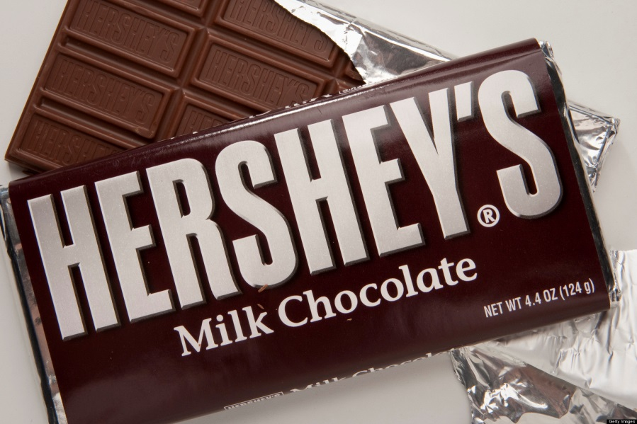
Case Study: The Hershey Company (HSY)
Shares worth about $103 per share
Was $87 in 2016
Was $104 in 2015
Rising stock prices indicate economic growth for that company
People usually sell their stock when it is really high.

Slide 10
Hershey Company

Slide 11
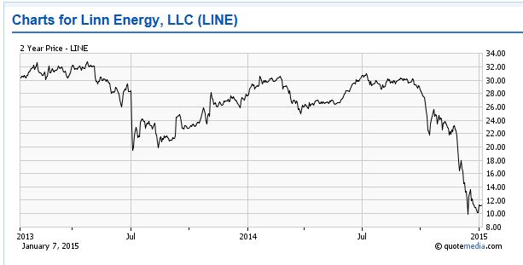
Case Study: Linn Energy, LLC (LINE)
Company has declared bankruptcy and is restructuring
Was $1.37 in 2016
Was $11 in 2015
When prices go down, it usually indicates economic troubles for the company (ex. Lay-offs, failing product, legal issues, etc.)

Slide 12
When Should One Buy Stock?
When the prices of stock are LOW! (Starbucks example)
Because this can get you the biggest return on your investment.
Sell that stock once the price is very high
Example:
If one purchased Hershey stock in 1990 at $5 a share, you have now made $80.
Investors usually buy more than one share at a time. You could have made $8,000 buying 100 shares of Hershey.

Slide 13
What Happens if my Stock Goes Down?
You lose money.
Example:
You buy a share of Starbucks stock for $80. Three months later, Starbucks has announced that they will shut down ten thousand stores. Therefore, the price of your stock falls to $60. One month later, it is $50. If you choose to sell, you have just lost $30.

Slide 14
Stock Market Game!!
I need a volunteer!
The volunteer gets $100 to invest in the stock market and can buy, sell, or hold (do nothing) each day.
This simulation will last four rounds (days).
Questions?
Let’s Get Started!

Slide 15
Stock Market Game
Day 1
Starbucks (SBUX) | $80
Walt Disney Company (DIS) | $90
Ford Motor Company (F) | $10
Constellation Energy (CEG) | $20

Slide 16
Stock Market Game
Day 2
Starbucks (SBUX) | $85 | + 5 | + 6.25%
Walt Disney Company (DIS) | $88 | -2 | -2.22%
Ford Motor Company (F) | $15 | +5 | +50%
Constellation Energy (CEG) | $21 | +1 | +5%

Slide 17
Stock Market Game
Day 3
Starbucks (SBUX) | $87 | + 2 | + 2.35%
Walt Disney Company (DIS) | $83 | -5 | -5.68%
Ford Motor Company (F) | $12 | -3 | -20%
Constellation Energy (CEG) | $25 | +4 | +19%

Slide 18
Stock Market Game
Day 4
Starbucks (SBUX) | $72 | -15 | -17.2%
Walt Disney Company (DIS) | $84 | +1 | +1.2%
Ford Motor Company (F) | $5 | -7 | -58%
Constellation Energy (CEG) | $27 | +2 | +8%

Slide 19
How Did You Do?
Lose money?
Make money?
Let’s try it again! Fill out the Stock Market Worksheet when you buy or sell stocks. Whoever makes the most amount of money gets 20 bonus points. You must complete the worksheet to get bonus points. Ready?

Slide 20
Stock Market Game-Day 1
American Can | 34
American Telephone & Telegraph | 114
General Electric | 139
General Motors | 10
United States Steel | 84
Radio Corporation of America | 2
Day 1

Slide 21
Stock Market Game-Day 2
American Can | 73 | + 39
American Telephone & Telegraph | 123 | + 9
General Electric | 182 | + 43
General Motors | 14 | + 4
United States Steel | 106 | + 22
Radio Corporation of America | 6 | + 4

Slide 22
Stock Market Game-Day 3
 | 104
American Telephone & Telegraph | 125
General Electric | 196
General Motors | 15
United States Steel | 94
Radio Corporation of America | 4
American Can | 75 | + 2
American Telephone & Telegraph | 120 | - 3
General Electric | 185 | + 3
General Motors | 20 | + 6
United States Steel | 90 | - 16
Radio Corporation of America | 4 | - 2

Slide 23
Stock Market Game-Day 4
American Can | 80 | + 5
American Telephone & Telegraph | 115 | - 5
General Electric | 196 | + 11
General Motors | 22 | + 2
United States Steel | 92 | + 2
Radio Corporation of America | 5 | + 1

Slide 24
Stock Market Game-Day 5
American Can | 81 | + 1
American Telephone & Telegraph | 120 | + 5
General Electric | 190 | - 6
General Motors | 18 | - 4
United States Steel | 80 | - 12
Radio Corporation of America | 3 | - 2

Slide 25
Stock Market Game-Day 6
American Can | 20 | - 61
American Telephone & Telegraph | 90 | - 30
General Electric | 192 | + 2
General Motors | 26 | + 8
United States Steel | 68 | - 12
Radio Corporation of America | 2 | - 1

Slide 26
Debrief
What was this experience like?
Did you lose or earn money?
GE and GM prices increased from Day 1 to Day 6
American Can, AT&T, US Steel decreased
RCA stayed the same
Why do you think people get involved with the stock market?
What are some limits to you buying stock right now?

