Slide 1
Bell Work-Fill in the words below.
During World War II, the United States refused to take a(n) __1.__ position after the Japanese attacked Pearl Harbor. President Roosevelt put an oil __2.__ on Japan, which limited the amount of __3.__ they had at their disposal. The navy made plans to attack the __4.__ of the Japanese empire, starting with the Philippines and various islands in the Pacific. __5.__ bombs were dropped on islands controlled by Japan; this was designed to decrease the size of the Japanese empire. __6.__ were useful in getting navy soldiers from the boats to the shore of these islands in sneak land invasions. And thanks to __7.__, the government was able to pay for the navy and their equipment. Fighting on the Pacific __8.__ was harsh, but because of the strength of the United States, the navy was able to come out on top!

Slide 3
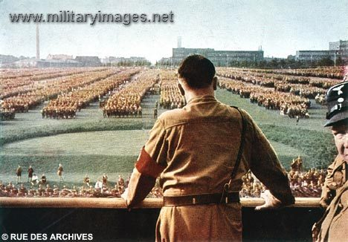
Background
Hitler begins rebuilding the German military in 1935
Violation of Treaty of Versailles
Why didn’t anyone stop him?

Slide 4
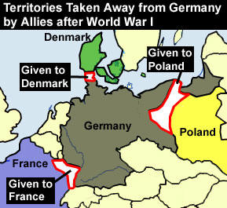
Reasons
Europe vainly tries to buy peace by giving into his demands to avoid war
Leaders fearful of another world war
Some thought that uniting all German-speaking areas was reasonable
Assumption that Nazis would be more interested in peace once territory was gained

Slide 5
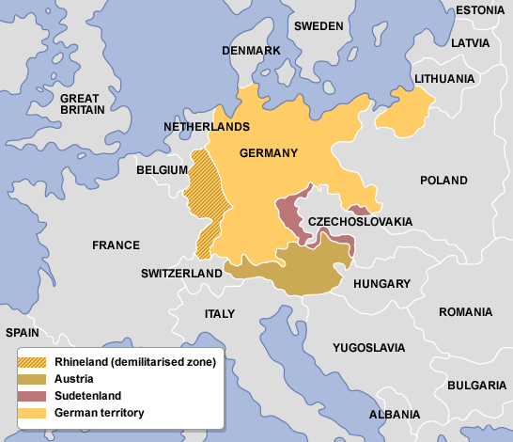
Austrian Anschluss
1937: Hitler calls for unification of German speaking land (Austria and Czechoslovakia)
Gain food, defensible frontiers, and soldiers
Feb 1938: Hitler threatens to invade Austria (his homeland) for unification
Anschluss: invasion in March

Slide 6
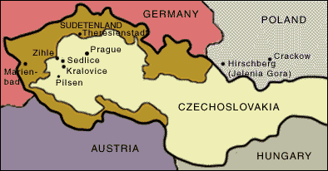
Sudetenland Threat
Hitler announces German claims to the Sudetenland
Anschluss was accepted because of similar culture/govt
Czechoslovakia, on the other hand, did not share the same language, was democratic, and had allied with France and Soviet Union

Slide 7
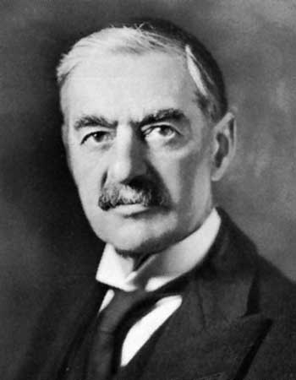
Reaction
Czechs resist German demands
France threatens to fight Germans, and Soviet Union offers assistance
British PM Neville Chamberlain promises to support France

Slide 8
Munich Conference
September 29, 1938
Representatives from Britain, France, Italy, and Germany meet to decide Czechoslovakia’s fate
Appeasement
Czechoslovakia: give up or fight Hitler
Chamberlain gambled that this would keep Hitler happy
Buying time for British army

Slide 9
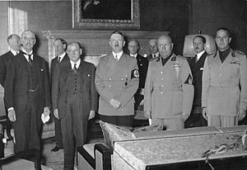
Munich Conference

Slide 10
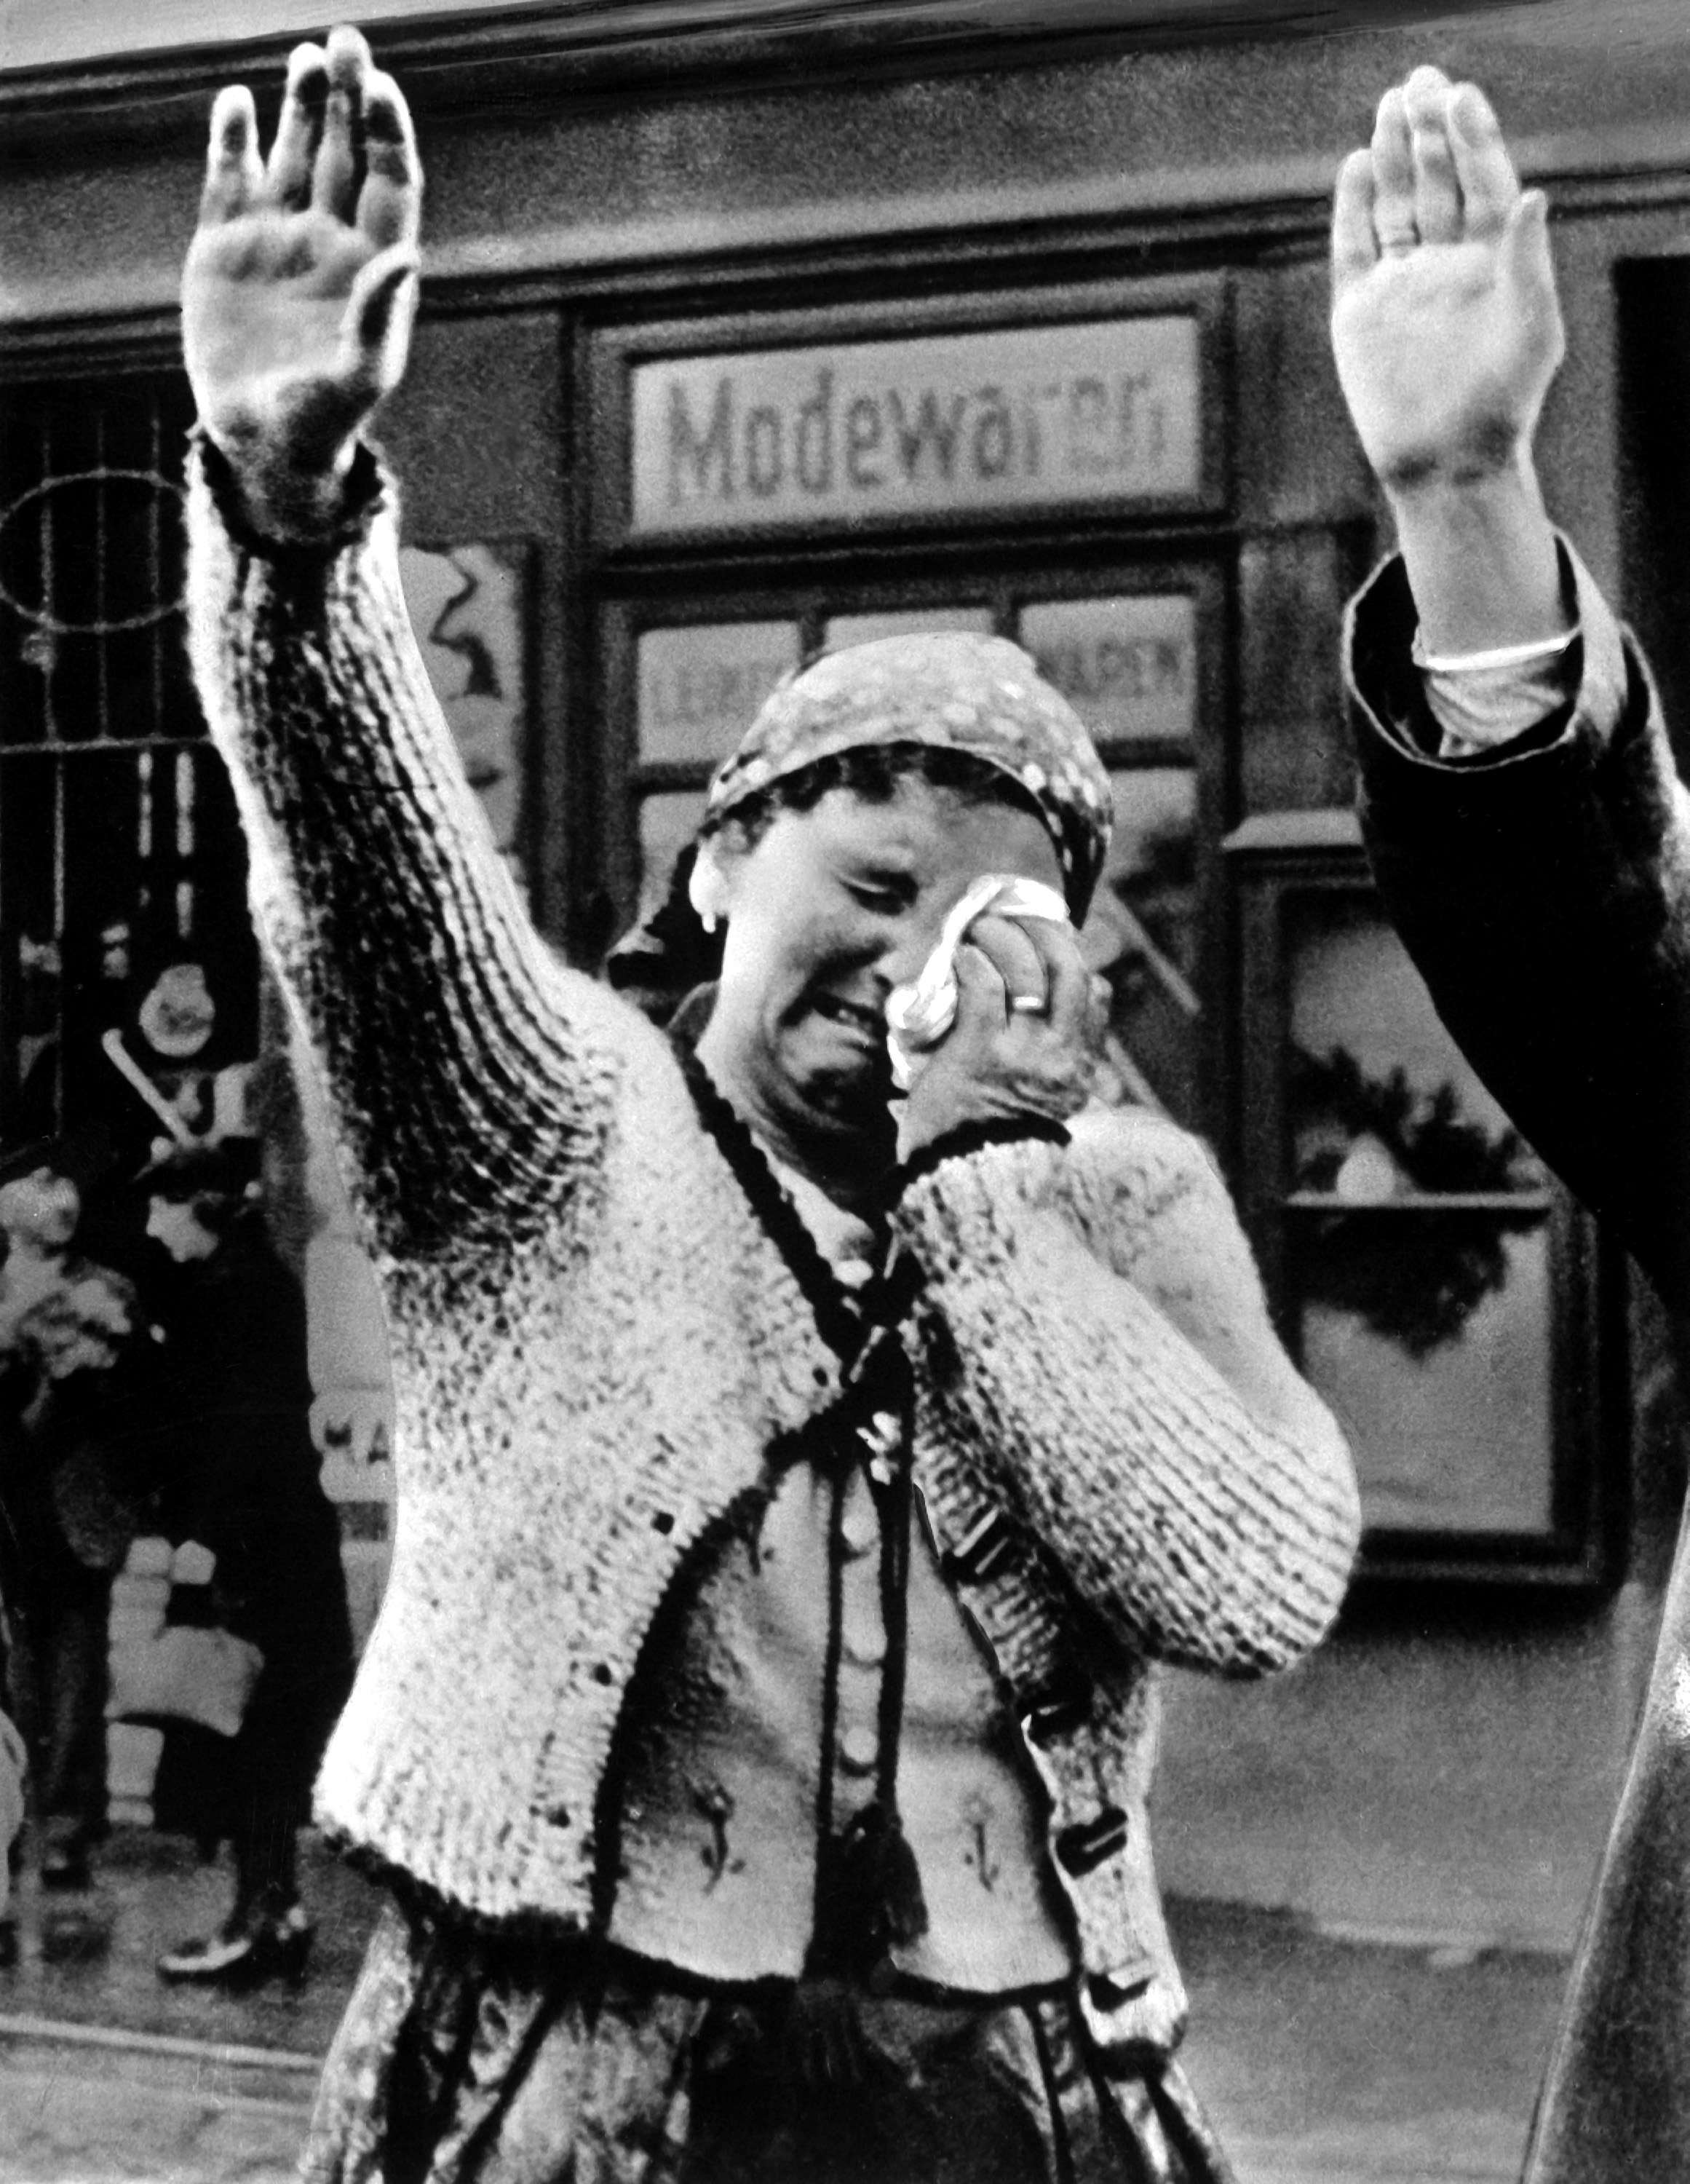
Result
March 1939: Hitler violates Munich Agreement by sending in troops to break up Czechoslovakia
German protectorate under the name Slovakia

Slide 11
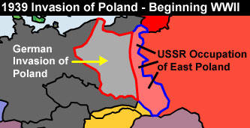
Next…Poland
Hitler wants Danzing (Poland) which used to be German
British and French convinced that appeasement failed (will help Poland defend land)
May 1939: orders German army to prepare to invade Poland
Tries to negotiate with USSR

Slide 12
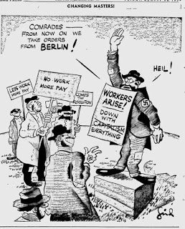
Nazi-Soviet Nonaggression Pact
August 23, 1939
Stalin agrees with German treaty (wants to turn capitalist nations against each other)
Shocking, as communism and Nazism are on opposite ends of political spectrum
Secret deal that divides Poland between Germany and Soviet Union

Slide 13
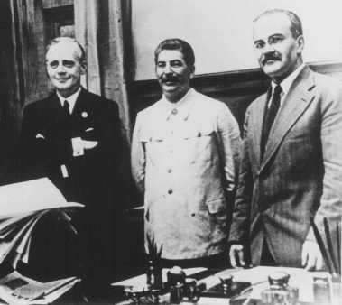
Nazi-Soviet Nonaggression Pact

Slide 14
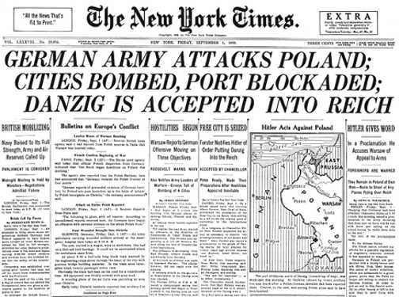
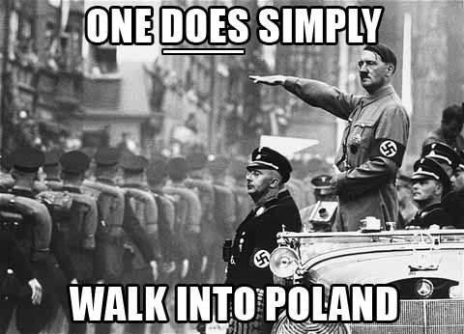
War Begins
September 1, 1939: Germany invades Poland from the west
September 3: Britain and France declare war on Germany

Slide 15
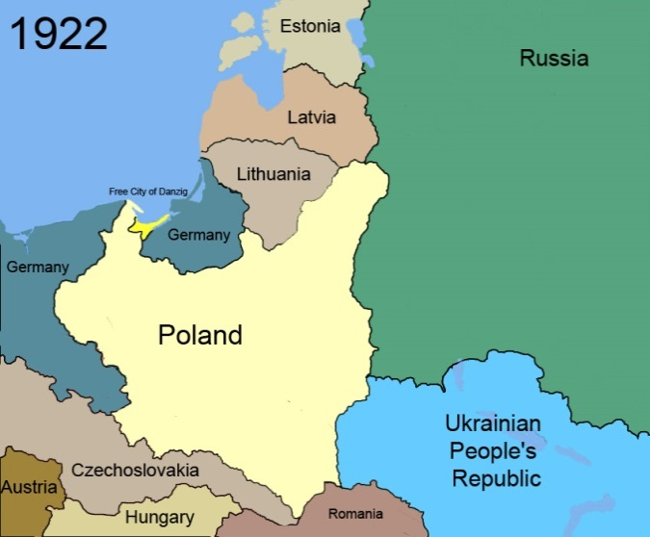
Blitzkrieg in Poland
“Blitzkrieg”-New type of warfare
Tanks break through on land and encircle enemy positions
Bombing from aircrafts
Polish unable to fight back
September 27: Warsaw falls
October 5: Polish army defeated

Slide 16
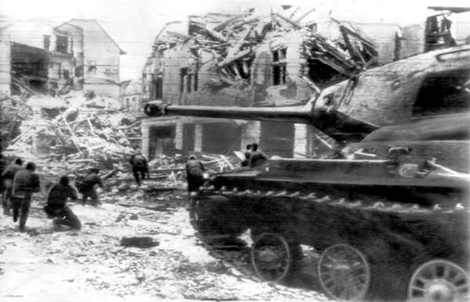
Blitzkrieg

Slide 17
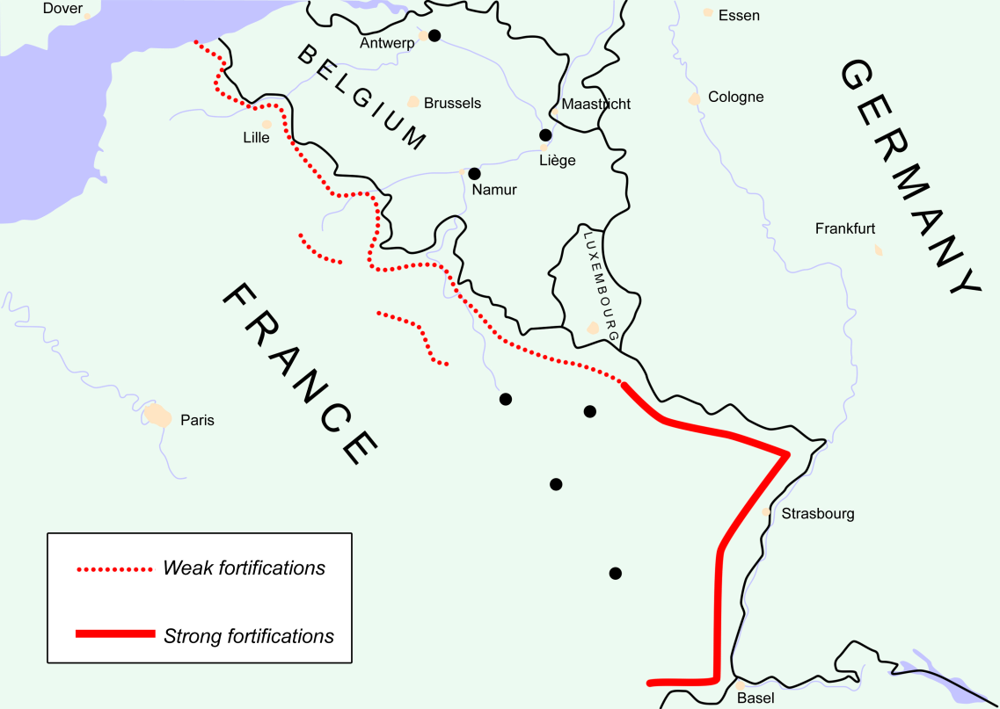
Fall of France
British and French troops wait in France on the defensive behind the Maginot Line.
After Poland, Hitler attacks Norway and Denmark before France
Hitler then conquers Netherlands, Belgium, and Luxembourg to reach France

Slide 18
Fall of France
May 10, 1940: Blitzkrieg in Benelux countries
French troops rush to Belgium, but that is a mistake
Germans rush into France through the mountains (French do not think tanks could get through)
Germans easily get through northern France to the English Channel

Slide 19
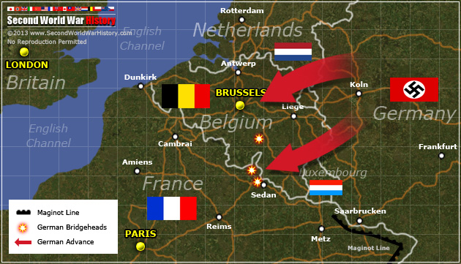

Slide 20
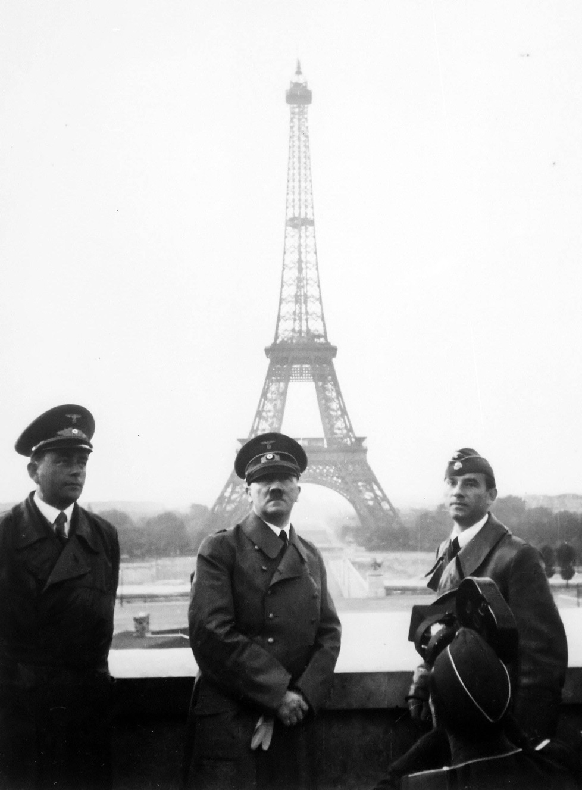
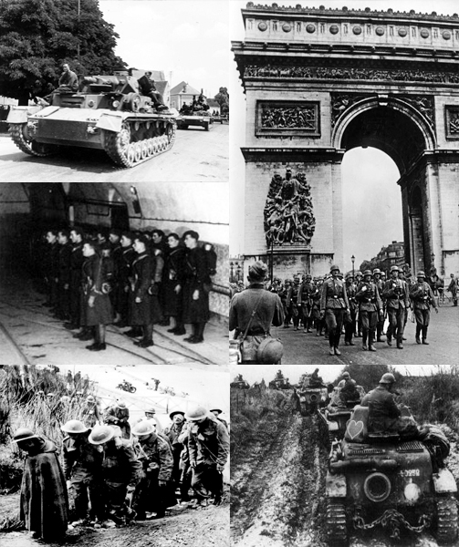
Vichy France

Slide 21
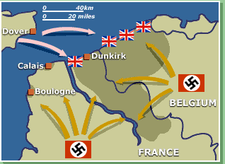
Battle of Dunkirk
Germans advance on Dunkirk
Hitler waits for three days
British strengthen their forces and save 338,000 British troops in Dunkirk
“Miracle”
Price: all ammunition, tanks, weapons left at Dunkirk
June 22: French surrender

Slide 22
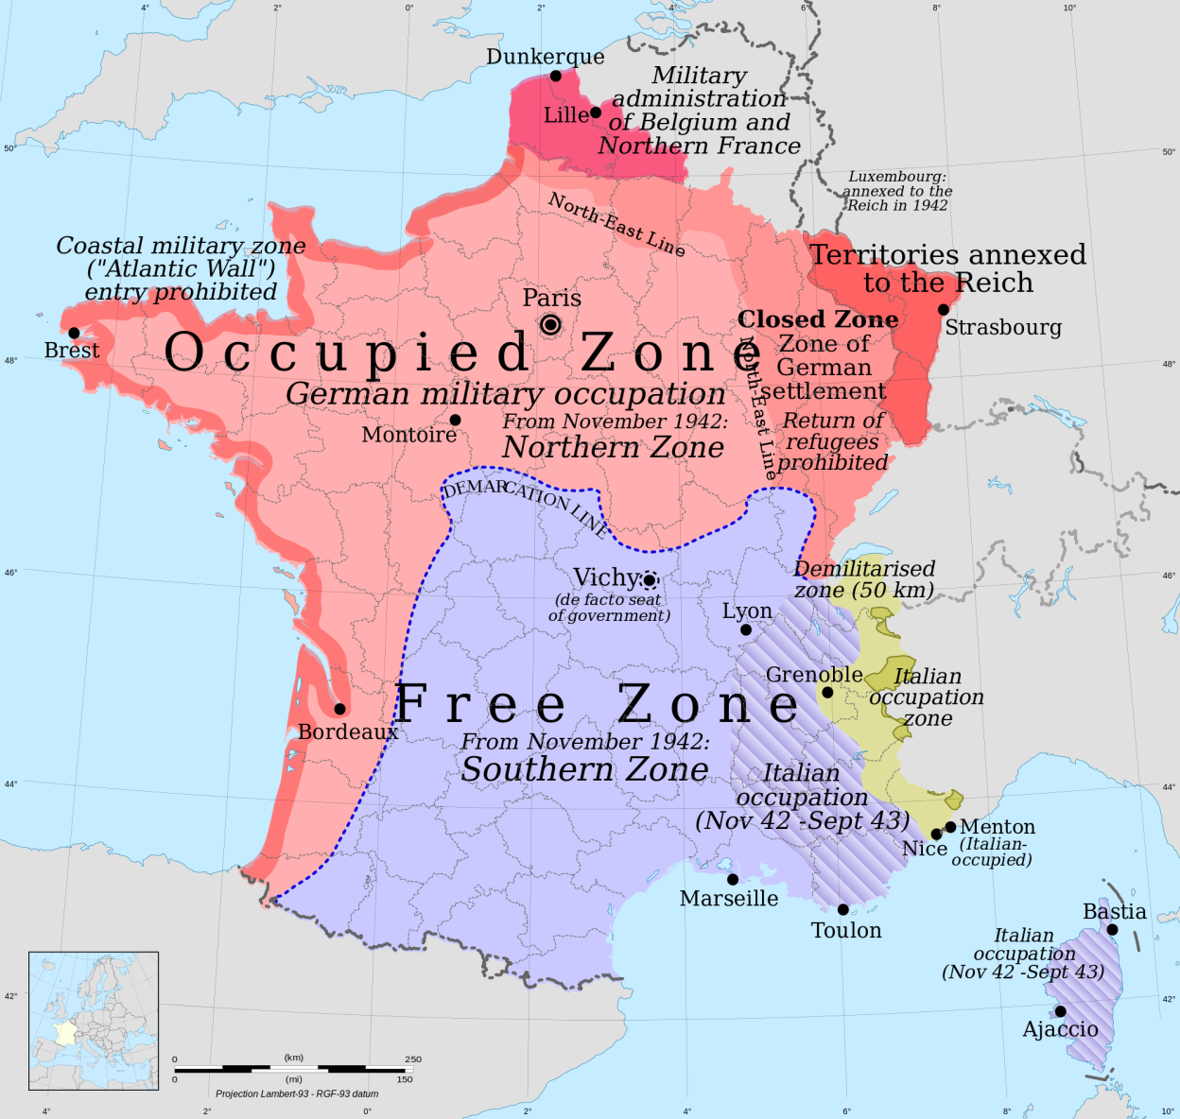
German Occupied France

Slide 23
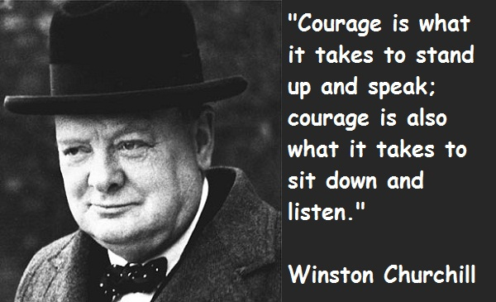
Britain
Without supplies, British do not stand a chance
British spirit underestimated by Hitler
Winston Churchill: fight to defend a civilization
“We shall never surrender”

Slide 24
Battle of Britain
Challenge to get across the English Channel
Germany decided to launch an airstrike
June 1940: German air force began to attack British shipping
August: all out air battle to destroy the Royal Air Force
When London is accidently bombed, the British began to bomb Berlin

Slide 25
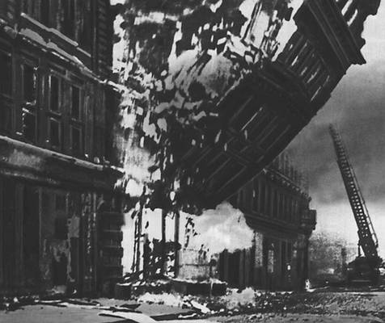

Slide 26
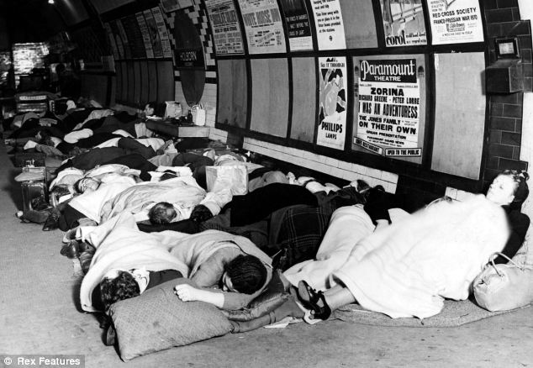
German Reaction
Infuriated Hitler
Goal to now terrorize the British into surrendering
Focus bombing on London
British hid in subway

Slide 27
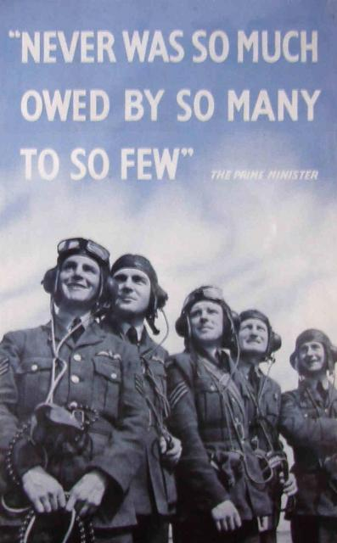
British Inventions
RADAR: British could detect incoming German planes and direct British fighters to intercept them
Skilled pilots saved Britain from invasion
October 12, 1940: Hitler cancels invasion of Britain

