Slide 1
Reconstruction

Slide 2
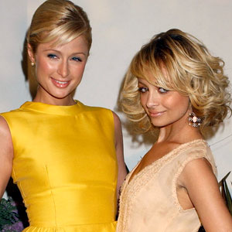
Imagine….
You are a happy-go-lucky teenage girl with your best friend.
You are each a little different, with certain preferences
You like little dogs; she likes purses.

Slide 3
Then one day…
You have a small disagreement.
You wore the same outfit without checking with the other.
You make up, but things are slightly tense.

Slide 4
Then…
You invite a third gal pal to go to the movies but don’t invite the BFF.
She finds out on Facebook and gets mad.
You have a small fight, and make up, but things are slowly getting tense.

Slide 5
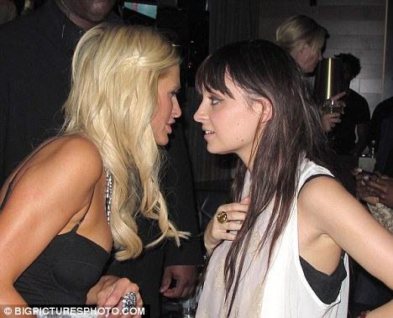
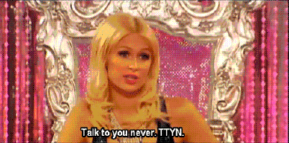
Then finally,
She steals your man!
You are furious and full-on war breaks out!
You spread rumors about each other
Refuse to speak to one another
Maybe fight in the hallways?

Slide 6
After awhile,
You slowly start to stop fighting.
She dumps the dude, and you realize that he was worthless anyway.
It’s the next school year, and you have to work together in Bio lab.
What do you do???
How will you slowly become civil classmates and possible friends again?

Slide 7
In this example,
You and your friend are the Union and Confederacy.
Your fight is the Civil War
Their process of becoming friends again is Reconstruction

Slide 8
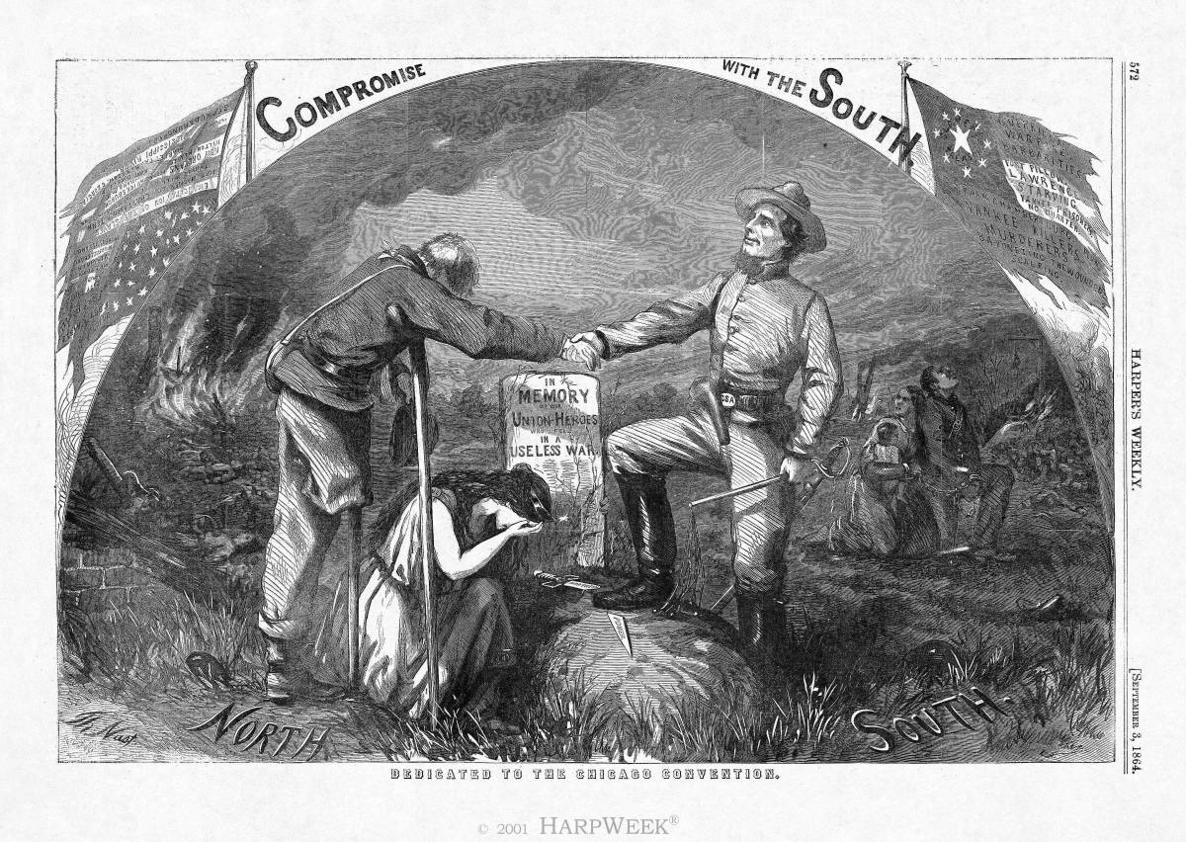
Reconstruction
The plan to reintegrate the South back into the Union after the Civil War
1865-1877

Slide 9
End of Civil War
Lincoln is assassinated five days after the Civil War ends.
Difficult questions need to be answered
Should the slave-owning South be punished or forgiven for their actions?
What rights should be given to former slaves?
How can the war-torn nation be brought back together?

Slide 10
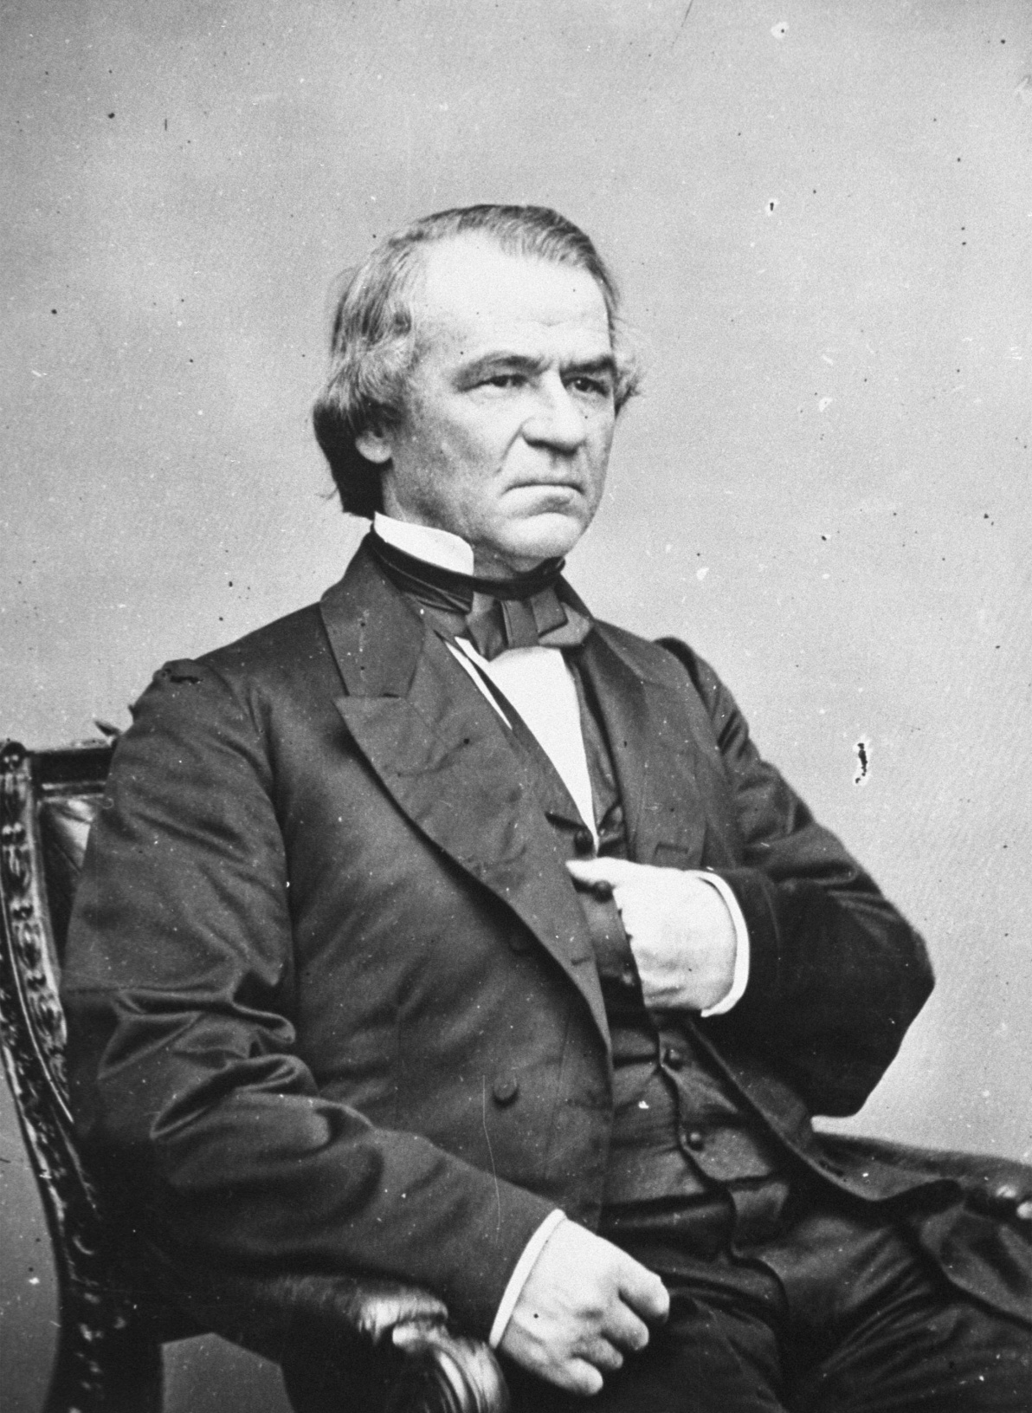
Division
Disagreement among Northerners about how the South should be handled
Lincoln feels like the former Confederate states should be given some sympathy
After assassination, President Andrew Johnson continues Lincoln’s plan

Slide 11
Presidential (Lincoln and Johnson) Plan
Ten Percent Plan: 10% of Southerners in each state take an oath of loyalty to the Union
Adopt a new state constitution that bans slavery
Pardons all white Southerners who will swear loyalty to the Union
Support right to vote for educated African Americans

Slide 12
Radical Republican Plan
Some Northern Republicans think Lincoln is being too soft on the former Confederates
Ex. Thaddeus Stevens and Wade-Davis Bill
Majority of white males have to swear loyalty to Union
Former Confederates are not allowed to hold office (those who fought against Union can’t vote in delegate elections)
Adopt new state constitution that abolishes slavery
Divide up the South into military districts

Slide 13
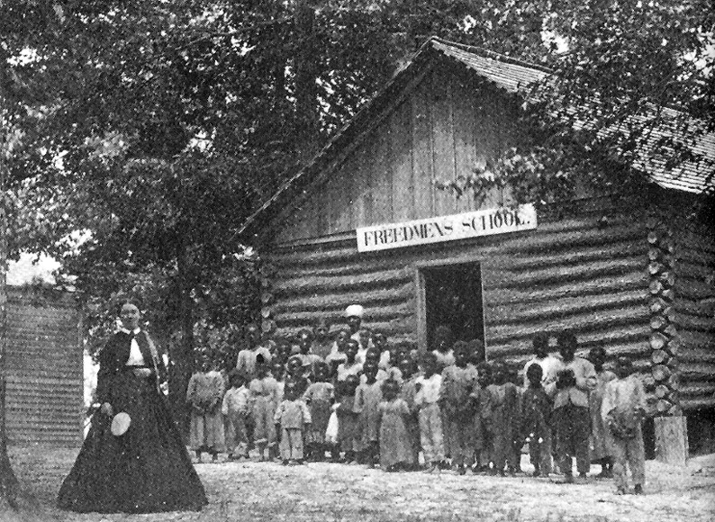
Freedmen’s Bureau
Government agency designed to help African Americans
Provide education, jobs, clothing, shelter

Slide 14
Black Codes
Southerners had to get rid of slavery in order to get back in the Union
BUT….their harsh feelings and discrimination did not end
Laws that aimed to control freed men and women and to enable plantation workers to exploit African American workers

Slide 15
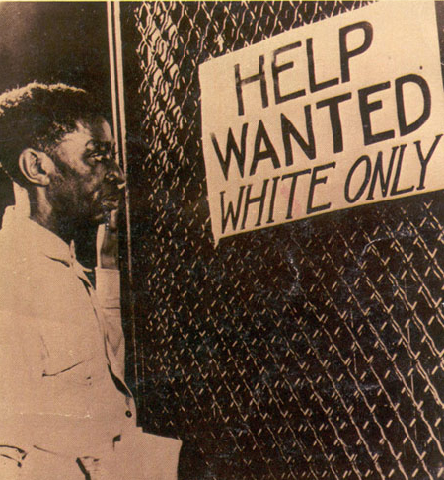
Black Code/”Jim Crow” Examples
Allow local officials to arrest and fine unemployed African Americans and make them work for white employers to pay off fees
Ban African Americans from owning or renting land
Allow whites to take orphaned African American children as unpaid apprentices

Slide 16
Reconstruction Amendments
Passed by Radical Republican Congress to ensure that rights were given to African Americans
13th-abolish slavery
14th-grants full citizenship to all individuals born in the US (also contains due process clause)
15th-right to vote for male citizens (can’t prevent them from voting due to race, color, or previous condition of servitude)

Slide 18
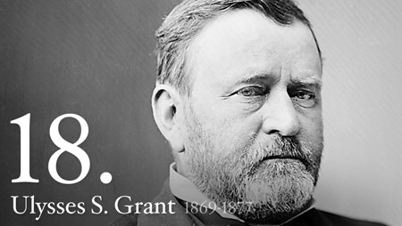
Lincoln’s Successors
When Lincoln is assassinated, Andrew Johnson becomes the 17th president.
Southern Democrat who sided with the Union (anti-Secessionist)
Resented Southern slaveholders, but did not want to give African Americans help
Impeached by the House, but not convicted by the Senate
Election of 1868-Ulysses S. Grant becomes president

Slide 19
New Social Groups
Scalawags-Southern whites who supported Reconstruction
Carpetbaggers-Northerners who came to the South during Reconstruction to help rebuild the nation
Ku Klux Klan-group of white Southerners who used terror to prevent African Americans from exercising their rights

Slide 20
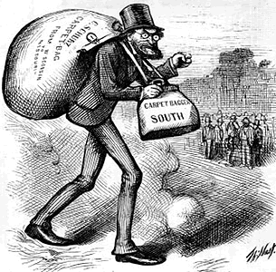
Carpetbaggers

Slide 21
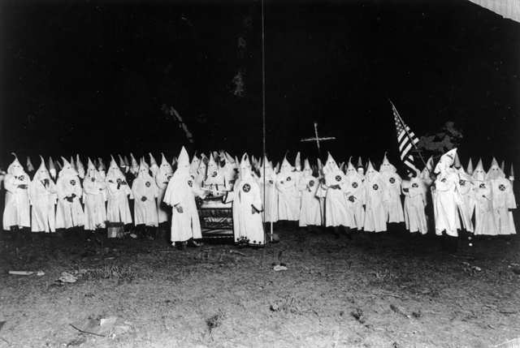
KKK

Slide 22
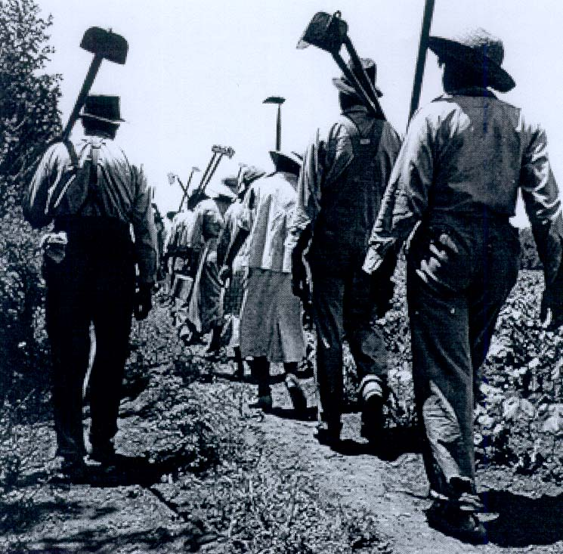
Sharecropping
Basically, little changes for African Americans
They still have few rights and abilities
Most become sharecroppers and rent land to farm

Slide 23
Voting Restrictions
Southern leaders find ways of getting around the 15th amendment
Poll tax-fee that people have to pay before voting
Literacy tests
Grandfather clauses-if grandfather had been able to vote, you could too
Plessy v. Ferguson-separate and equal facilities

Slide 24
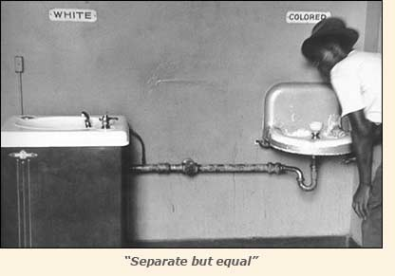

Slide 25
Change in the South
Democratic ruling party
Build-up of Southern industry
Duke Tobacco Company
Bessemer process to inexpensively produce steel
Cheap reliable workforce
Rural South is impoverished and in debt

Slide 26
Impact of Reconstruction
South gets help rebuilding its infrastructure and economy (most needs to be done to fix the economy)
At first, more rights for freed African Americans
BUT Reconstruction does NOT make good on the promise of true freedom for African Americans—South becomes segregated

