Slide 1
Bell Work
How did World War I end?
Who was blamed for the war, and why?

Slide 3
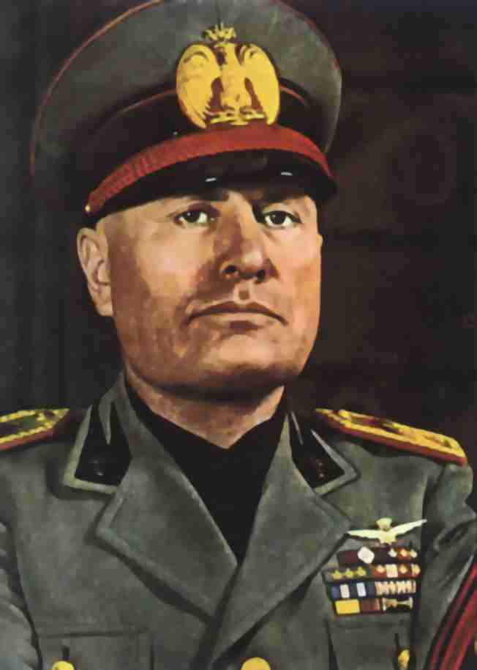
Italy After World War I
Economic depression contributes to rise of antidemocratic governments in Europe
Benito Mussolini
Founder of Fascist Party in 1919 (nation more important than individual, so government needs strong dictator to impose order

Slide 4
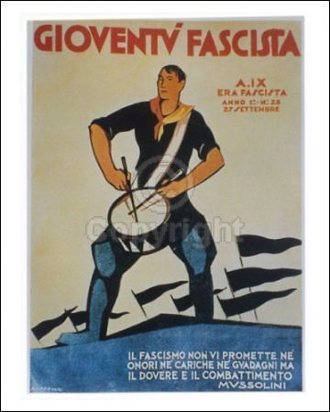
Il Duce (“the Leader”)
Increase nation’s power by expanding territory and building up military
Return to glory of the Roman Empire
Anti-communist
Protection of private property and the middle class
Nationalism

Slide 5
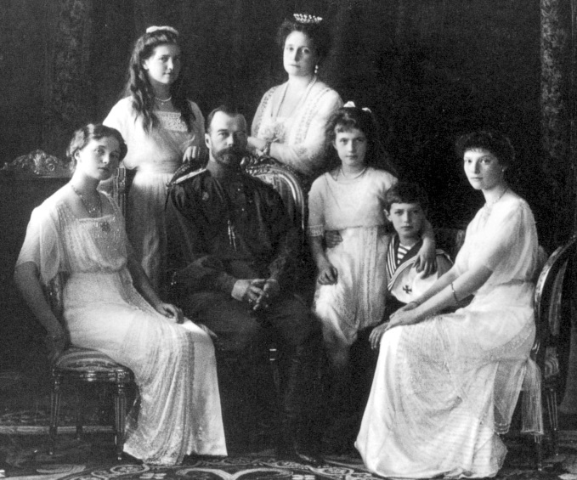
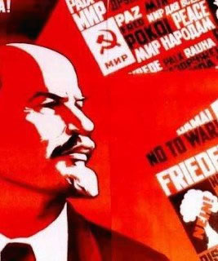
Moving to…Russian Revolution
1917: Russian Revolution removes Czar Nicholas II from power
Enter the communist Bolsheviks under Vladimir Lenin (USSR)
Government seizes private property, institutes one-party rule, suppress individual liberties, and punish opponents

Slide 6
Romanovs

Slide 7
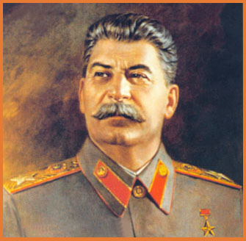
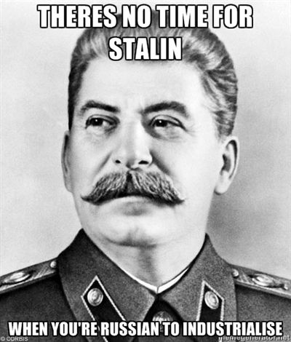
Joseph Stalin
Lenin dies in 1924
By 1926, Stalin is the new Soviet dictator
Begins massive effort in industrializing, resulting in peasant deaths
Cruel dictator who murders all who oppose him

Slide 8
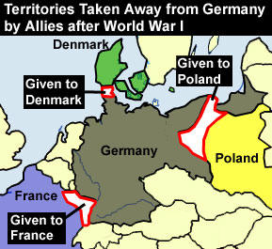
Rewind—the End of World War I
Treaty of Versailles 1919
Germany is made to accept blame for the war
Reparations
Demilitarize
Germans are completely humiliated and ashamed.
Economic disaster (hyperinflation)

Slide 10
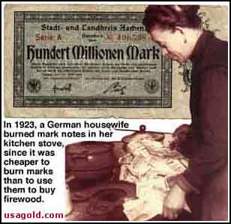
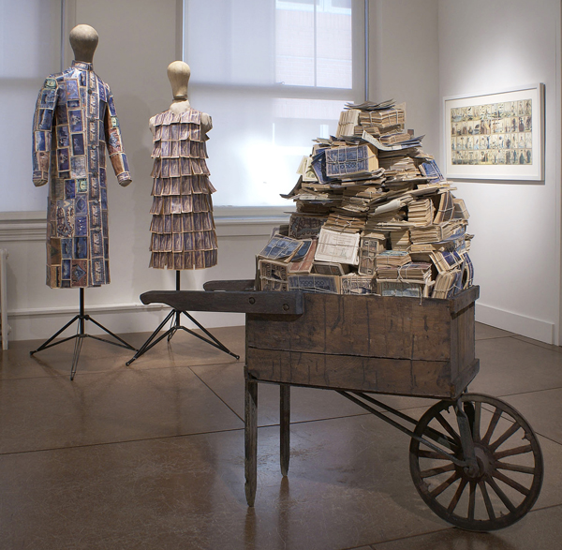
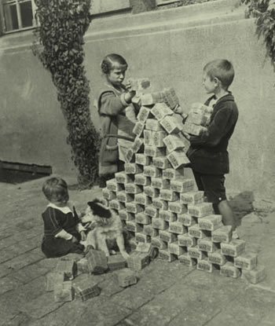
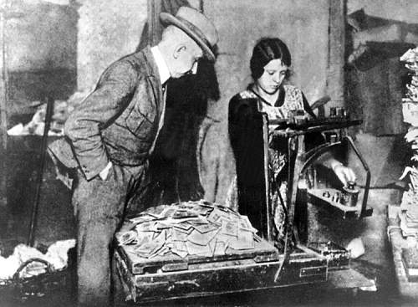

Slide 11
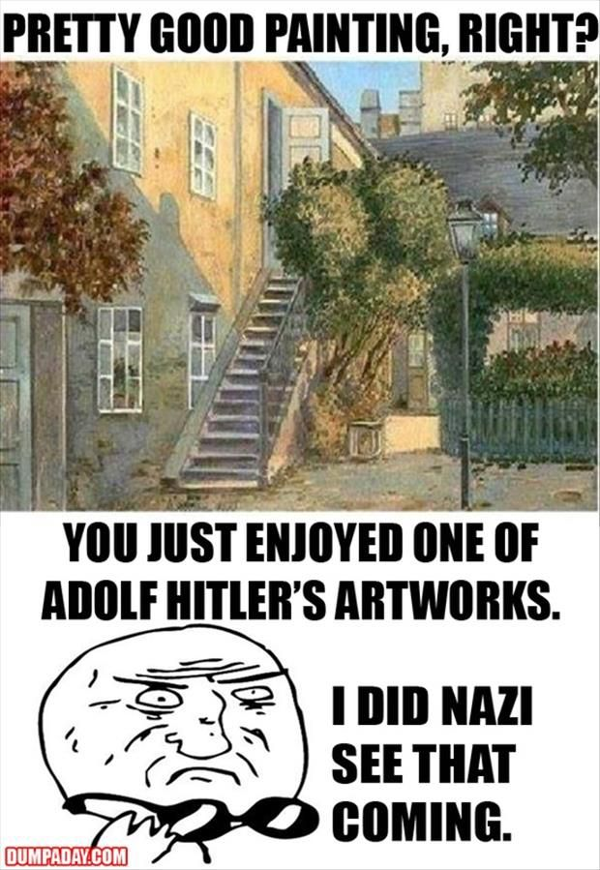

Slide 13
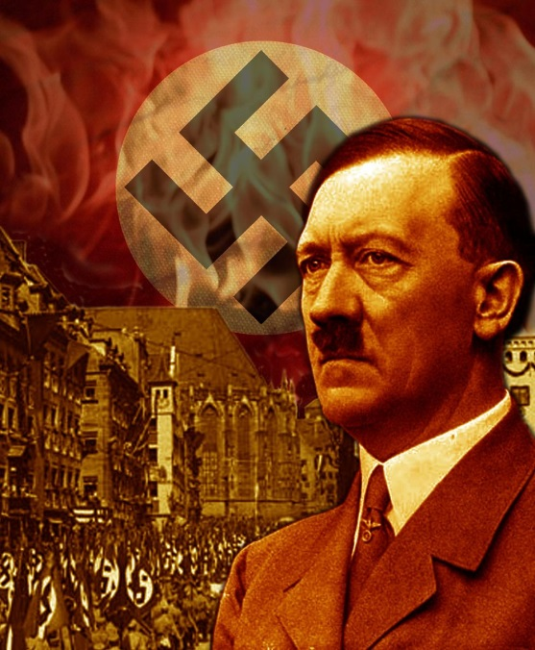
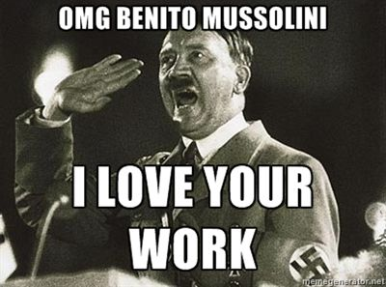
German Condition Between Wars
The Germans really need someone to make them feel better about themselves.
Adolf Hitler
Anticommunist and nationalist
Admirer of Mussolini
Hatred of the victorious Allies
Great orator
Increased German self-esteem through the scapegoat effect

Slide 14
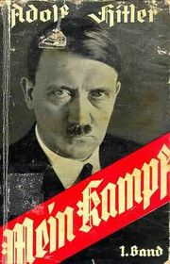
Nazi Party
Nationalistic and anti-Communist party that recruits Hitler
Try to seize power in Germany in 1923, resulting in Hitler’s arrest
Mein Kampf
master Aryan race with blond hair and blue eyes
Expansion of Germany into Poland and Russia
Enslave the inferior races (Slavic)
Blame the Jews for Germany’s defeat

Slide 15
Rise to Power- “Fuhrer”
After his release, Hitler gets Nazis elected to the Reichstag
1933 Hitler appointed to chancellor (PM)
Orders police to crackdown on socialist and communist parties
Reichstag votes to give Hitler dictatorial powers
Rebuild German military in 1935

Slide 16
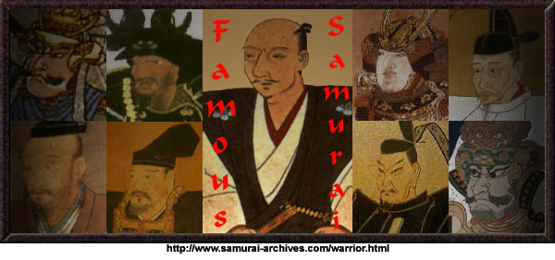
In the East…
Japan had had a traditional shogunate empire in the 1800s
Begin to industrialize at the turn of the century, but economic times are hard
Not enough exports to pay for imports
Increased unemployment

Slide 17
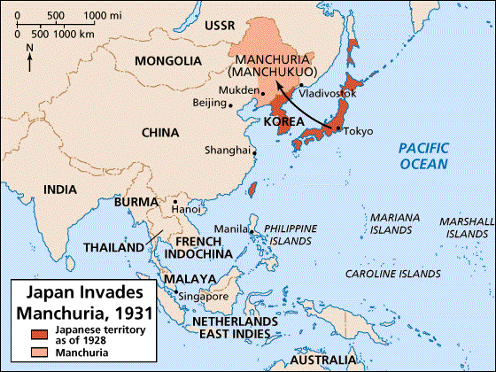
Japanese Problems
Corrupt politicians are blamed for economic problems
Anti-democracy military leaders believe Japan is destined to rule East Asia
Military leaders begin to invade Manchuria in 1931

Slide 19
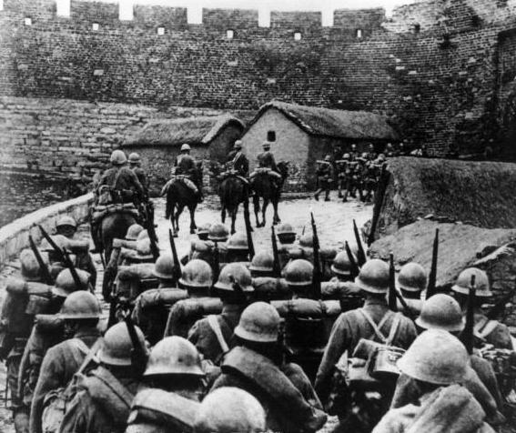
Militarists Control Japan
The Japanese prime minister tries to end the war but gets assassinated
Now the military controls Japan
Government now supports the nationalist policy of expanding the empire

Slide 20
American Reaction
Isolationism and focus on improving the economy
During the Depression, other countries stopped paying war debt
Nye Committee: Americans were tricked to going into WWI by arms manufacturers
Neutrality Act of 1935: no selling arms to other countries

Slide 21
Spanish Civil War
1936: General Franco takes power in Spain
Soviet Union helps govt while Germany and Italy help Franco
US refuses to sell arms to either side
After Spanish Civil War, Hitler and Mussolini sign Rome-Berlin Axis
Then, Japan aligns with Germany and Italy in the Anti-Comintern Pact---Axis powers

Slide 22
US Continues to be “Neutral”
Neutrality Act of 1937: no selling arms, but if a foreign country wants to buy other goods, we will only take cash and the country itself has to send someone to pick it up

Slide 23
Roosevelt and Internationalism
“International relations [are] secondary to the establishment of a sound national economy”
Opposes isolationism, but sees that the public supports it
Supports internationalism (trade between countries leads to prosperity and prevents war)
Does sell weapons to China when Japan invaded Manchuria (claims Neutrality Act does not apply)

