Slide 1
The 1970s
Politics, Economics, and Culture

Slide 2
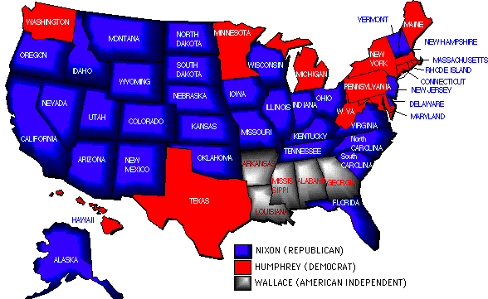
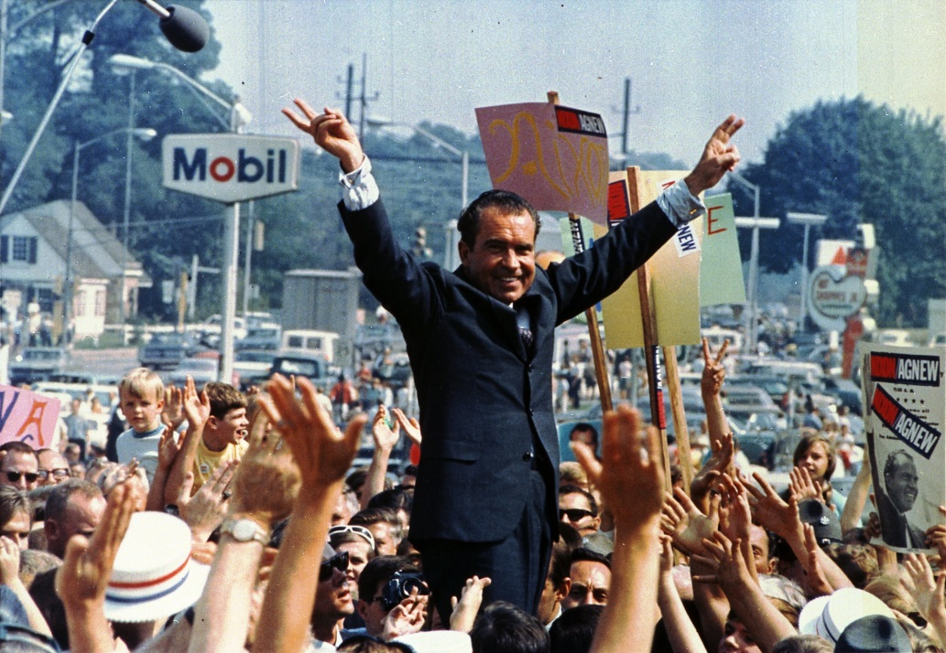
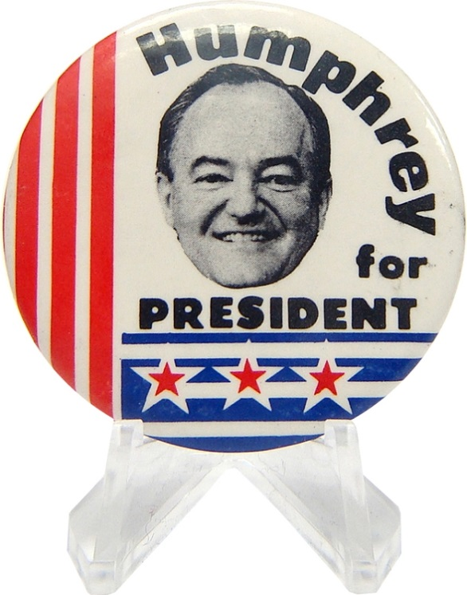
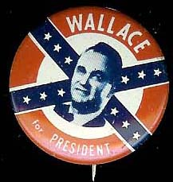
Politics: Election of 1968
Republican Richard M. Nixon
Democrat Herbert Humphrey
American Independent Party George Wallace-segregationist

Slide 3
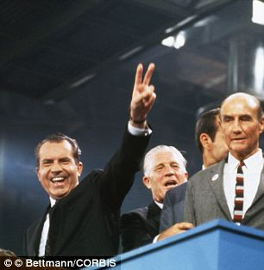
Nixon’s Promise
Addresses Middle America & “silent majority”
“Peace with honor” in Vietnam
Law and order
Return to traditional values
Strom Thurmond-win the South
Slow desegregation

Slide 4
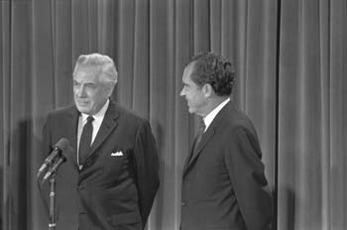
Nixon’s Domestic Policy
Environmentalism!
Overturn some civil rights legislation
Tough on crime
Earl Warren Court to Warren Burger Court
New Federalism-dismantle federal programs and give control to local and state govts
Revenue sharing

Slide 5
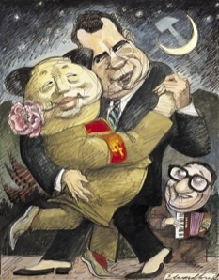
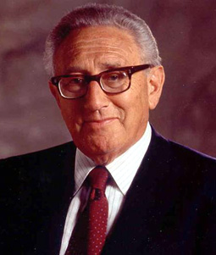
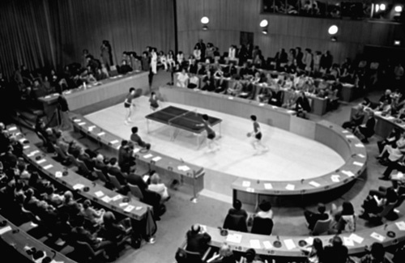
Nixon’s Foreign Policy
National Security Advisor Henry Kissinger
Forge friendly relations with Soviet Union and China
Détente
Build a better relationship in the interest of world peace
Ping Pong Diplomacy 1971
Nixon visits China 1972

Slide 6
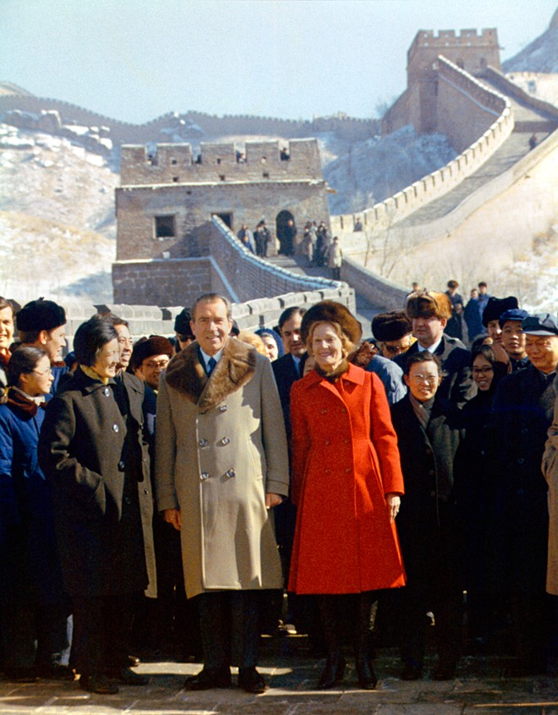
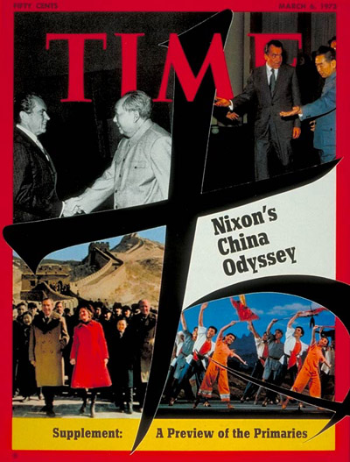
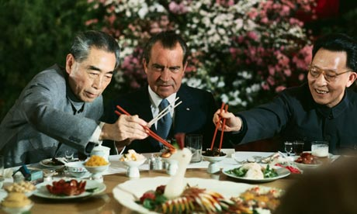
Nixon in China 1972

Slide 7
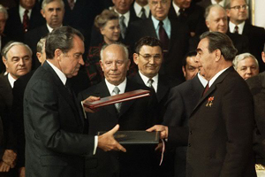
Détente in Soviet Union
May 1972 Summit with Soviet Union
Sign SALT I, or Strategic Arms Limitation Treaty
plan to limit nuclear arms the two nations had been working on
Successful example of détente!

Slide 8
Watergate Scandal
Nixon deeply suspicious and distrustful
Fought hard to become president
“Enemies list”
Concerned about reelection in 1972
Unpopular Vietnam War
Engage in subversive tactics in the election

Slide 9
Break-In at the Watergate
June 17, 1972-five Nixon supporters break into the Democratic National Convention headquarters at the Watergate Hotel
Obtain sensitive campaign info and wire-tap
James McCord & Committee for the Re-election of the President
Cover-up in the White House and denial ($)
Nixon wins the election in a landslide

Slide 10
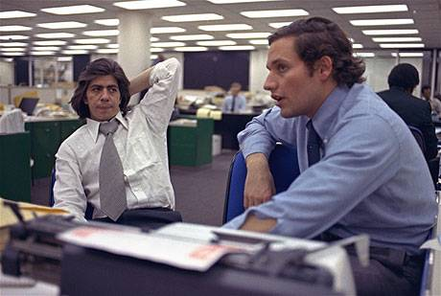

Slide 11
The Cover Up Unravels
1973 burglars go on trial
McCord’s testimony opens up a floodgate
June 1973: John Dean testified that Attorney General John Mitchell ordered the break-in and Nixon played an active role in covering it up
July 16: Alexander Butterfield says Nixon has tapes

Slide 12
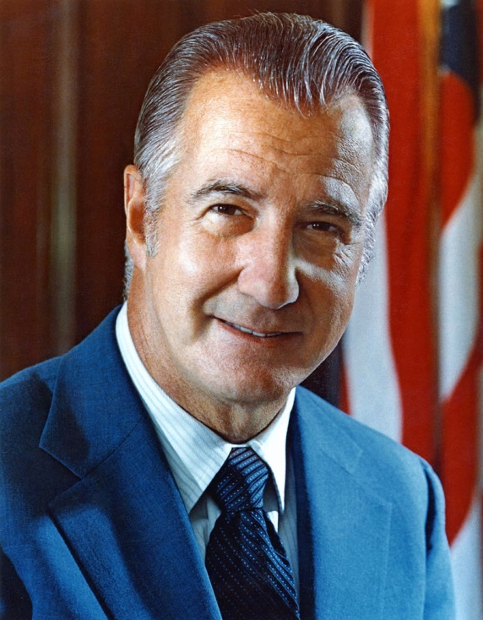
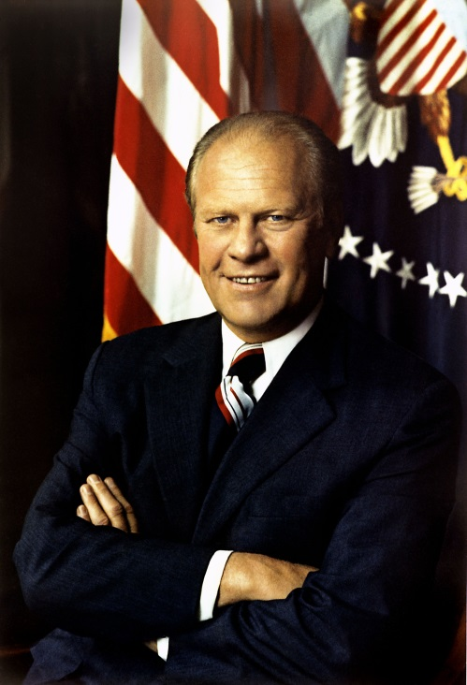
Problems for Nixon
Refuses to hand over tapes, citing executive privilege
Saturday Night Massacre-firing prosecutor Archibald Cox
VP Spiro Agnew forced to resign for taking bribes
Gerald Ford becomes VP
April 1974: Nixon releases edited tapes
July: Supreme Court involvement

Slide 13
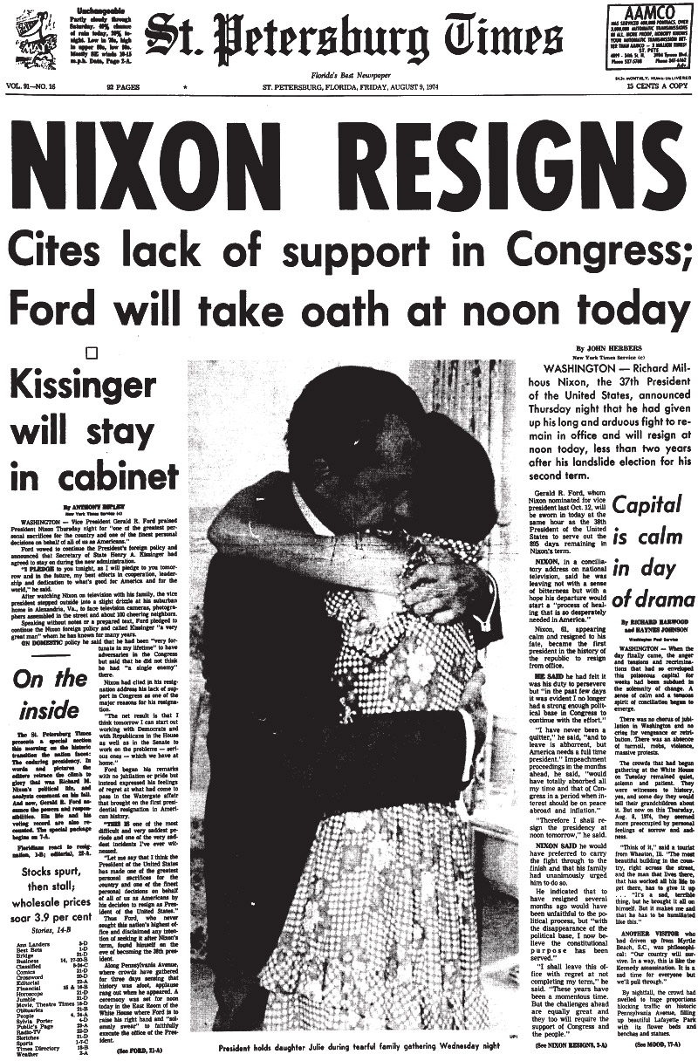
Nixon Resigns
House of Representatives votes to impeach Nixon
obstruction of justice in the Watergate cover-up
Misuse of federal agencies to violate the rights of citizens
Defy authority of Congress by refusing to deliver tapes
June 23, 1974: tapes reveal that Nixon ordered the CIA to stop the FBI’s investigation of the break-in
August 9, 1974 Nixon resigns in disgrace

Slide 14
Legacy of Watergate
Distrust of govt
Laws to limit power of the executive
Laws passed to limit campaign contributions and maintain ethics
Independent appointment of prosecutors

Slide 15
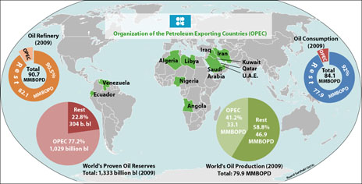
Economic Crisis
Prosperity in 1950s and 1960s
Inflation as a result of Johnson’s deficit spending
Rise in the cost of oil
OPEC embargo, price increase, and shortage
Result of US stance in Arab Israeli Conflict

Slide 16
Stagflation
Rising prices plus economic stagnation
Unsure of what fiscal policy to pursue
Old, less efficient factories close, leaving lots of people unemployed
Rising prices due to deficit spending and oil price increase
Nixon decides to control inflation by cutting spending and raising taxes
Does not work

Slide 17
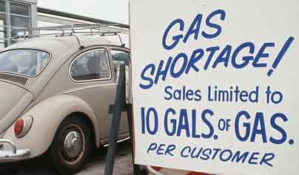
Economy Under Ford
Bad recession by 1975
Unemployment at 9%
“Whip Inflation Now”
Ask Americans to voluntary cut back on oil and gas
fails
Pardon Nixon drop in approval rate

Slide 18
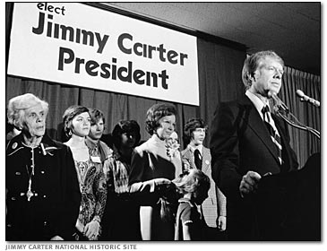
Election of 1976
Ford loses election
Americans pessimistic and unsure of future
Soviet Union becoming aggressive again (failure of détente at Helsinki Accords)
Jimmy Carter
Man of the people
Moral and upstanding individual from Georgia

Slide 19
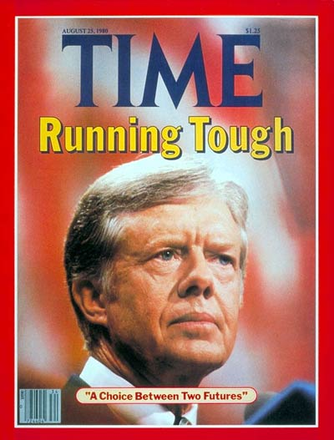
Economy Under Carter
Tries to end recession and reduce unemployment by increasing govt spending and cutting taxes (leaves people with more $)
Changes mind in 1978 by reducing money supply and raising interest rates (leaves people with less $)
Focus on energy crisis

Slide 20
Economy Under Carter
Dependency on foreign oil is a problem
National energy program to conserve oil and promote renewable resources
At the same time, oil companies are suffering
Leads to an energy crisis
Hard to solve
Not willing to work with Congress or form a list of concrete goals results in approval rating sinking

Slide 21
Carter’s Foreign Policy
Human rights
First African American ambassador to UN
Turn over control of the Panama Canal to the citizens of Panama
Détente collapses
Criticize Soviets for prisoning political protestors
Embargo on grain and boycott 1980 Moscow Olympics when USSR invades Afghanistan in 1979

Slide 22
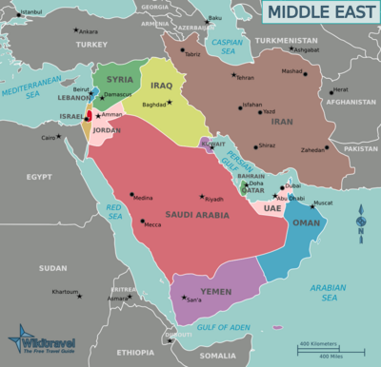

Slide 23
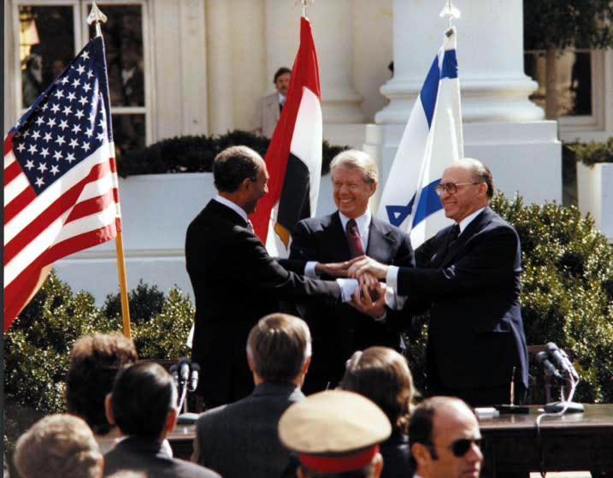
Carter in the Middle East
Camp David Accords signed between Israel and Egypt
Marks first step to achieving peace in the Middle East

Slide 24
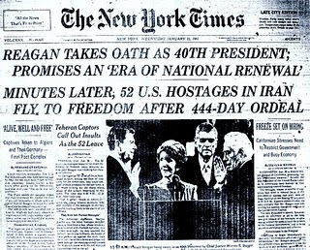
Carter in the Middle East
Problems in Iran
1979 Ayatollah Khomeini takes control of Iran
November: Revolutionaries storm the American embassy and hold 52 Americans hostage
Rescue mission in 1980 fails
Hostages released on January 20, 1981

Slide 25
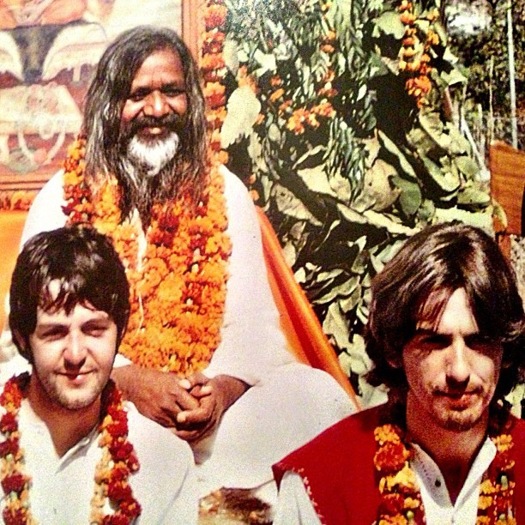
Culture in the 1970s
“Me Decade”
Greater individual satisfaction
New Age Movement
Spiritual enlightenment
Yoga, chanting, self-healing, zen
Transcendental Medication
Gurus suggest daily meditation, mantras to achieve peace, intelligence, and harmony
Changing families due to women’s roles
Birth rate decrease
Labor force increase
Divorce rate increase

Slide 26
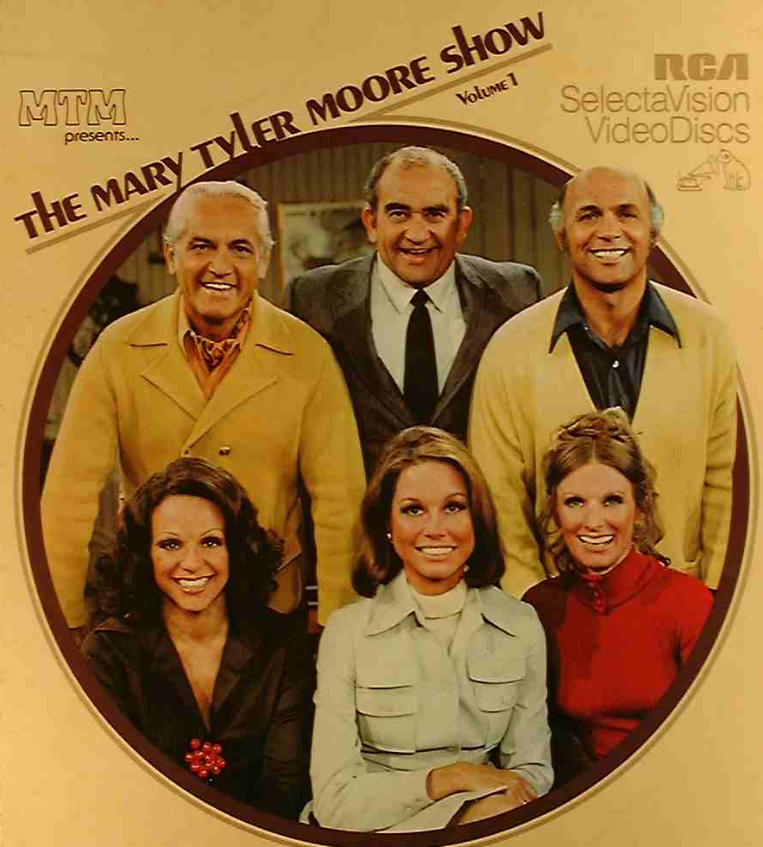
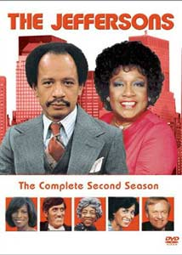
Television of the 1970s
Portray women in independent roles or formerly taboo subjects, like racism, poverty, and abortion

Slide 27
Music of the 1970s
Hard-driving protest rock of the 1960s gives way to softer sounds
Music becomes less political
Barry Manilow, Chicago, John Denver, ABBA, the Eagles
Disco-allows people dancing to assume greater prominence than the music

Slide 28
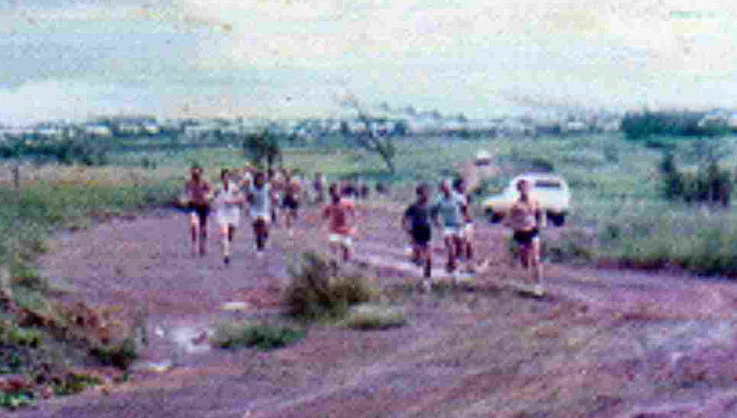
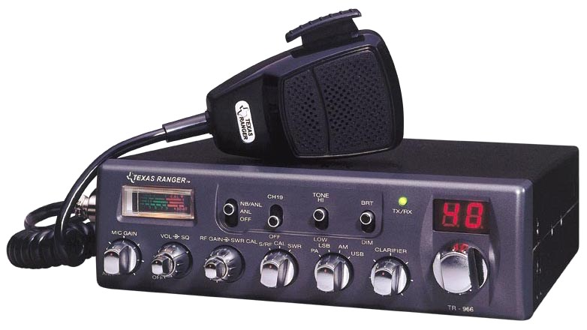
Fads and Fashion

