Slide 1
Industrialization in the Late 1800s

Slide 2
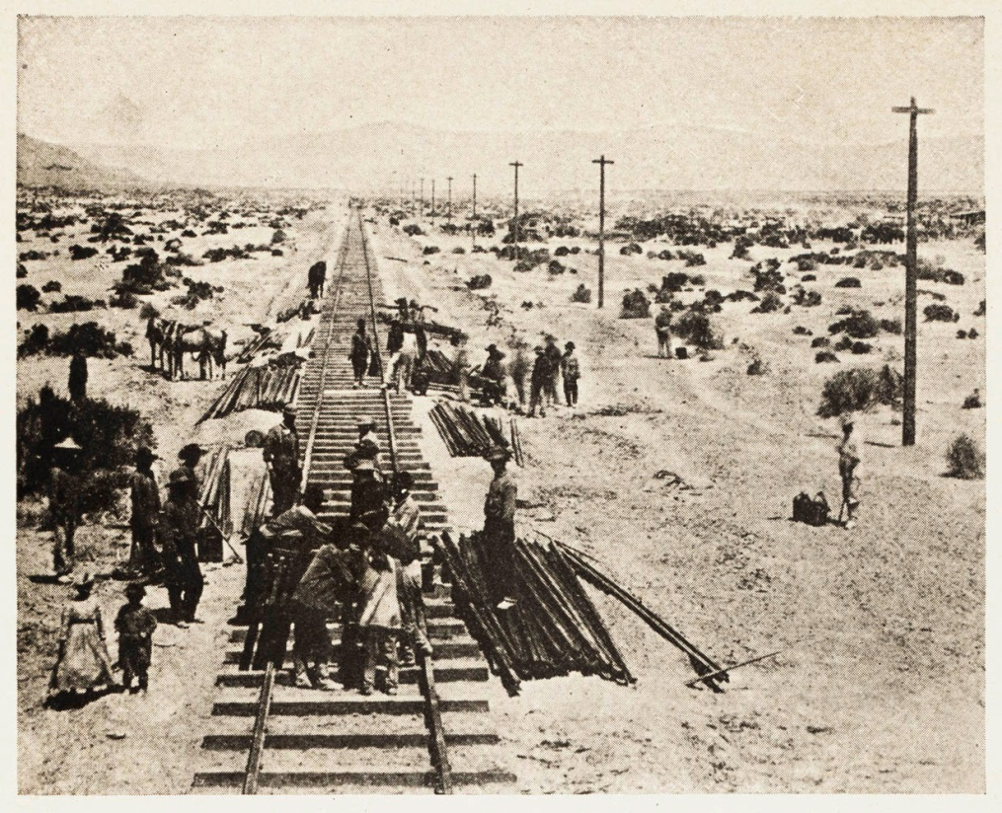
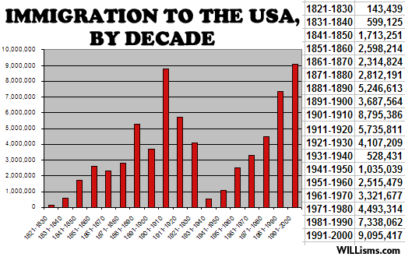
Industrial revolution
A period in the late 1800s where factories are established to create manufactured goods
Why does it occur?
Abundance of raw materials from the West (ex. coal and iron ore)
Transcontinental railroad
Discovery of petroleum
Large workforce (allows for more workers and new markets)

Slide 3
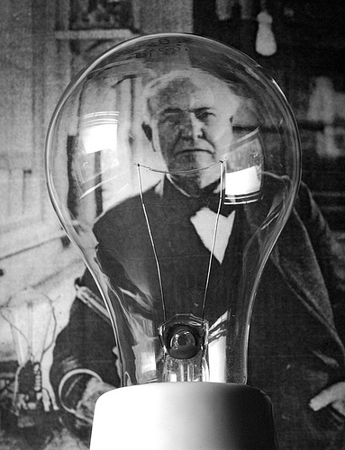
Industrialization leads to…
Factories can stay open later due to kerosene lamps
New Inventions
Thomas Edison (GE)
Phonograph, electricity, motion picture, battery, electric generator, light bulb
1874 Alexander Graham Bell (AT&T)
Telephone

Slide 4
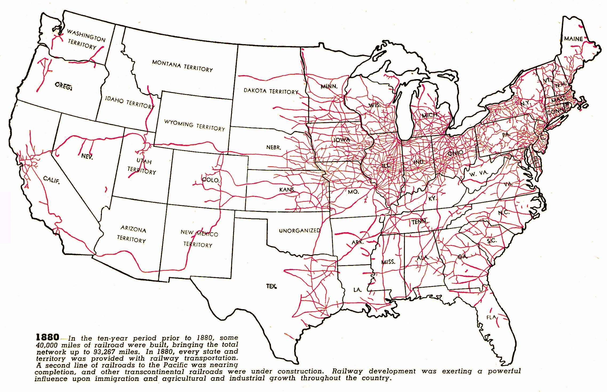
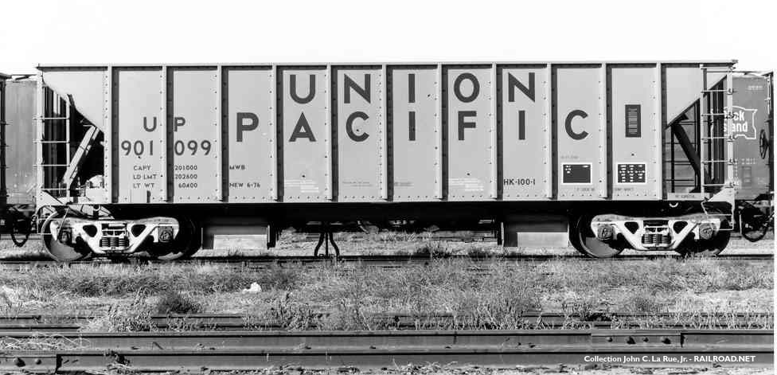
railroads
Pacific Railway Act 1862
Provides for construction of transcontinental railroad built by Union Pacific and Central Pacific companies
Government gives land grants to encourage rapid construction
Built by the Chinese

Slide 5
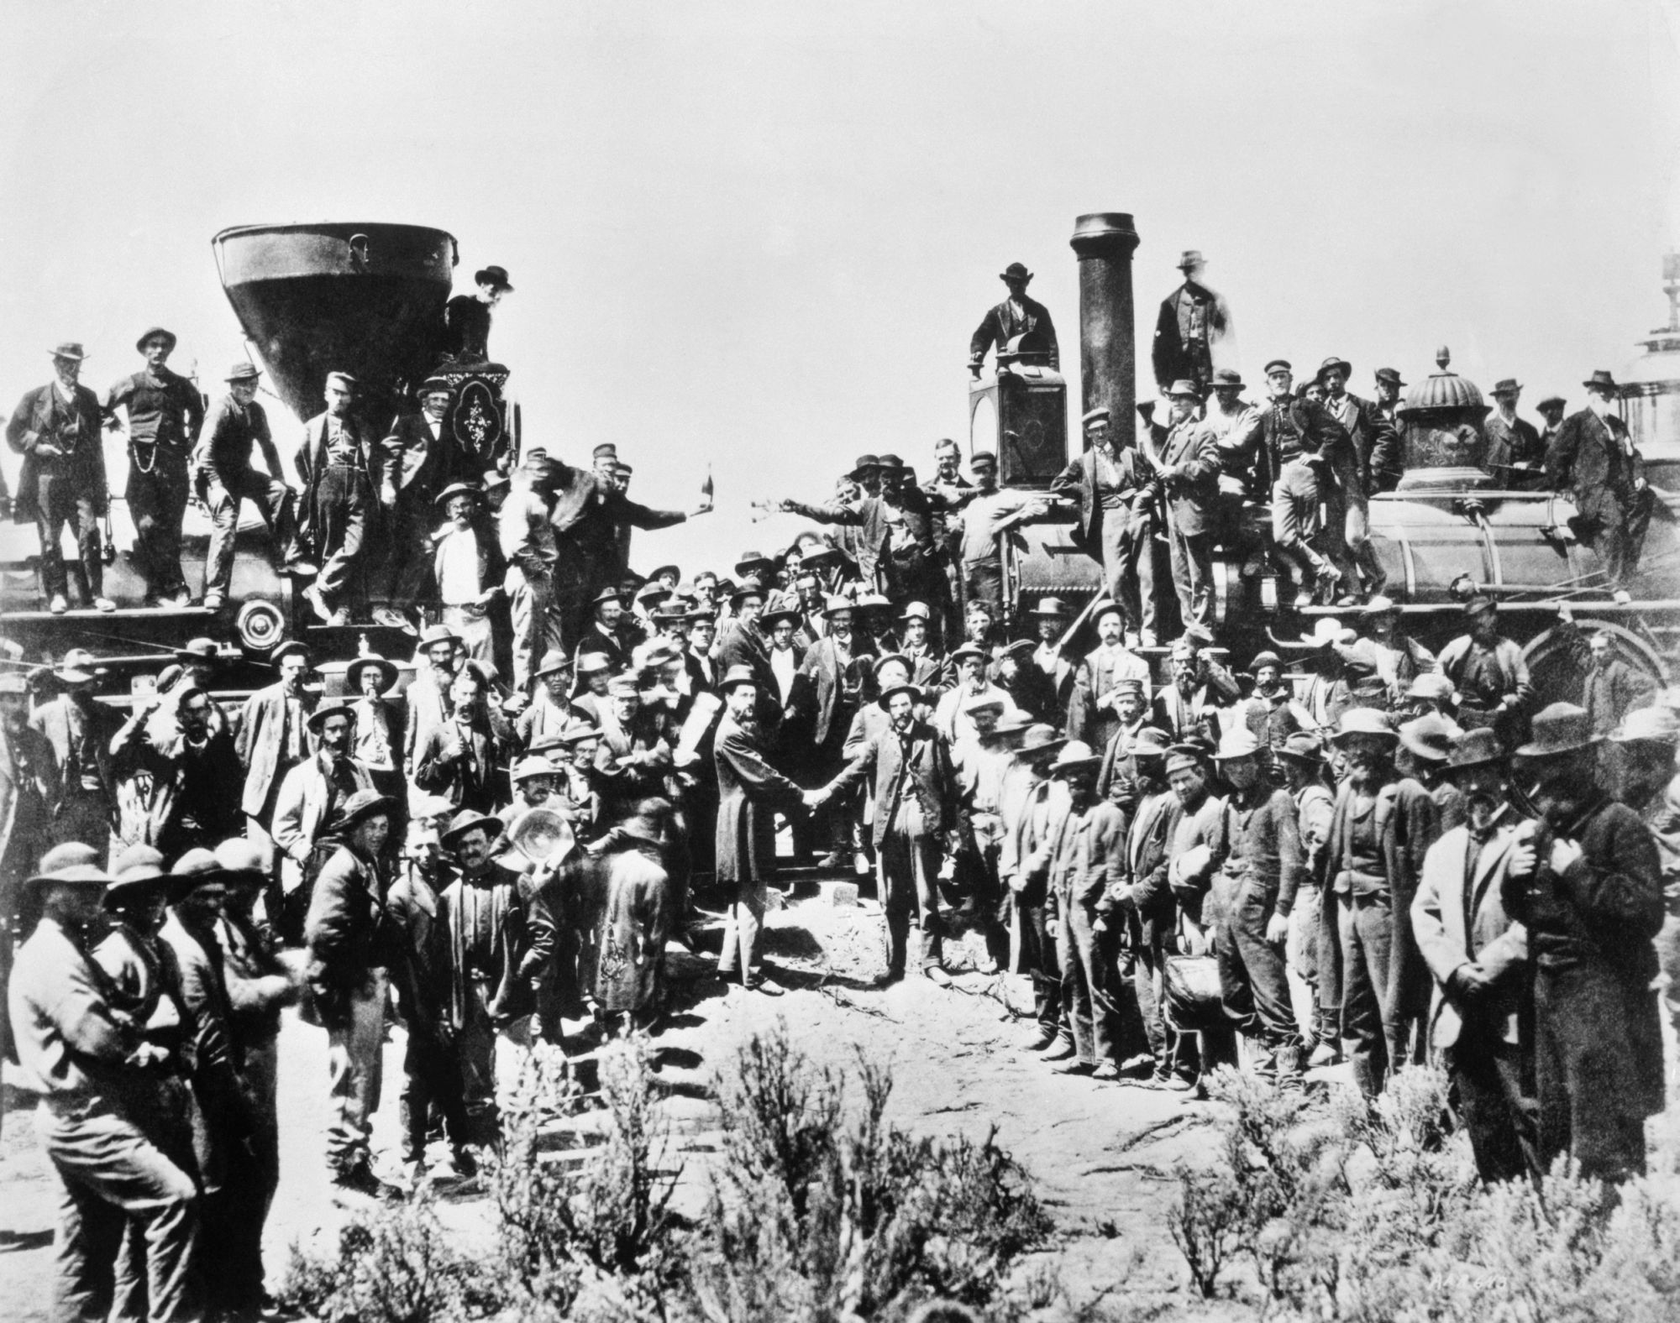

Slide 6
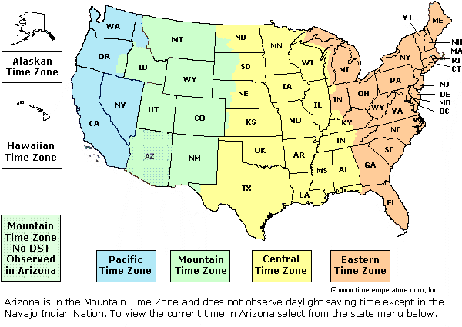
More railroads lead to…
Spurs industrial growth
Increase access to and size of markets
Stimulate economy in steel, coal, timber purchases
Creation of time zones
Railroad companies use unfair practices and abuse farmers by charging unfair rates
Results in passage of the Interstate Commerce Act to supervise railroad activity and prevent abuses (somewhat ineffective)

Slide 7
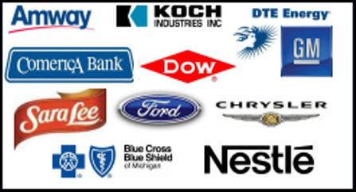
Big business
Big business booms in the late 1800s
For the first time, people become very wealthy
Entrepreneurs who start their own profitable businesses
Believe in laissez-faire, which means that the government does NOT involve itself in the economy, so businesses are able to make their own decisions without supervision
Believe in Social Darwinism, which means that only the smartest and best businessmen will survive and thrive in industry

Slide 8
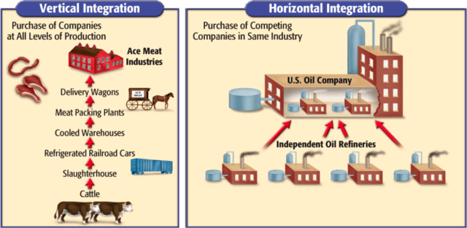
Horizontal & vertical integration-Can a business use both?

Slide 9
Monopolies & trusts
When a single company achieves control of an entire market, it becomes a monopoly.
This is good for the company owner, because they make lots of money!
This is bad for the consumer, because the company can charge high prices for the product!
Monopolies become illegal, so company owners find loopholes and form trusts, which are legal monopolies (still bad for the consumer).

Slide 10
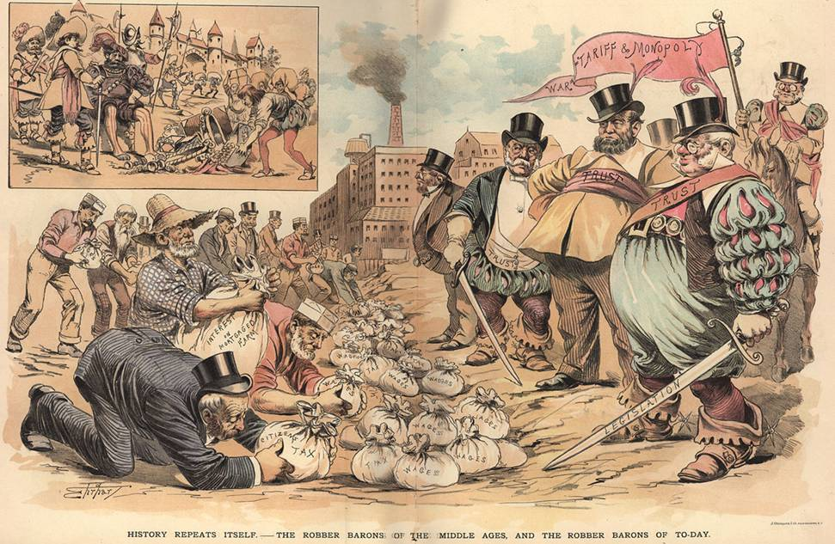

Slide 12
Big business leads to…
Rich entrepreneurs: Robber barons or captains of industry?
Sherman Anti-Trust Act passed in 1890
Laissez-faire dominates the early and mid 1800s
But government begins to grow weary of the power of big business and starts to regulate monopolies
Law makes trusts and monopolies illegal
Hard to enforce and ineffective

Slide 13
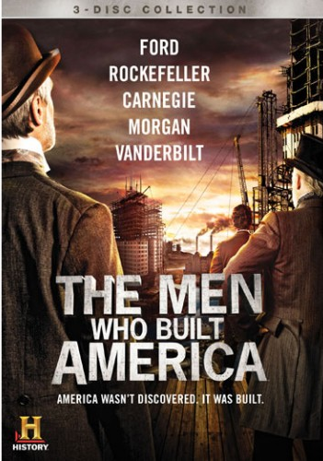
Robber barons or captains of industry?
Cornelius Vanderbilt
Railroad consolidator in the Northeast
Andrew Carnegie
US Steel giant
Philanthropist who believed in the Gospel of Wealth
John D. Rockefeller
Standard Oil monopoly

Slide 14
Working Conditions in factories
Life for workers in industrial America was difficult
Unhealthy and dangerous conditions
Repetitive and monotonous
Uneven distribution of wealth leads to resentment
59 hours at 22 cents per hour (actually rise in standard of living)
Workers decide only way to improve working conditions is form labor unions

Slide 15
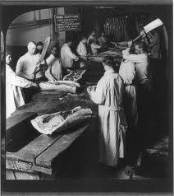
The Jungle by upton sinclair
With a partner, read the following passage from The Jungle.
Authors write everything for a reason. What is Upton Sinclair’s attitude towards the meat packing industry?
Highlight some quotes from the excerpt that support your answer.

Slide 16
Poor working conditions lead to…
Formation of labor unions
Groups that campaign for better working hours, wages, and conditions
Use strikes to achieve their goals
Catch a bad reputation and seen as violent

