Slide 1
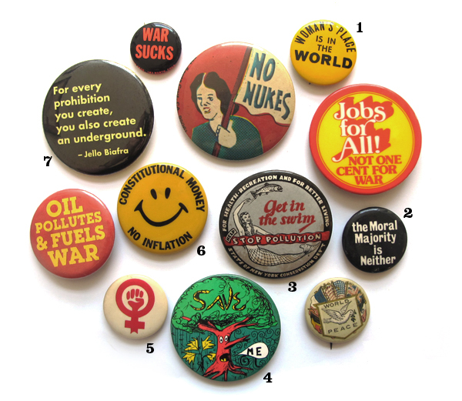
Politics of Protest

Slide 2
Politics of Protest Assignment
As we learn about forms of protest and different social movements, you will be required to look up primary source images that reflect the 1960s and 1970s. Arrange these images on a collage (size can be anywhere between one page and a poster), complete with an appropriate title of your choosing, a written explanation of your images and how they reflect the time period, and a proper works cited page. This will be due on Thursday, April 17th.

Slide 3
Youth Movement
Challenged the American political and social system and conventional middle-class values
Roots
1950s: prosperity did not extend to all
Beat movement openly criticizes conformity over independence and financial gain over spiritual/social advancement
Nuclear arms race makes many uneasy about the future
Active in social causes (civil rights, Peace Corps)

Slide 4
Youth Movement
Roots
“Baby boom” generation
1970: 58% of population is younger than 34
Rapid increase in college enrollment
College life empowers young people with a sense of freedom and independence
Meet and bond with others who share common interests

Slide 5
Students for a Democratic Society
Port Huron Statement 1962: end to apathy; urge citizens to stop accepting a country run by big corporations and big government
New Left
Protest Vietnam War
Address poverty, campus regulations, nuclear power, and racism

Slide 6
Free Speech Movement
Mario Savio at UC Berkeley
Reaction against restricting students rights
Can’t hand out literature or recruit volunteers for political causes
Dec. 2, 1964: police break up Savio’s speech and sit-in which result in student strikes
Supreme Court upholds freedom of speech and assembly rights

Slide 7
Counterculture
Culture with values and beliefs different from the mainstream
Promote flamboyant dress, rock music, drug use, and free and independent living
Examples:
Hippies
Religious movements

Slide 8
Hippies
Rejection of Western society and middle class values
Utopian ideal: society should be free, close to nature, and full of love, empathy, tolerance, and cooperation
Live in communes
Slowly, the outward signs become what matter (long hair, headbands, shabby jeans, use of LSD)

Slide 9
Religious Movements
Astrology, magic, Eastern religions, new forms of Christianity
Many were led by an authoritarian (cults)
Unification Church
Hare Krishna

Slide 10
Counterculture Declines
Hippie communities become seedy and deteriorate
Glamour of drug use wanes
Unable to establish an ideal community

Slide 11
Impact-Fashion
Men’s clothes became more colorful
Women’s clothes became more comfortable
Recycled clothing (blurs social class lines)
Ethnic clothing-beads, fringes, tie-dyed
Hair the 1967 musical

Slide 12
Impact-Art
Pop art-subject matter comes from pop culture (comic books, advertisements, brand names
Andy Warhol
Roy Lichtenstein

Slide 13
Impact-Music and Dance
Rock n roll-eventually becomes mainstream
Beatles
Bob Dylan
Janis Joplin
Jimi Hendrix
Woodstock in 1969

Slide 14
Feminism
Belief that men and women should be equal politically, economically, and socially
After 19th amendment passed, some crusaders wanted an amendment forbidding discriminating on the basis of gender
Increased responsibilities in WWII, but then women return to the kitchen

Slide 15
Women’s Movement Reawakens
Women resentful over unequal pay, less distinguished jobs, etc.
Strides made with JFK’s President’s Commission on the Status of Women and the Equal Pay Act

Slide 16
Workplace Rights
Title VII of the Civil Rights Act of 1964 outlawed job discrimination on the basis of gender
Equal Employment Opportunity Commission in charge of handling the law

Slide 17
Feminine Mystique
By Betty Friedan 1963
Unhappiness over inequality and feeling unfulfilled
NOW (National Organization for Women)=complete equality and freedom of choice for women
Want Equal Rights Amendment
Gloria Steinem

Slide 18
Other Women’s Topics
Title IX: prohibits federally funded schools from discriminating against girls and young women
Roe v. Wade
1972 Congress approves Equal Rights Amendment, but not all the states ratify it
Opponent Phyllis Schafly

Slide 19
Affirmative Action
After MLK dies, focus is on access to jobs and education
Affirmative action: active effort to improve employment or educational opportunities for minorities
Challenges
Reverse discrimination
Bakke case

Slide 20
Civil Rights for Hispanics
Hispanics face prejudice, limited access to education, housing, and employment
Cesar Chavez and Dolores Huerta form the United Farm Workers
Organization demanding union recognition, increased wages, and better benefits for migrant workers
Boycott grapes

Slide 21
Political Activism
League of United Latin American Citizens (LULAC): rights for Mexican Americans in court, hiring, and education
Hernandez v. Texas (juries)
La Raza Unida (Jose Angel Gutierrez): push for job training programs and greater access to financial institutions

Slide 22
Civil Rights for Natives
Many grievances against America
High unemployment rate, discrimination, limited education, low life expectancy
Declaration of Indian Purpose 1961: call for greater economic opportunities on reservations
Indian Civil Rights Act 1968: guaranteed reservation residents protections of Bill of Rights, but also recognized reservation law

Slide 23
Civil Rights for Natives
American Indian Movement: militant group who wanted more action for Native rights
Protect on Alcatraz
FBI incident at Wounded Knee

Slide 24
Native Gains
Indian Self-Determination and Educational Assistance Act 1975: increased funds for Native American education
Land and water rights Supreme Court gains
Economic gains include developing businesses (including casinos)

Slide 25
Environmentalism
Banning of DDT pesticide in 1972
Rachel Carson’s Silent Spring reveals hazards of this pesticide
Concern over smog
April 1970: Earth Day
Nixon: Environmental Protection Agency
Set and enforce pollution standards, conduct research, coordinate anti-pollution activities with state and local govts

Slide 26
Environmentalism
Clean Air Act 1970: emissions standards for factories and automobiles
Clean Water Act 1972: restricted discharge of pollutants into nation’s lakes and rivers
Endangered Species Act 1973: measures for saving threatened animal species
Love Canal dumping

Slide 27
Nuclear Energy
Concern over nuclear power
March 28, 1979: Three Mile Island-radiation escapes from reactor into air (doubts about safety of nuclear energy)

Slide 28
Consumer Movement
Ralph Nadar
National Traffic and Motor Vehicle Safety Act

