Slide 1
Civil Rights After 1965

Slide 2
Finishing…
1964-Civil Rights Act passed to end segregation
1964-24th amendment outlaws the use of poll taxes
1965-Selma March
1965-Voting Rights Act of 1965 passed

Slide 3
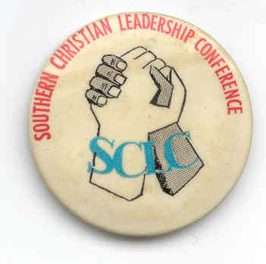
What were the two major goals of the SCLC and NAACP during the Civil Rights Era?
End to segregation
Civil Rights Act of 1964
Restoring voting rights of African Americans
Voting Rights Act of 1965

Slide 4
But…
Full equality still eluded many African Americans
Can’t be achieved through laws
Racism still common
Many African Americans still living in poverty in urban black neighborhoods
Despite the CRA and VRA, nothing seemed to be changing for these African Americans, and anger finally erupted

Slide 5
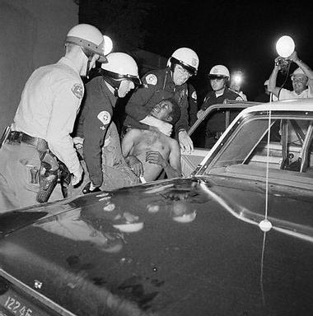
Violence
Race riots break out in Watts (a black neighborhood in Los Angeles) after Voting Rights Act is passed
Riots nationwide from 1965-1968
Detroit
Kerner Commission blamed white
white society and racism for the
majority of the problems

Slide 6
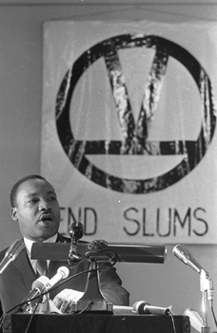
Change in MLK
Many African Americans now critical of MLK’s passive resistance
He begins to focus on economic issues, by moving to a poor neighborhood in Chicago and trying to improve housing there
Little success

Slide 7
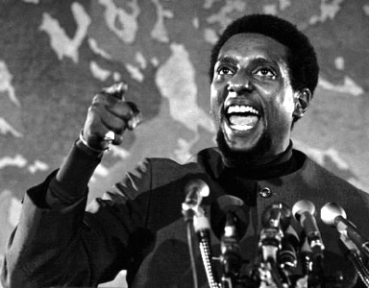
Black Power
Call for a more aggressive form of protest
Focus less on cooperation with whites
Ex: CORE and SNCC expel all whites from leadership positions
Support physical self-defense and even violence in defense of one’s freedom
Stokely Carmichael: leader of SNCC who believes AA should control the social, political, and economic directions of their struggle

Slide 8
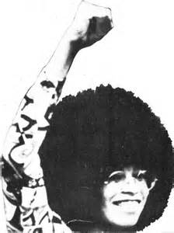
Black Power
Pride in African American culture
Promote racial distinctiveness
Ex. Afro hairstyle , African-style clothing, distinct names, African American study programs in college
Dr. King: black power is a philosophy of hopelessness and despair

Slide 9
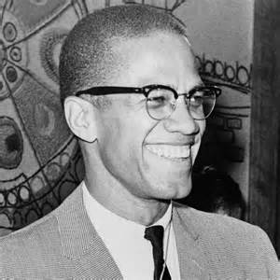
Malcolm X and the Nation of Islam
Joined Nation of Islam led by Elijah Muhammed while in prison
Preach black nationalism (Marcus Garvey)
African Americans should separate themselves from whites and form their own self-governing communities
Did not advocate violence, but rather self-defense
Took a pilgrimage to Mecca in 1964, which changed his views regarding whites and caused him to separate from the Nation of Islam
Assassinated by three Nation members in 1965

Slide 10
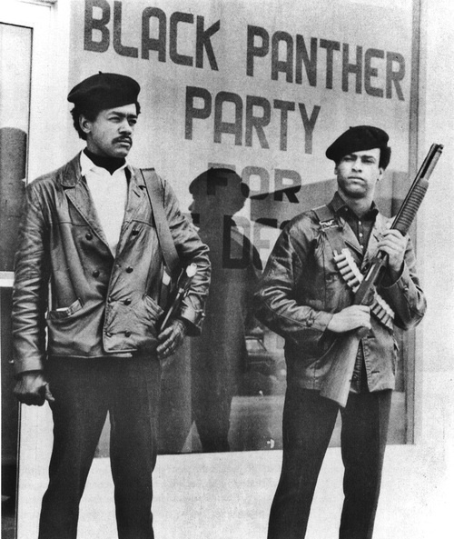
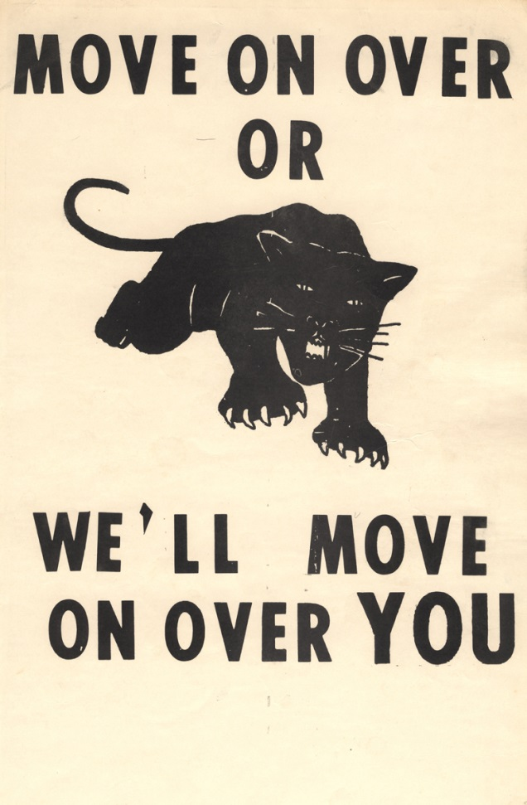
Black Panthers
More militant group organized in Oakland 1966
Preached black power, black nationalism, and economic self-sufficiency
Urge African Americans to arm themselves and confront white society to grant them equal rights

Slide 11
Assassination of MLK
Dr. King and the SCLC are promoting economic advancement for all impoverished Americans and plan to lobby the federal government for billions of dollars to end poverty and unemployment
Plan to march on Washington again
In Memphis to support a strike of African American sanitation workers
April 4, 1968 Dr. King is assassinated by a sniper
“I have been to the mountaintop…I’ve looked over and I’ve seen the Promised Land. I may not get there with you, but I want you to know tonight that we as a people will get to the Promised Land.”

Slide 12
Aftermath of the Assassination
National mourning
Racial riots
Poor People’s Campaign did not achieve any of the major objectives that MLK hoped it would
Civil Rights Act of 1968 passed
Outlawing discrimination in housing sales
Marked an end of an era
Civil rights movement lacked unity and purpose

