Slide 1
Reagan Onward!

Slide 2
Political Spectrum
Liberal (Left)
Conservative (Right)
Believe govt should regulate the economy to protect people from large corporations
Govt should play an active role in helping the disadvantaged
Tax the wealthy
Do NOT want govt to regulate social behaviors
Supporters of free speech and privacy
Do not believe govt should endorse religion
Distrust of the federal govt
Govt should NOT regulate eco (support free enterprise)
Oppose high taxes
Oppose govt programs to help the disadvantaged
Support religious faith
Believe social problems are the result of morality and character issues

Slide 3
Rise of Conservatism
Liberal ideas dominated politics in most of the 1900s
New Deal=govt intervention in the economy
Kennedy and Johnson=aid to the poor
Conservatism rises in the latter half of the 1900s
Cold War era: Liberals will turn the US communist
Religious individuals begin to support conservatism
Example: Barry Goldwater=conservative presidential nominee in 1964
Sunbelt region starts to vote Republican
Plus, rise of the “Moral Majority” who oppose Roe v. Wade (make abortion legal) and oppose the ERA
Billy Graham & the televangelists
When population of Sunbelt surpasses the population of the Northeast in 1980, a Republican becomes president

Slide 4
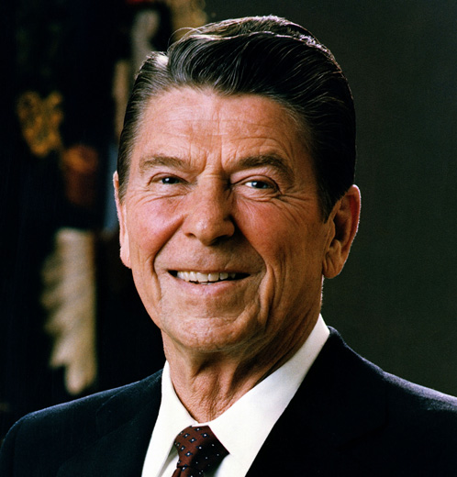
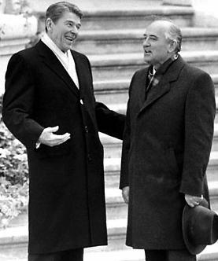
Reagan Recap
Conservative resurgence
Reaganomics=raise interest rates + big tax cut
Solves energy crisis by deregulating industry
BUDGET DEFICIT
Cutback on social programs, like Medicare/Medicaid
Nominate conservative justices
Sandra Day O’Connor
Reject containment and détente
Peace Through Strength=military buildup
Reagan Doctrine: send aid to guerilla groups fighting communism (ex. Mujahedeen in Afghanistan)
Iran Contra Affair
Star Wars (Strategic Defense Initiative)
“Tear Down this Wall”

Slide 5
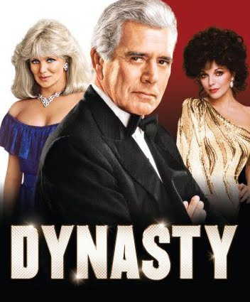
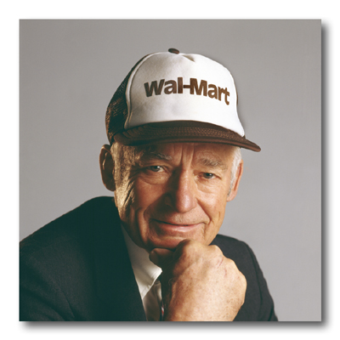
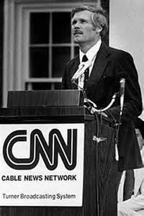
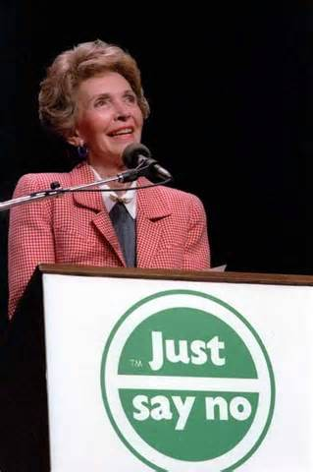
Life in the 1980s
Indulgence
Yuppies (economic growth)
Retail Revolution
Walmart (computer database to track sales)
Ted Turner and CNN
Robert Johnson and BET
MTV
“Just Say No”
MADD
1981 HIV/AIDS

Slide 6
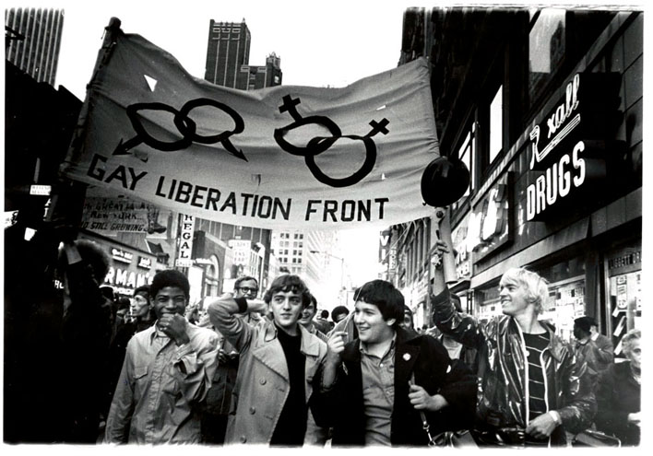
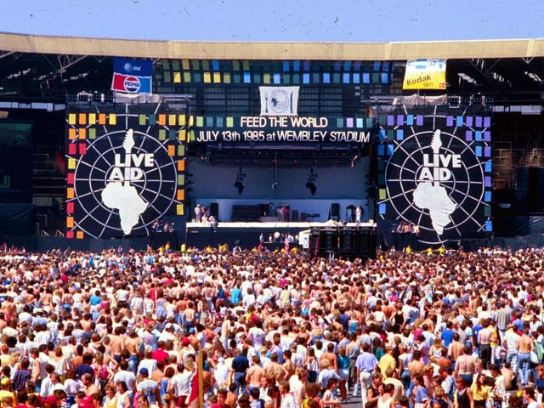
Social Activism & Technology
Gay rights-Stonewall Riot in 1969
Sierra Club-environmentalism
Live Aid/Band Aid concerts in 1984
AARP
Space shuttle 1981 and space stations
Columbia, Challenger, Endeavor, Discovery
Skylab and International Space Station

Slide 7
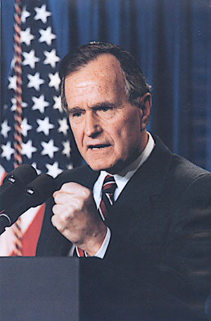
New President
George H.W. Bush
“Read my lips; no new taxes”
Strength in foreign policy

Slide 8
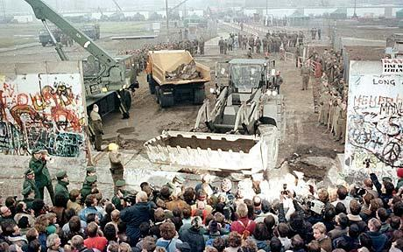
End of the Cold War
Berlin Wall falls in 1989
Gorbachev pursues perestroika (restructuring to allow for private enterprise) and glasnost (openness in terms of freedom of speech and religion)
Peaceful revolutions in Poland, Hungary, Czechoslovakia, Romania, and Bulgaria
Dec 1991 Gorbachev announces end of Soviet Union
Collapsed economy

Slide 9
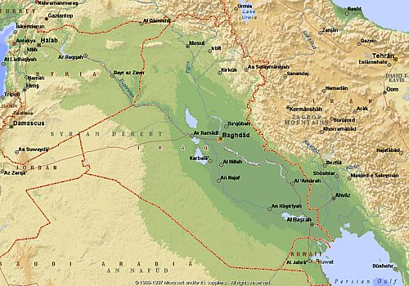
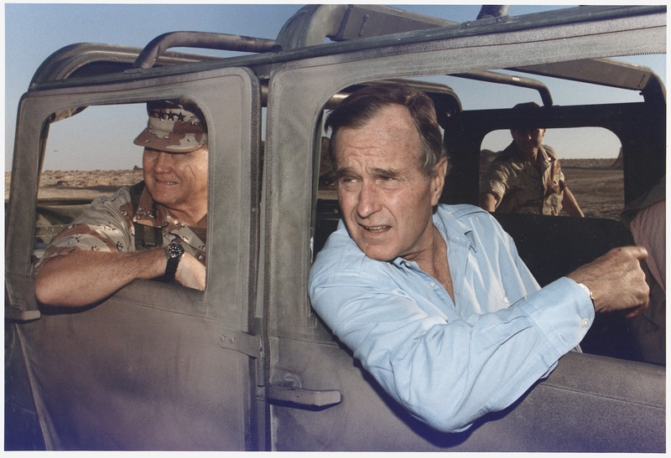
Persian Gulf War
1990 Iraq’s dictator Saddam Hussein invades oil-rich Kuwait
UN sets date that Saddam has to withdraw, but he does not
January 16, 1991: Operation Desert Storm launched
Victory for US

Slide 10
Economy Slows
Bush inherits Reagan’s deficit and slowing economy
Recession and unemployment
Bush breaks no new tax promise and cuts social programs
Americans with Disabilities Act: ends discrimination for mentally and physically challenged in workplace and public places
Ross Perot: grassroots movement in 1992

Slide 11
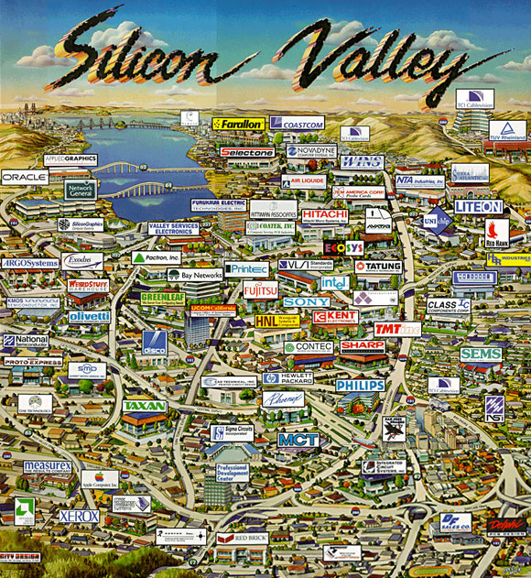
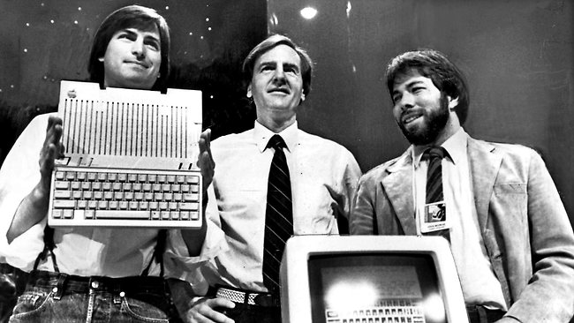
Technological Revolution
Circuit chips in Silicon Valley
Computers in the military
Steve Jobs and Steve Wozniak & Apple
Bill Gates and Microsoft
Internet (dot-com bubble)
Cell phones
DNA and Watson & Crick
Humane Genome Project

Slide 12
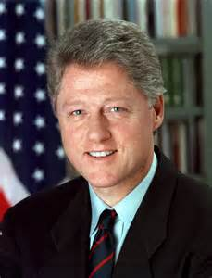
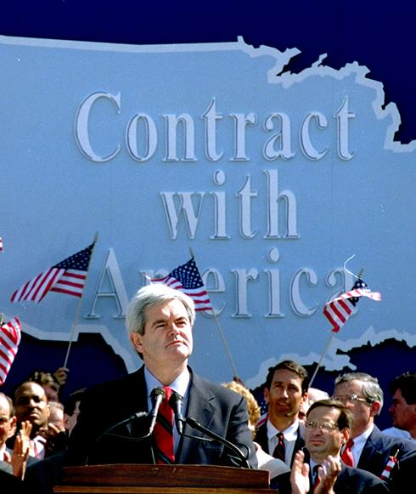
Clinton Years
Democrat
Raise taxes to pay for entitlement programs
Family Medical Leave Act
AmeriCorps
National Rifle Association and the Brady Bill
CHIP
Impeachment for perjury
Conflict in the Middle East
Balances budget
Newt Gingrich and the Contract with America fails

Slide 13
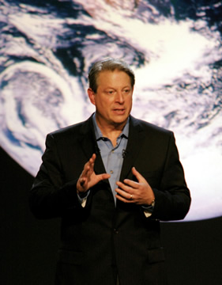
Issues at the Turn of the Century
NAFTA-free trade in North America
Global warming
Ozone concern
Nuclear proliferation

Slide 14
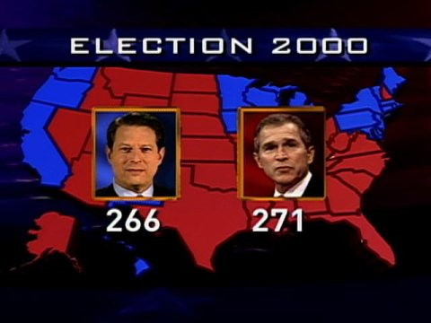
Election of 2000
Republican George W. Bush and Democrat Al Gore
Nader and the Green Party
Florida issue
Bush v. Gore: hand recounts violated the Equal Protection clause of the 14th amendment
Bush declared the winner in December

Slide 15
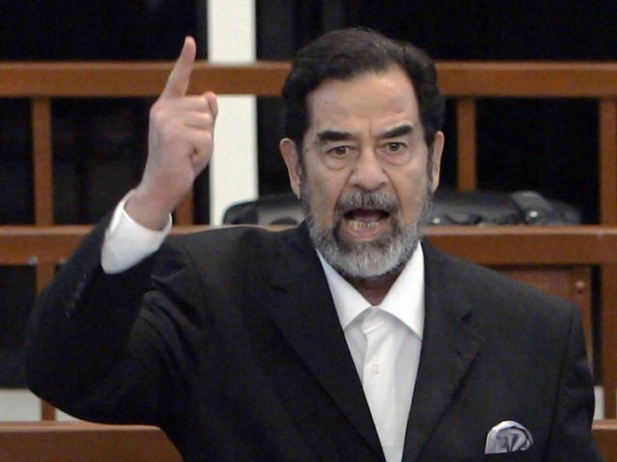
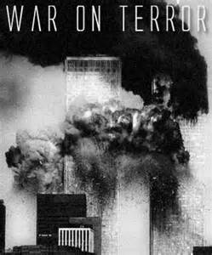
War on Terrorism
September 11, 2001
Patriot Act allows secret searches to avoid tipping off suspects in terrorist cases; nationwide search warrants; easier to wiretap, track emails, and seize voicemail
Anthrax
War in Afghanistan on the Taliban
Axis of evil and WMDs
Iraq and the gassing of the Kurds
War in 2002
Election of 2008

