Slide 1
Bell Work
How were European areas affected by nationalism prior to World War I?
What was the spark that started World War I?

Slide 2
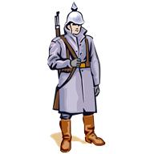
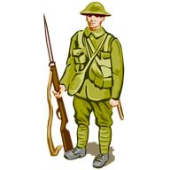
World War I
United States Enters the War – Sinking of the Lusitania

Slide 3
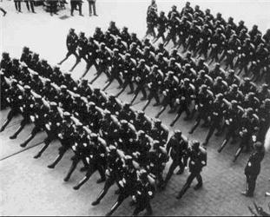
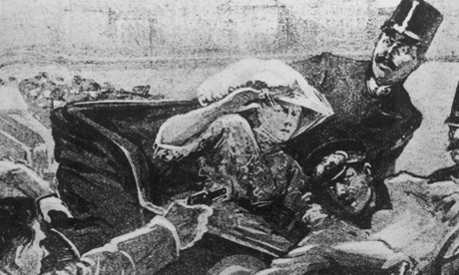
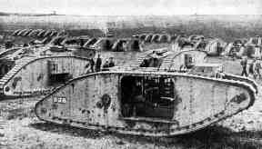
Let’s Review
Before World War I countries had a lot of nationalism, militarism, and imperialism. Countries were also bound together in alliances.
On June 28, 1914, Archduke Franz Ferdinand the heir to the Austro-Hungarian Empire was shot by a Serbian nationalist! This event started World War I!
World War I was very deadly because of trench warfare and new weapons.

Slide 4
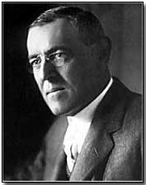
Neutrality
When World War I broke out in June of 1914, the United States did not enter the war, they war neutral.
Neutral = to not take a side.
Re-elected for a second term in 1916, Woodrow Wilson was known as the President who kept America out of the First World War.
President Wilson’s 1914 address to Congress
“Such divisions amongst us would be fatal to our peace of mind and might seriously stand in the way of the proper performance of our duty as the one great nation at peace…”

Slide 5
Americans Take Sides
German and Irish immigrants support Central Powers
In general, Americans supported the Allies
Share heritage, political values, and culture with British and France
Wilson’s cabinet (except WJB)
Chief Advisor Lansing and Walter Hines Page (ambassador)
The British limited American news to purely anti-German.
Financial link-money tied to Allied business

Slide 6
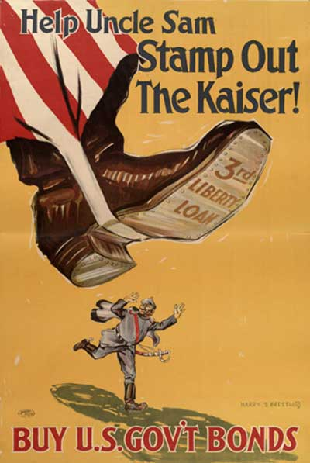
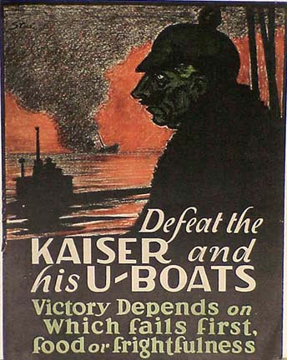

Slide 7
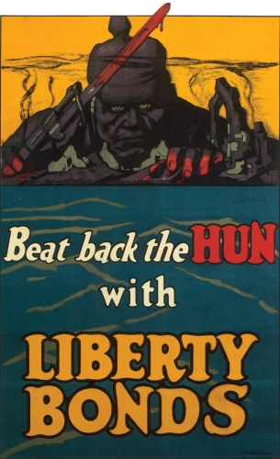
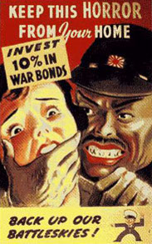

Slide 8
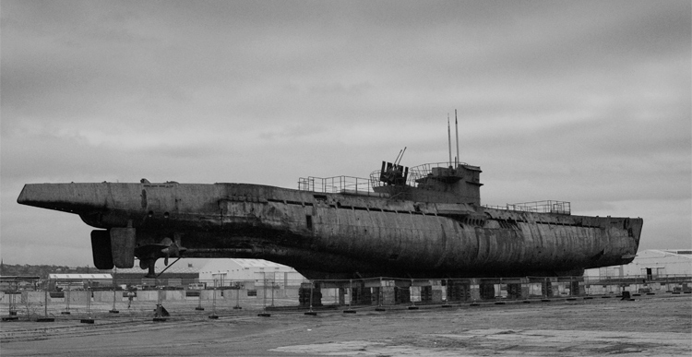
Moving Toward War
America wants to stay out of the war
British use navy to blockade Germany
By 1917, results in a German famine
Germany use U-boats to get around the blockade

Slide 9
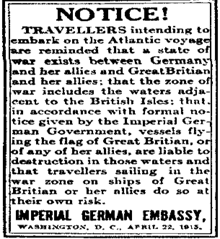
Moving Towards War
1915 Germans announce that they will sink any ship around Britain
Anger in the US (attacking civilians without warning)
US start sending supplies to Allies

Slide 10
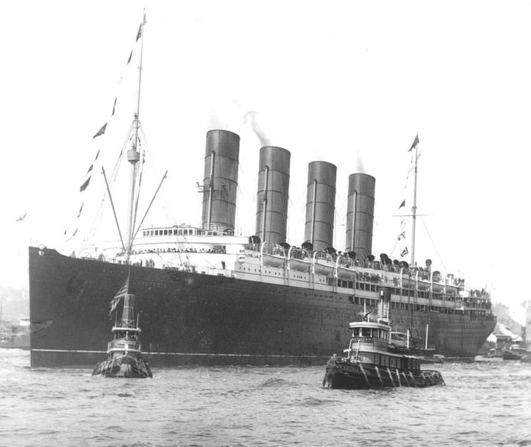
Lusitania
How would British ocean liner Lusitania change the United States position of neutrality?

Slide 11
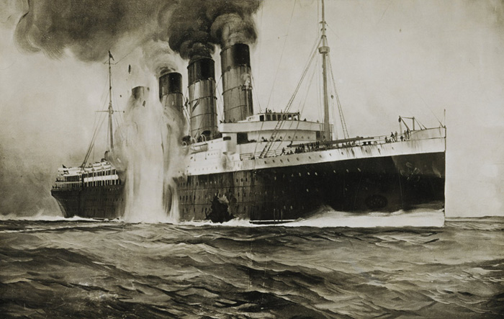
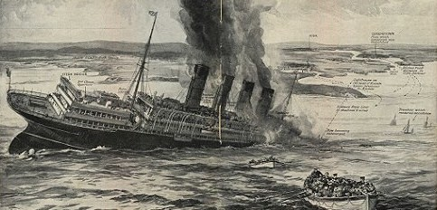
Lusitania
On May 7, 1915 a German U-Boat torpedoed and sunk the Lusitania.
There were 1,957 people on board, over 1,000 people died, including over 150 Americans!

Slide 12
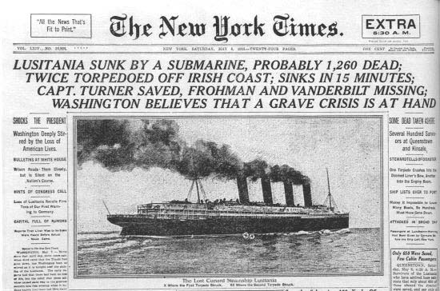
America and the War
If you lived in America during this time, what would you be feeling if you heard the Germans killed innocent Americans?

Slide 13
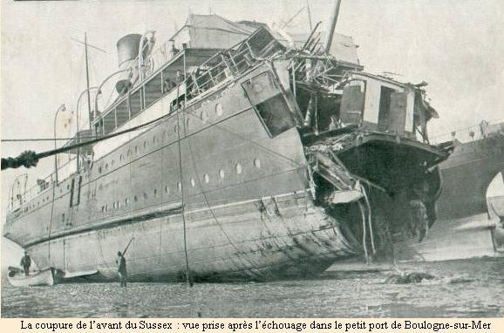
Sussex Pledge
March 1916
U-boat sinks a French boat called the Sussex and injures Americans
Wilson warns Germany to abandon unrestricted submarine warfare or risk war with the US
Germany promises to stop sinking merchant ships without warning to avoid war with the US

Slide 14
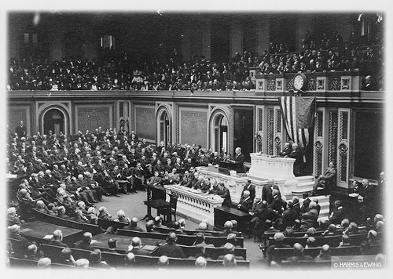
America and the War
Many people wanted America to go to war with Germany!
Germany stated they would not torpedo any more passenger ships.
Germany did not keep her promise and continued to attack American ships.
Congress debating if the United States should enter the war.

Slide 15
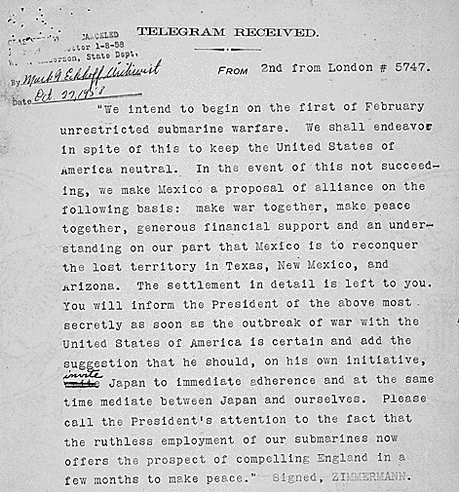
America and the War
Zimmerman Telegram
British cryptographers deciphered a telegram from German Foreign Minister Arthur Zimmermann to the German Minister to Mexico, von Eckhardt, offering United States territory to Mexico in return for joining the German cause.

Slide 16
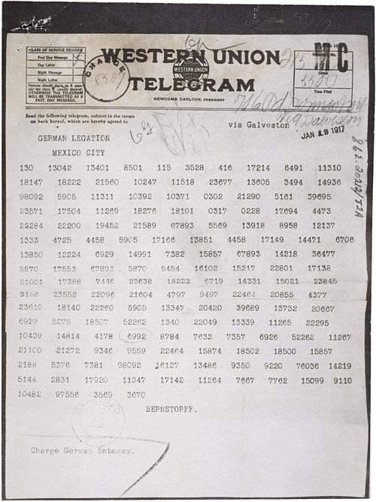
America and the War
How do you think this message helped draw the United States into the war?

Slide 17
The US Declares War
February 1, 1917
Germany resumes unrestricted submarine warfare
Germany thought American would not have enough time to raise an army and ship supplies to Europe…
Germany sank six American merchant ships between February 3 and March 21…..

Slide 18
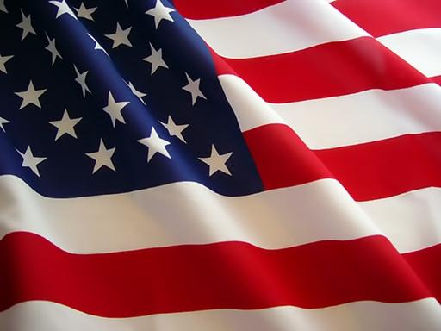
America Enters the War
In April 1917, America had no choice but to declare war on the Central Powers.
America entered the war on the side of the Allied Powers!
Think about it…
If you lived during that time, would you have joined the war and fought against the Germans?
How do you think America entering World War I would affect the war?

Slide 19
Conclusion
America was neutral in World War I until 1917.
The Lusitania and the Zimmerman Telegraph made a lot of people want America to enter the war on the side of the Allied Powers.
Germans were continuing to fire on United States ships.
America enters World War I and helps the Allied Powers gain strength.

